Slide 1
Note for the DL Committee:
The full presentation discusses three lab methods & applications and is comprised of 52 slides.
The presentation is adaptable: only one or two of the lab methods may be presented, which reduces the number of slides to 26 or 38, respectively.

Slide 2

Innovative lab methods for quicker and more accurate reserves assessment
Nicola Bona
Eni e&p

Slide 3
Presentation Outline
Introduction
Innovative lab methods
  Ultrafast resistivity index
  Quick fractional wettability
  Efficient trapped gas saturation
Conclusions
Q&A

Slide 4
Introduction

Slide 5
Introduction
Accelerating reserves assessment is a strategic imperative
  Core analysis may be a bottleneck for achieving this objective

Slide 6
Ultrafast resistivity index

Slide 7
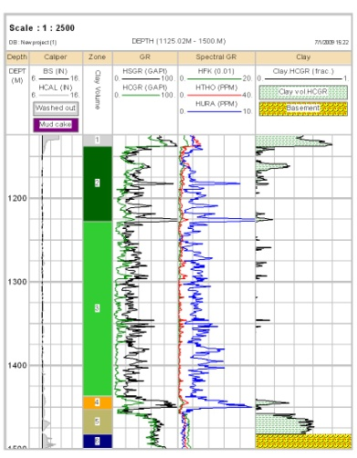
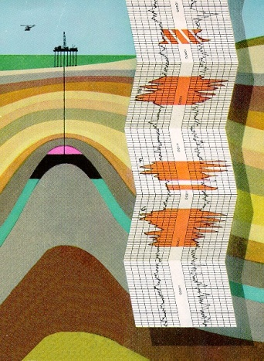
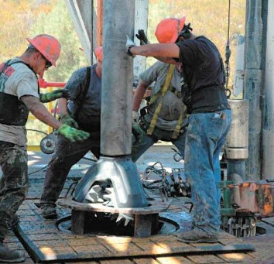
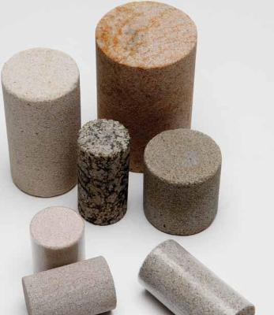
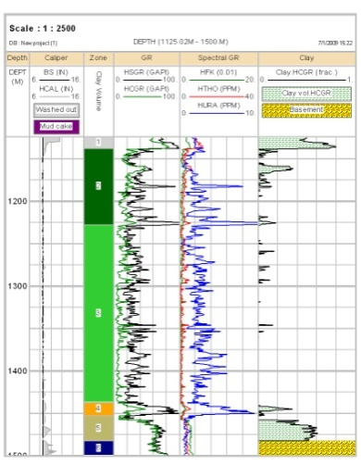
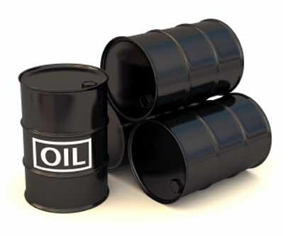
Electric log interpretation
D
A
Y
Prelim. CPI
S
Logging
M
O
N
T
H
S
Drilling & Coring
Lab results
Final CPI
First Assessment
Hydroc. In Place

Slide 8

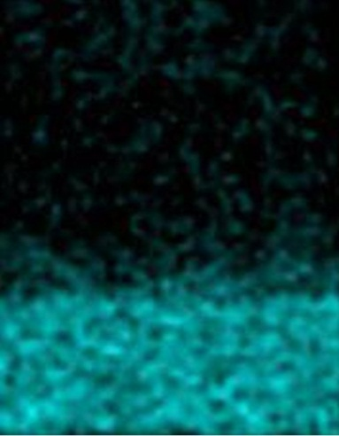
Why are lab times so long?
Uneven saturations give erroneous electrical parameters
Equilibrium times for achieving even saturations are long

Slide 9

Impact on OIP estimation

Slide 10
Current Resistivity Index methods
Porous plate (months)
Continuous injection (weeks)
FRIM (IFPEN patent)

Slide 11
Quick resistivity index method
- the underlying idea

Slide 12
The underlying idea
Instead of waiting for a global equilibrium, exploit local equilibria that establish in a very short time at a smaller scale

Slide 13
Quick resistivity index method
- experimental details

Slide 14
Quick resistivity Index: workflow
  Saturate the rock sample with brine
  Measure the sample resistivity
  Acquire a magnetic resonance image
  Desaturate in centrifuge (2 hours)
  Measure the resistivity at partial Sw
  Acquire another magnetic resonance image

Slide 15
Resistance measurement
4-planar contact cell
Access to whole sample volume
High accuracy in a wide frequency range with any rock resistance
Resistivity apparatus
Voltage
Current
Electrode configuration

Slide 16

Resistance measurement
I⁺
V⁺
Sample
Equipotential Lines
V⁻
I⁻

Slide 17
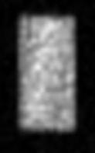
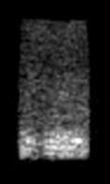
Sample imaging
φ_{j}
After each electrical measurement, the sample is MR scanned with a resolution (voxel size) of 2 mm³
MRI gives estimates of voxel’s water contents (Φ_{j} and Sw_{j})
MRI
Sw = 100%
Sw_{j}
MRI
Sw < 100%

Slide 18
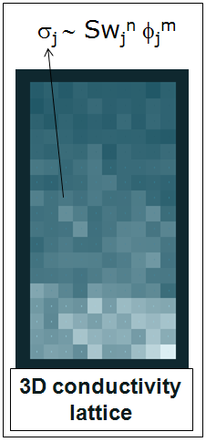
Resistance networks
Two cubic resistance networks are generated
The resistance assigned to the j-th voxel depends on Φ_{j}, Sw_{j}, m and n
The Archie exponents m and n are assumed to be the same in all voxels

Slide 19

Network conductivity
σ_{j}
Network conductivity is calculated by means of a Random Walk algorithm
Probability of moving:
Probability of staying:

Slide 20
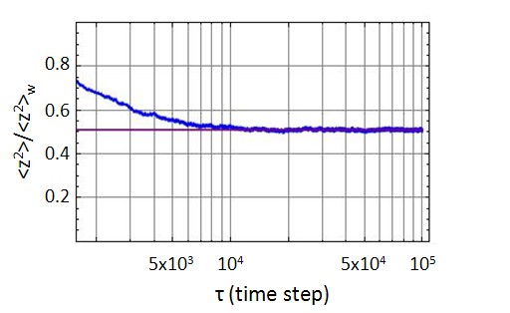
Extraction of network conductivity
Network conductivity is proportional to the mean-square distance travelled by random walkers at large time

Slide 21
Quick resistivity index method
- extraction of Archie parameters

Slide 22
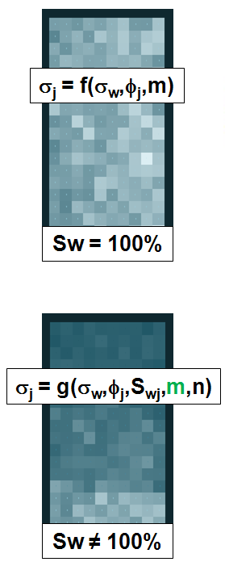
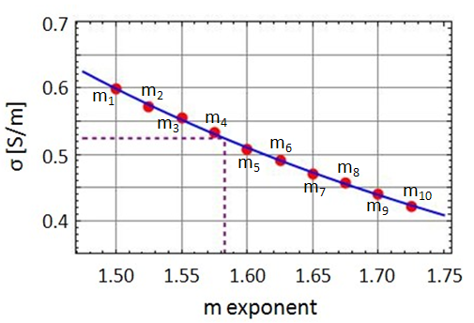
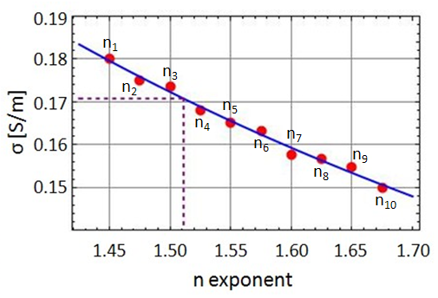
Extraction of Archie parameters
σ_{EXP}
m = 1.58
σ_{EXP}
n = 1.51
Networks’ conductivities are matched to
the experimental measurements

Slide 23
Quick resistivity index method
- applications

Slide 24
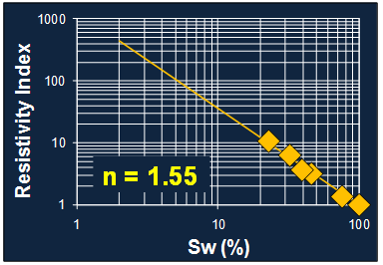
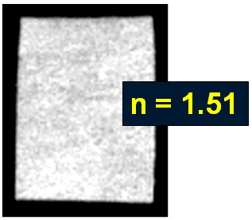
Example 1 – Berea sandstone
Porous Plate
MRI method
4 WEEKS
1 DAY

Slide 25
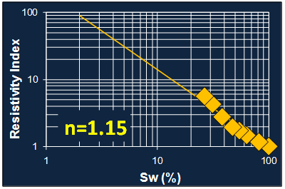
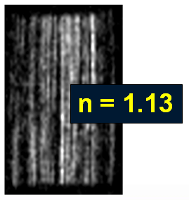
Ex. 2 – Laminated sandstone
Porous Plate
MRI method
2 MONTHS
1 DAY

Slide 26
Ex. 3 – Tight sand
Porous Plate
MRI method
n = 2.33
3 MONTHS
1 DAY

Slide 27
Quick resistivity index method
- summary

Slide 28
Quick resistivity index summary
  Reliable n-measurement in the presence of non-equilibrium saturation distributions
  Experimental setup includes centrifuge, MRI, 4-contact cell with co-planar electrodes
  n-measurement takes 1 day
  Any types of Sw heterogeneity can be handled

Slide 29
Quick fractional wettability

Slide 30
Drawbacks of current methods
Amott and USBM do not allow us to characterize fractional wettabilities
Amott is time consuming
NMR may be inconclusive (response is controlled by other factors)

Slide 31
Advantages of the new method
Able to discriminate different wettability contributions
Fast and cheap (does not require doped fluids)

Slide 32

Principle
Wettability governs the shape of the water phase
  water wet: elongated shapes
  oil wet: more spherical shapes
WATER-WET
rock
oil
OIL-WET
brine

Slide 33
Principle (cont.)
E
When an electric field is applied, the ions in the water move
The ions travel a certain distance before getting blocked against an interface
The travelled distance is longer in a water wet rock
WATER-WET
LONG TRAVEL TIME
OIL-WET
SHORT TRAVEL TIME

Slide 34
Principle (cont.)
Dielectric permittivity is measured at different frequencies
The resulting curve exhibits a peak
The peak frequency is proportional to the reciprocal of the distance travelled by ions
OIL WET
Dielectric permittivity
WATER WET
Applied field frequency

Slide 35
Application: fissured carbonate
-0.2
Wettability
change after
cleaning
-0.4
d(Log ε)
d(Log f)
-0.6
PRESERVED
CLEANED
MATRIX
FISSURES
-0.8
2
4
6
8
10
Log (frequency)

Slide 36
Application: fissured carbonate
Oil wet fissures
Strongly water wet matrix

Slide 37
Quick fractional wettability
- summary

Slide 38
Fractional wettability summary
  Quantification of wettability contributions in multiple porosity systems
  Based on high-frequency dielectrometry, relativley simple measurement
  Measurement takes a few minutes
  Any rock type is suitable for this analysis

Slide 39
Trapped gas saturation

Slide 40
Process and output from the lab
Reservoir process to be mimicked
GAS
WATER
Trapped Sg
Output of lab analysis
Initial Sg

Slide 41
Drawbacks of the standard method
Few data points per analyzed sample
Uses toluene
Countercurrent flow
Saturation homogeneity can be an issue
Pickell et al., SPEJ, March 1966

Slide 42
Advantages of the new method
Efficient: 30-40 independent observations of trapped gas saturation per analyzed sample
Sustainable: uses water instead of toluene, which is a toxic fluid
Representative: flow is co-current
Robust: saturation homogeneity is no longer an issue

Slide 43
Experimental workflow
  Coat the lateral surface of a sample
  Saturate with brine
  Desaturate in centrifuge (2 hours)
  Acquire a magnetic resonance image
  Centrifuge under water (30 min)
  Acquire another magnetic resonance image

Slide 44

Centrifuge tests
sample holder
heat-shrink
tubing
Desaturation
in air
Co-current water imbibition
WATER

Slide 45
Trapped vs Initial Sg data extrac.
INITIAL Sg
IMAGE
Trapped Sg
TRAPPED Sg
IMAGE
Initial Sg

Slide 46
Trapped vs Initial Sg data extrac.
Trapped Sg
Initial Sg

Slide 47
Trapped vs Initial Sg data extrac.
Trapped Sg
Initial Sg

Slide 48
Trapped vs Initial Sg data extrac.
Trapped Sg
Initial Sg

Slide 49
Application: sandstone reservoir

Slide 50
Trapped gas saturation
- summary

Slide 51
Trapped gas saturation summary
  Comprehensive data base with a limited number of rock samples
  Co-current flow → more representative
  Measurement takes one day

Slide 52
Conclusions

Slide 53
Conclusions
New lab methods for:
  Resistivity index
  Fractional wettability
  Trapped gas saturation
Times are reduced from months to days
Accuracy of results is improved

Slide 54
Thank You For Attending!
Question & Answer Session

