Slide 1
Primary funding is provided by
The SPE Foundation through member donations
and a contribution from Offshore Europe
The Society is grateful to those companies that allow their professionals to serve as lecturers
Additional support provided by AIME
Society of Petroleum Engineers Distinguished Lecturer Program
www.spe.org/dl

Slide 2
Cement Testing
Are We Looking at The Right Things The Wrong Way?
Don Purvis
Marathon Oil Company
Society of Petroleum Engineers Distinguished Lecturer Program
www.spe.org/dl

Slide 3
A Brief History of Oil well Cement Testing
“Cements for Oil Wells, Status of Testing Methods and Summary of Properties”; W W Robinson, May 1939
First Official Document : “API Code for Testing Cements Used in Wells”; Code 32*, February 1948
*Code 32 Evolved into current ISO-10426 / API Spec 10A

Slide 4
Code 32 Testing Included:
Cement Sampling
Slurry Fluidity (Correct water content)
Thickening Time Test
Consistometer Test
Tensile –Strength Test
Foam Test

Slide 5
Let’s Talk About Three of Those Tests
Thickening Time Test
Consistometer Test
Tensile –Strength Test

Slide 6
Thickening Time Test
First Test made with Ice Cream Freezer & Electric Heater Otis D. Small ……. 1929
1929
First Described in Code 32
“Cement for Oil Wells: Status of Testing methods & Summary of Properties”
W.W. Robinson May 1939
May 1939

Slide 7
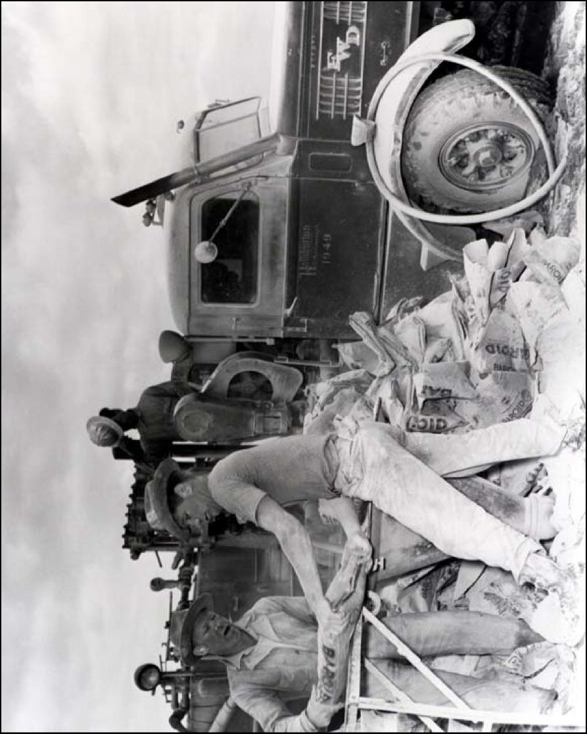
The Jet Mixer Patented in 1921

Slide 8
Modern Cement Pump in the Early 40’s

Slide 9
Cement Complexity & Code 32
Code 32 Designed for ‘Neat’ Cement
1951 Francis Anderson (Halliburton) Review of Developments Code 32
“Casing cementing only”
“Impossible to test cement slurries containing some of the present day additives”

Slide 10
1939 Thickening Time Tester
Cement for Oil Wells: Status of Testing Methods and Summary of Properties
W.W. Robinson; May 17, 1939

Slide 11
1939 Cement Consistometer
Cement for Oil Wells: Status of Testing Methods and Summary of Properties
W.W. Robinson; May 17, 1939

Slide 12
Where Are We Today?
Seven Standard tests Outlined in ISO 10426-1:
Slurry Density
Thickening Time
Compressive Strength
Fluid Loss
Rheology / Gel Strength
Stability / Free Fluid
Compatibility
And Then ……….

Slide 13
API-65-2 Published December 2010
Macondo April 21, 2010
…..In his expert report, Glen Benge concluded that cement didn't cut off the flow of hydrocarbons into the well because of inadequate design of the cementing slurry…….
…”based mainly on experiences in the United States outer continental shelf”…..

Slide 14
Where Are We Today?
Seven Standard tests Outlined in ISO 10426-1:
Slurry Density
Thickening Time
Compressive Strength
Fluid Loss
Rheology / Gel Strength
Stability / Free Fluid
Compatibility
Slurry Density
Thickening Time
Compressive Strength
Fluid Loss
Rheology / Gel Strength
Stability / Free Fluid
Compatibility
Three Additional in RP 65-2:
Static Gel Strength
Shrinkage/Expansion
Sheath Integrity
Static Gel Strength
Shrinkage/Expansion
Sheath Integrity
Let’s Examine Three of These:

Slide 15
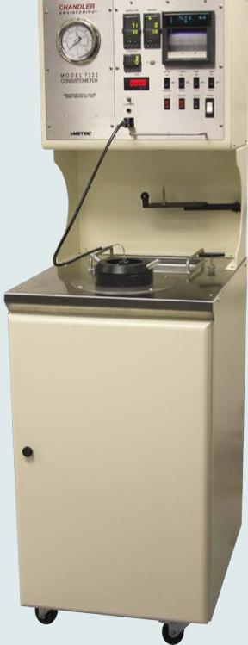
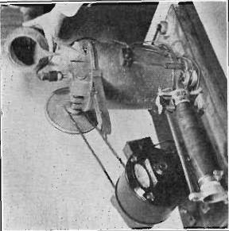
‘Thickening Time’ We Have Come a Long Ways
Consistometer Then & Now
Circa 2014
Circa 1939

Slide 16
Consistometers Then and Now
 | 1939 | 2014
Maximum Temperature | 180 deg F | 600 deg F
Mixing process | Slurry Jar | Precision Blender
Blends Tested | Cement & Water | Complex Systems & Additives
Measurement | Pendulum & cord | High Temp Spring & Rheometer
Stirring Device | Modified ice cream paddle | Modified Ice Cream paddle

Slide 17
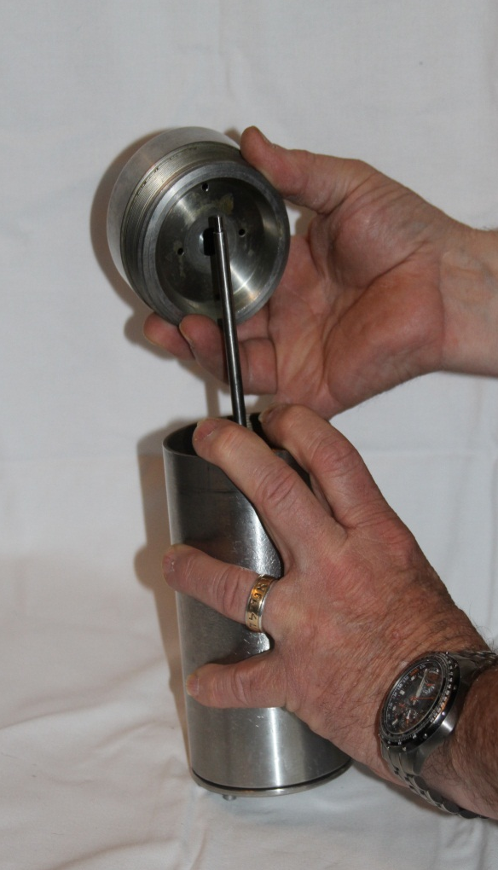
Or Have We?......
Consistometer Chamber Then & Now
1939
2014

Slide 18
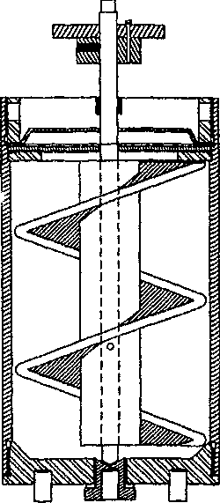
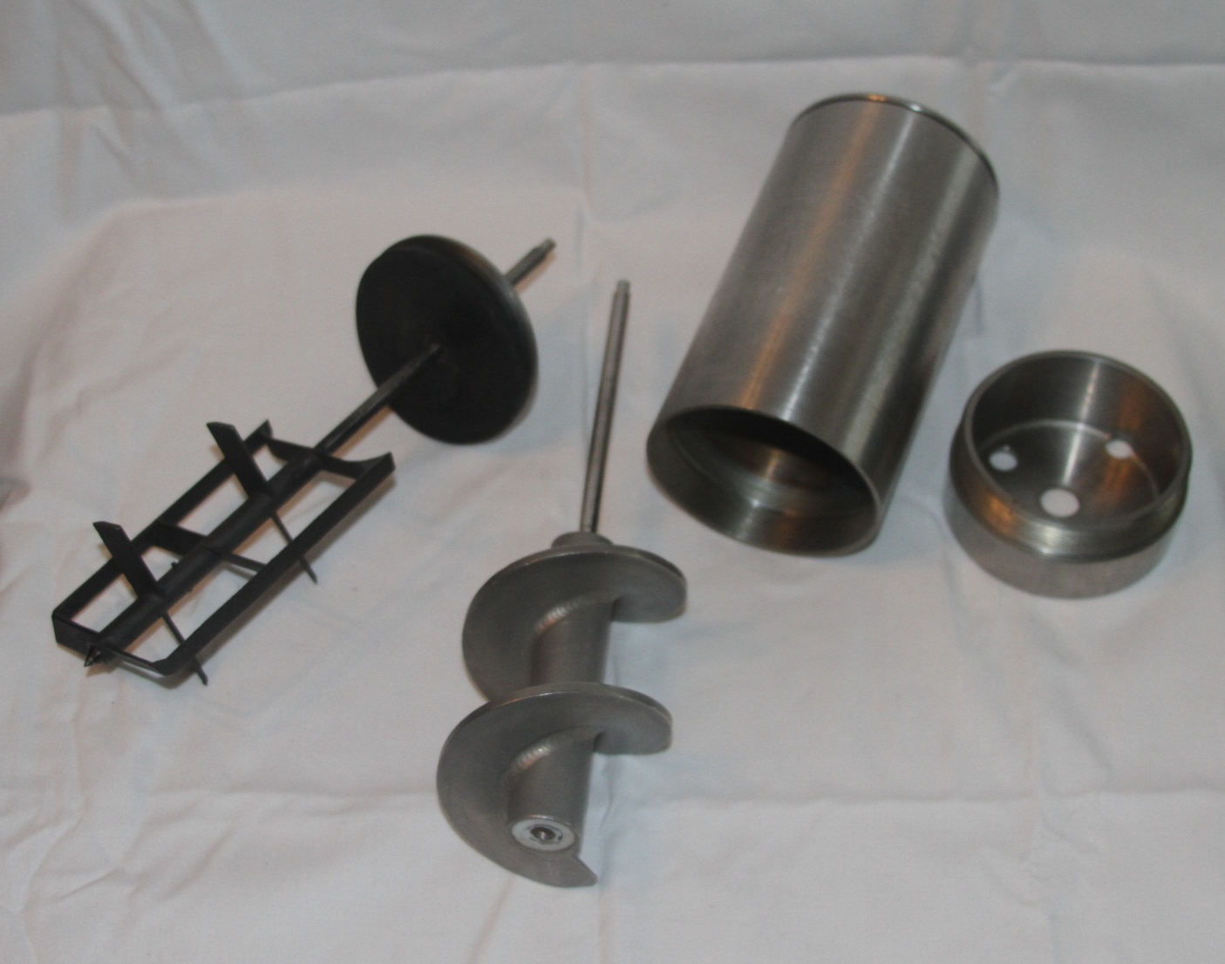
Consistometers Is There a Better Way?

Slide 19
Stirring Shear Rate: What Difference Does it Make?
Slurry Blend | Temp | Thickening Time |  | Delta
API Class plus additives | ⁰F | API Paddle @ 150 RPM | Helical Screw @ Actual Shear
G + 2% CaCl | 75⁰ | 4:10 | 2:25 | 72%
35:65:6 Poz:C:Gel + 5% NaCl | 75⁰ | 8:10 | 6:00 | 36%
H + 3% SMS | 90⁰ | 7:40 | 1:35 | 480%
G +35%SF +1%FLA +1.2%LSR 15.8 ppg | 197⁰ | 3:10 | 4:40 | 32%
H +35%SF +1.5%HTFLA + 0.6% SR 16.2 ppg | 308⁰ | 3:15 | 5:00 | 35%

Slide 20
Compressive/ Tensile Strength
Early Tests were Tensile
Cement for Oil Wells: Status of Testing Methods and Summary of Properties
W.W. Robinson; May 17, 1939

Slide 21
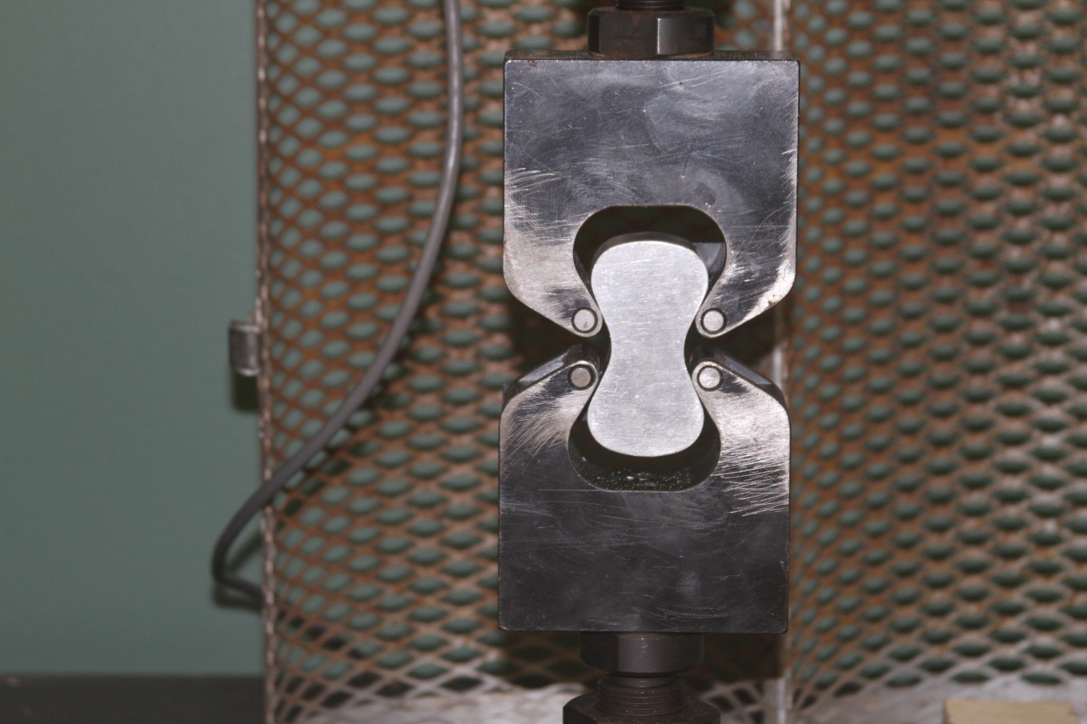
Tensile Strength Lost Favor
Very Difficult to Cure /Cool/ Remove & Test

Slide 22
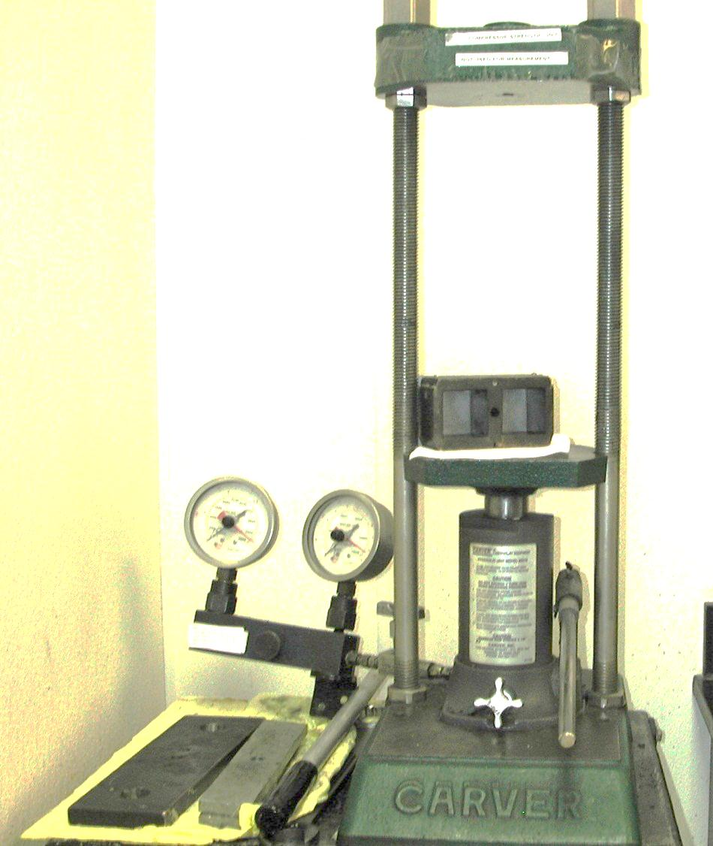
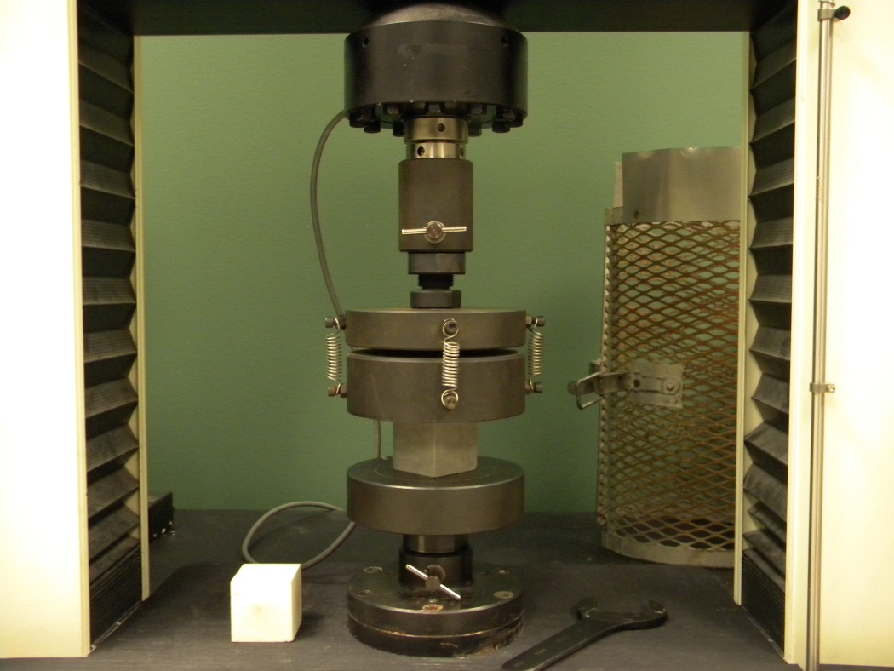
Replaced with Compressive
Simpler, more consistent, could be modeled with a UCA

Slide 23
Unfortunately:
Wellbore Cement Fails in Tension
Tensile Tests Are Not Specified in ISO-10426 or API RP 10B-2

Slide 24
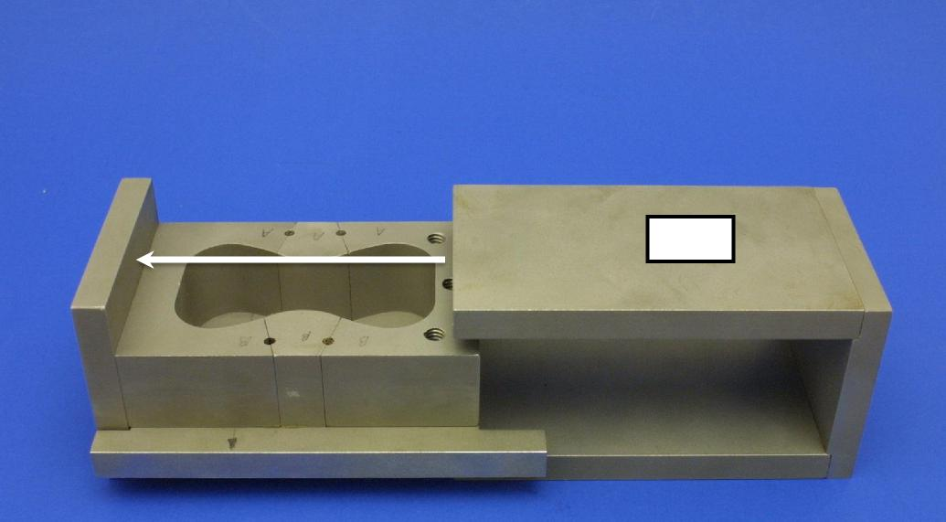
Today’s Tensile Testing ‘TBDC’ Test
CAM
Test Performed under Temperature and Pressure

Slide 25
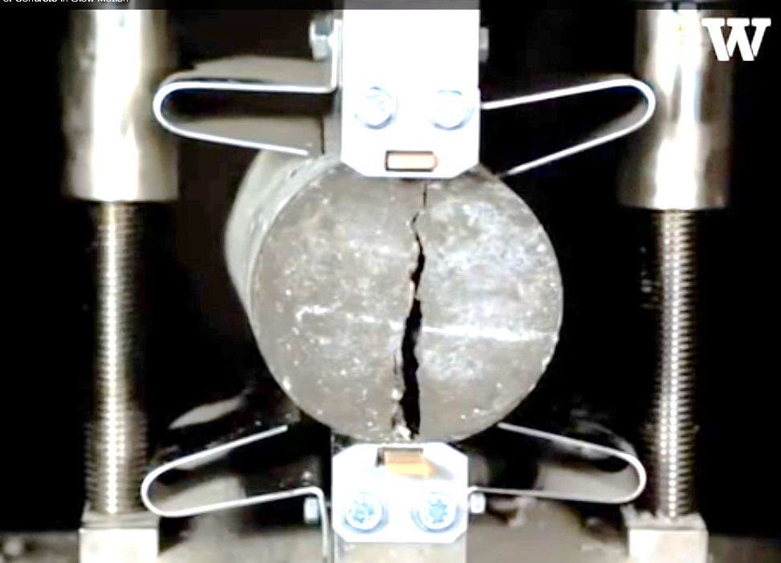
Today’s Tensile Testing Brazilian Test
CAM

Slide 26
Conclusion
Do not rely on standard tests
We have the technology to test the Right Things The Right Way
If your wellbore integrity is important:
Consider going beyond ISO/ API
Understand what you expect your cement to do
Test accordingly

Slide 27
Your Feedback is Important
Enter your section in the DL Evaluation Contest by completing the evaluation form for this presentation :
Click on: Section Evaluation
Society of Petroleum Engineers Distinguished Lecturer Program
www.spe.org/dl

