Slide 1
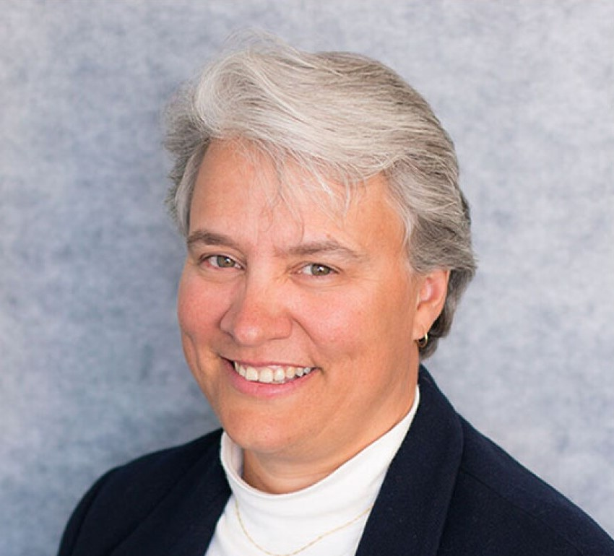
SPE Board of Directors Meeting, July 2026
Sharing highlights from the following board committees:
  Membership and Engagement
  Technical Content
  Finance
  Audit
Coordination meetings held for:
  Regional Directors
  Technical Directors
Please send feedback to president@spe.org
Dr. Jennifer Miskimins
2026 SPE President

Slide 2
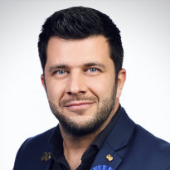
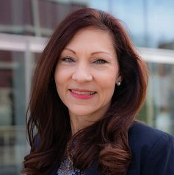
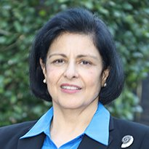
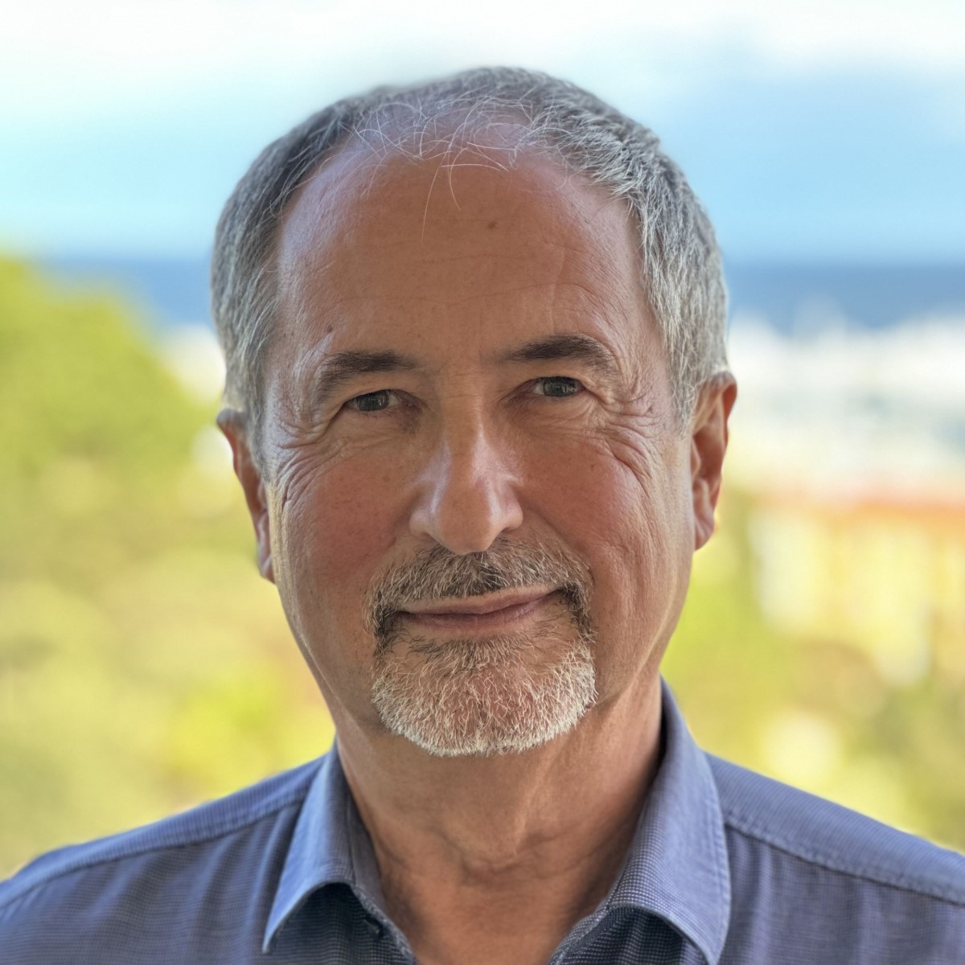
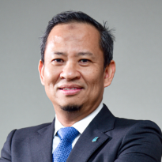
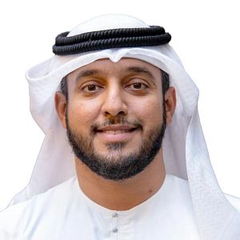
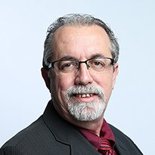
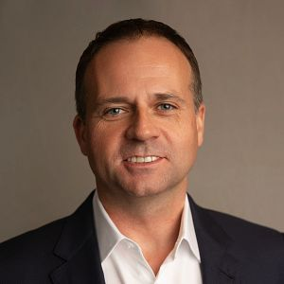
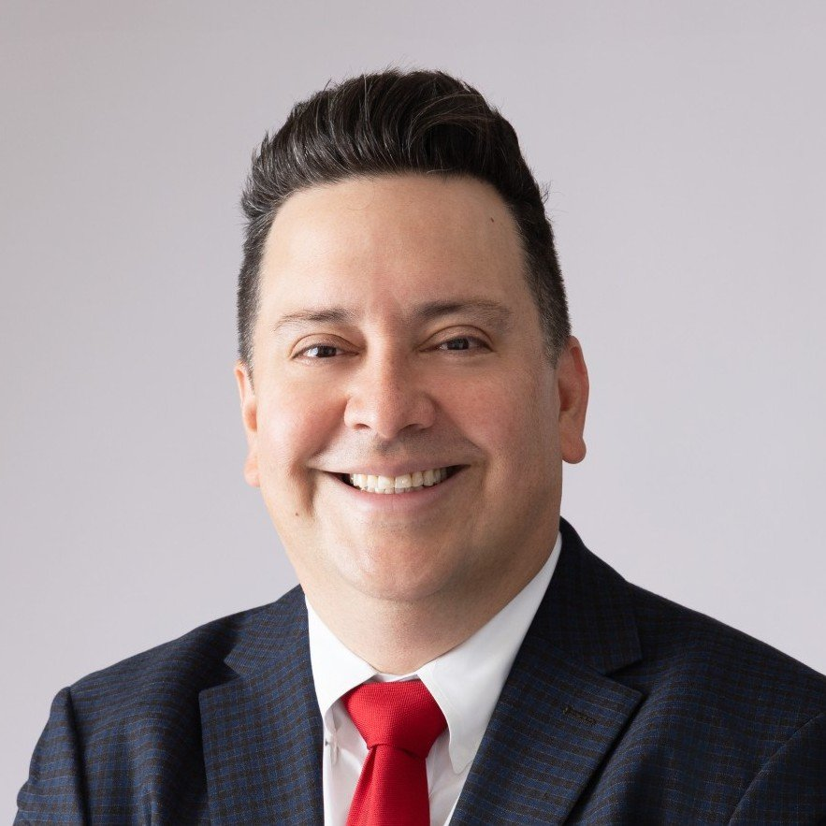
Membership & Engagement Committee – July 2026
Recommendations from the Board Committee on Membership and Engagement taken to the full board for approvals:
Approved:
2026 International Award recipients as submitted by the Awards and Recognition Committees.
USD 10 dues increase for Country Group 1 in 2027.
One-year dues exception for the SPE Georgetown Section to remain at the Country Group 2 dues rate of USD 50.
Awards & Recognition Committee and staff authorized to shorten the awards process timeline; update expected October 2026.
Declined:
No recipient selected for the 2026 Stephen A. Holditch Lifetime Achievement Award, following review of nominations against established selection criteria.
Other topics reviewed/report/updates:
The Engineering Professionalism Committee (EPC) will begin work updating the SPE Competency Matrix and the SPE Certification Exam to align with the matrix.
Directed staff to distribute the remaining balance of the Section Support Fund budget to eligible sections who requested the funds.
2027 World Bank Country Group updates with Venezuela moving from Country Group 4 (USD 25) to Country Group 3 (USD 35) and Jordan, Philippines, Sri Lanka, and Vietnam moving from Country Group 3 (USD 35) to Country Group 2 (USD 50).
SPE Ashgabat Section changing its name to the SPE Turkmenistan Section.
Received pre-read updates on volunteer leadership pathways, Young Professional engagement initiatives including townhalls and future collaboration with Membership Standing Committee, OTC 2027 grant proposal decision, and the SPE NEXTGEN program.
Pierre Emmanuel d’Huart
(Chair)
Linda Battalora
Sushma Bhan
Olivier Houze
Hazli Sham Kassim
Maged Mabrook
Carlos Pedroso
Gregory Stephenson
Carlos Torres

Slide 3
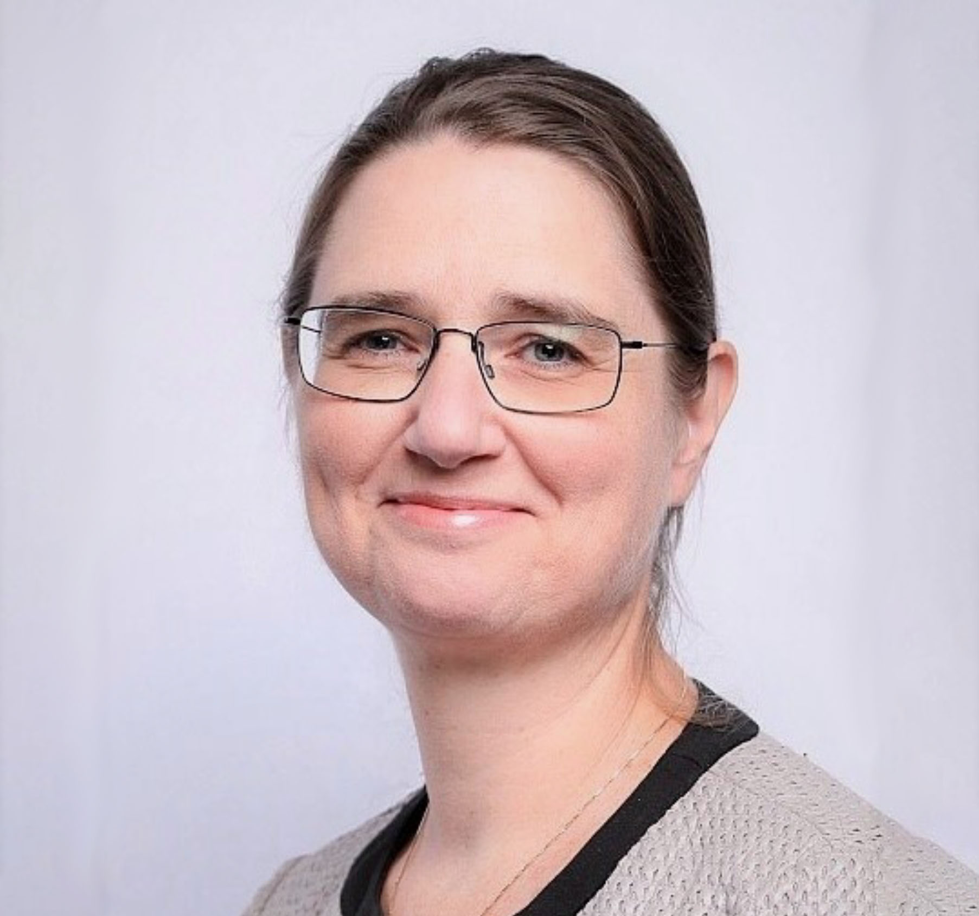
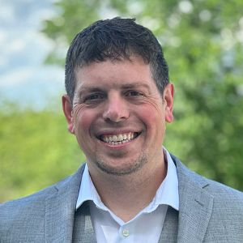
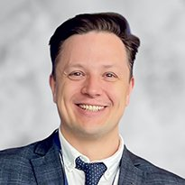
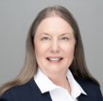
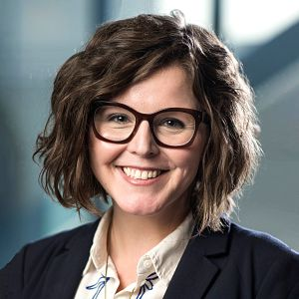
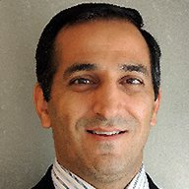
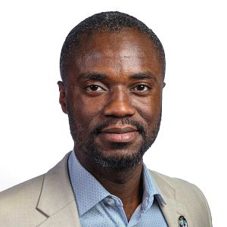
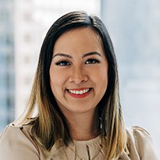
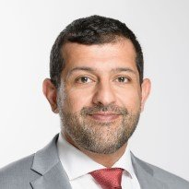
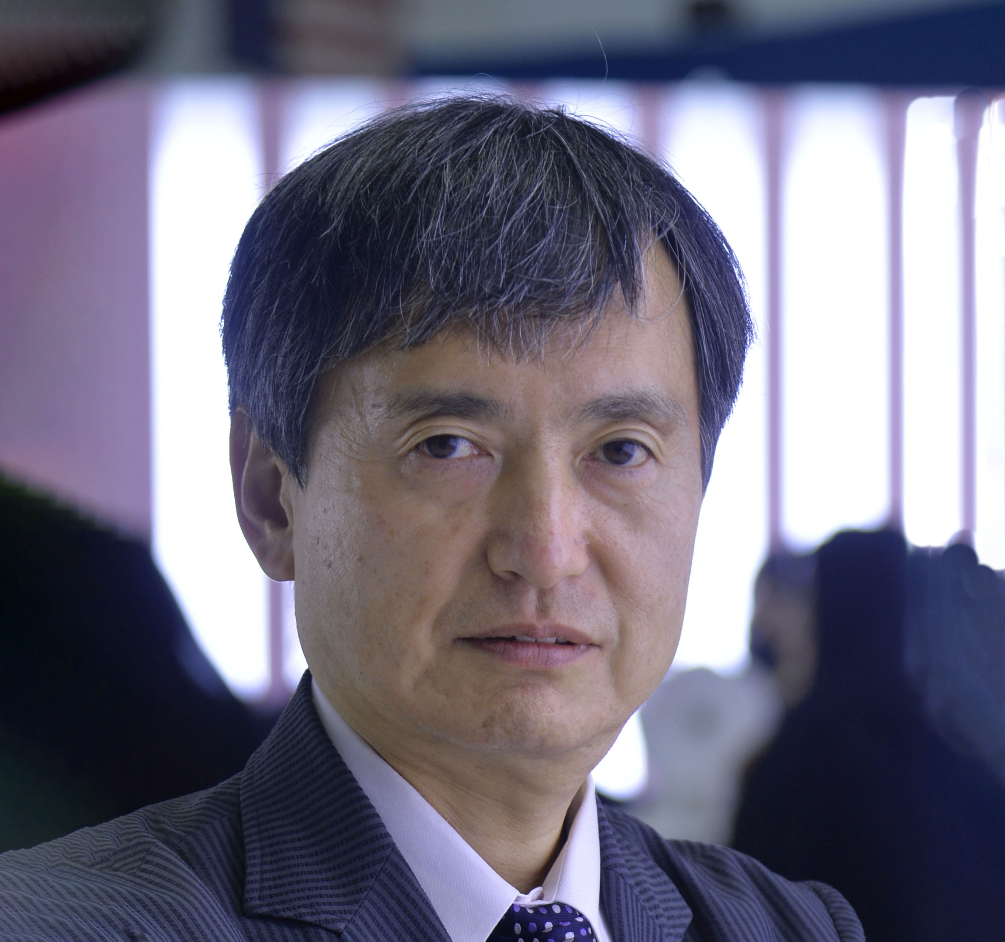
Technical Content Committee – July 2026
Committee and Board approved the recommended revenue model for PRMS/SRMS, consisting of a pricing and access model, revenue opportunities to include hosting PRMS and SRMS training courses, pursue collaboration with 6 sister (partner) societies, and establish an MOU between SPE and the 6 sister societies. ​
Approved:
  CSI Score Criteria to redesign SPE conference and symposia surveys in alignment with the proposed CSI framework for attendees and exhibitors (9 July)
  Oil and Gas Reserves Committee (OGRC) to begin work on building an Umbrella Resources Management System (RMS). (9 July)
  1 ERF – SPE Symposium: Asset Integrity and Management, Malaysia/Thailand
  Event Portfolio Management Policy Clarifications such as a new section conference must have TC Committee approval to 1) occur and 2) publish papers in OnePetro and that new section symposia do not need TC Committee approval and may not have papers.
  2 of the Events under Review and 1 Revisited:
      SPE/CHOA Slugging It Out Conference (SIO), Canada – Recategorize the event to a regional workshop and continue to offer a one-day program
      SPE Latin American and Caribbean Petroleum Engineering Conference (LACPEC) – Focus on expanding current topic-specific successful workshops into symposiums with a potential to grow to a conference format rather than continuing this conference. LACPEC will be paused and a plan for its future will be reviewed in the February 2027 TC Committee meeting.
      SPE Reservoir Simulation Conference (RSC), US – The conference to occur in late 2027 (proposed November 2027) rather than 2028 as approved at the January 2026 TC Committee meeting.
Received updates on:
  Project Innerspace/GEODE Projects (9 July)
  The Global Event Operations and Flagship Event Reports
  ATCE 2026 and Beyond
  2026 TC Committee goals. In particular, the Event Portfolio Roadmap Plan was reviewed, outlining the 3 phases to occur – and to align with the new Strategic Plan.
Peggy Rijken
Chair
Neil Boyer
Alexey Borisenko
Susan Howes
Sarah Kern
Rahim Masoudi
Riverson Oppong
Kim Oracheski
Abdullatif Al-Omair
Koji Yamamoto

Slide 4
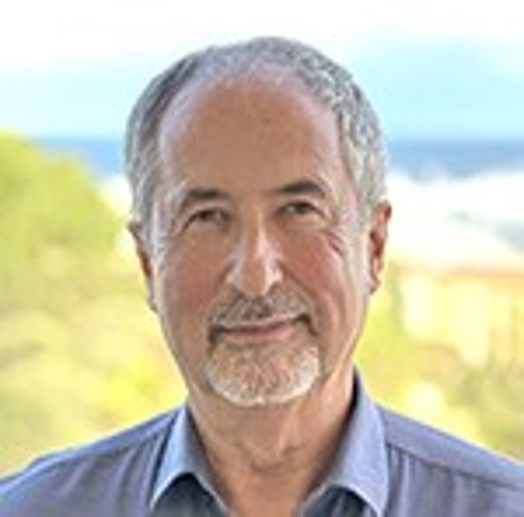

Finance Committee – July 2026
Received an update on SPE’s investment portfolio, reporting global investments of $36.9 million as of 30 June 2026.
Received an update on the FY2026B forecast, which reflected a $2.6 million operating loss unfavorable to budget.
Received an update on the FY2027 budget, which reflects an operating surplus/loss of $3.38 unfavorable to budget.
Received an update on the SPE Foundation and discussion on the transfer of assets to be managed by SPE International.
Received an update on the Richardson building and a potential buyer.
Olivier Houzé
Chair
Jennifer Miskimins
Susan Howes
Hazli Kassim
Peggy Rijken
Pierre Emmanuel d’Huart

Slide 5
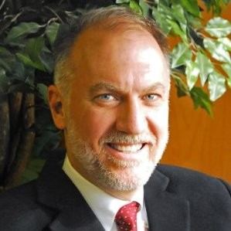
Audit Committee – July 2026
Received an update on SPE’s cybersecurity improvement program, which includes enforcing multi-factor authentication across all high-risk and critical systems, inventory and govern all accounts and credentials, and implementing a vulnerability management process with defined SLAs.
Reviewed the FY2026 audit schedule conducted by RSM.
  1 April 2025 – 30 April 2026 (Legacy Oracle EBS System)
  1 May 2026 – 30 September 2026 (Oracle NetSuite)
Reviewed the internal audit committee charter to ensure timely hiring of an internal audit firm for FY2028.
Hazli Kassim
Chair
Alexey Borisenko
Carlos Torres
Olivier Houzé
Ford Brett

Slide 6
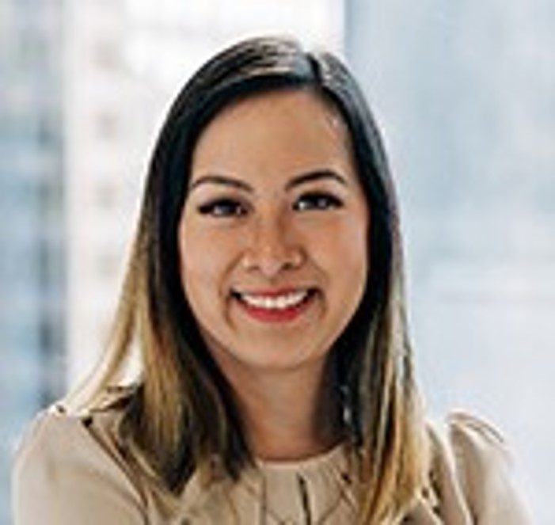
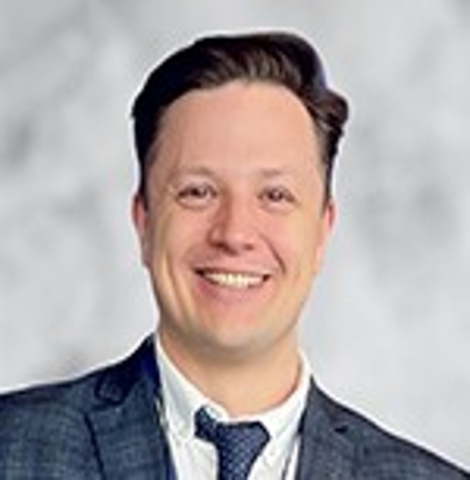

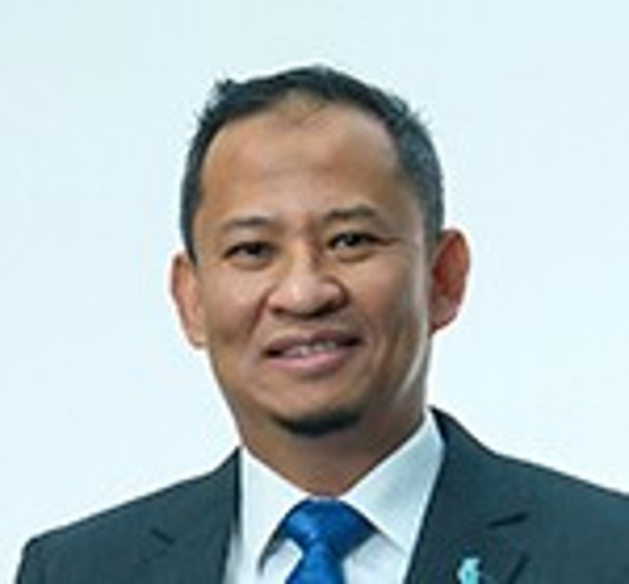
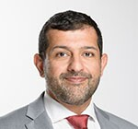
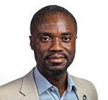

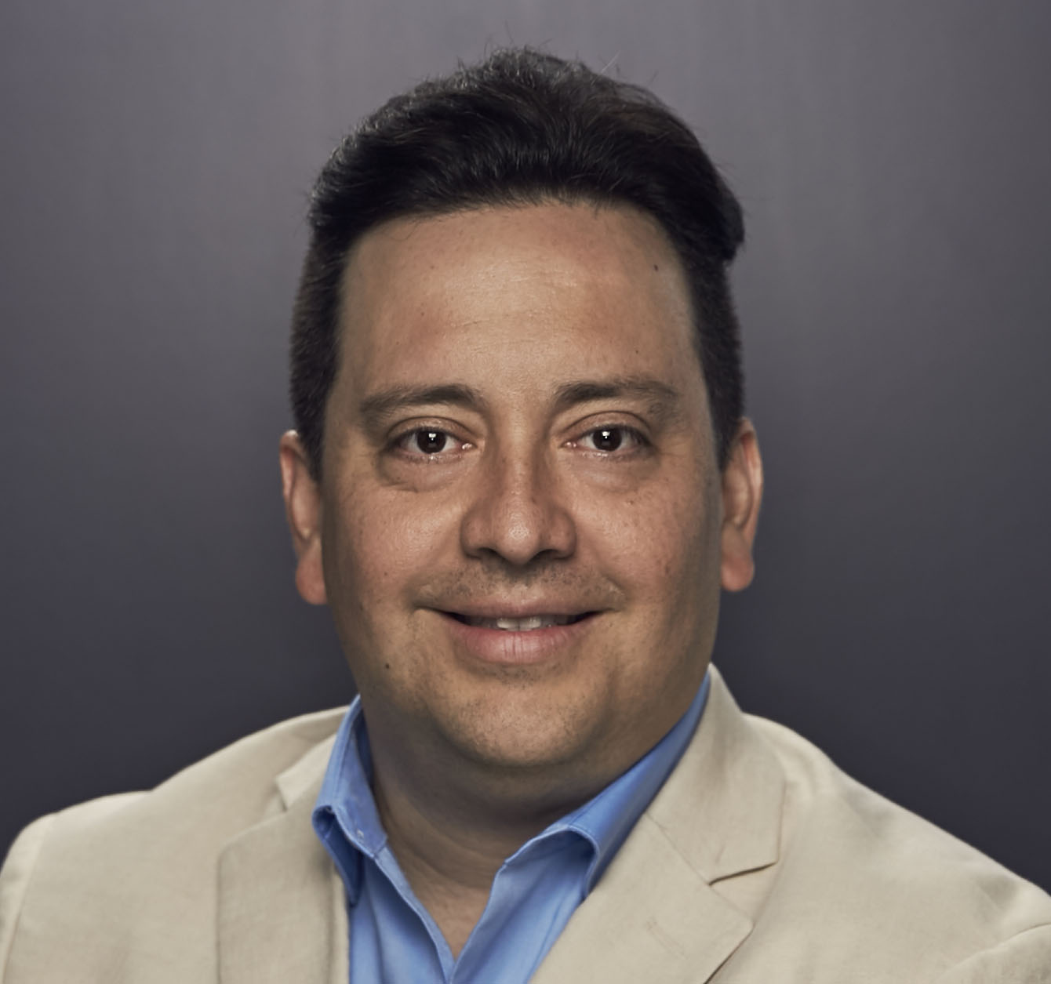
Regional Directors – July 2026
Discussed the Section Support Fund and shared feedback.
Discussed the Student Dues communications including the publication of the June President’s Column, a July JPT/TWA article, and email communications.
Received information regarding Member Communication Strategies that included:
  a discussion of email performance
  the launch of value-led versus incentive-led member communications
  upcoming OnePetro chatbot for SPE members
  details for the association management software project.
Regional PetroBowl activities were discussed including each region owning their support level and upcoming competitions.
Engaged in an open discussion on the collaboration between SPE Regional Directors and Technical Directors where RDs are open and available to support Technical Director efforts.
RDs provided regional updates.
Kim Oracheski
Lead
Alexey Borisenko
Neil Boyer
Pierre-Emmanuel d’Huart
Hazli Kassim
Maged Mabrook
Abdullatif Al-Omair
Riverson Oppong
Carlos Pedroso
Carlos Torres
Koji Yamamoto

Slide 7
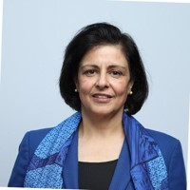
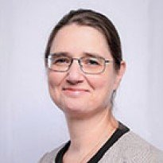
Technical Directors – July 2026
Geothermal & Project InnerSpace: All TDs engaged; $48K funding ($8K per discipline) shared among 6 TDs, with proposals progressing alongside student volunteers.
New Technical Sections under review: Acid Stimulation (ASTS) and Asset Integrity (AITS) proposed; Robotics & Autonomous Systems (RASTS) now under DSEA; Human Factors renamed to Safety TS; Critical Minerals TS operational; Drilling Uncertainty Prediction (DUP) merged into DSATS.
Technical Section growth & pipeline strategy:
  ATCE special session proposals submitted
  Student TS enrollment increased year-over-year on stronger global engagement
  Standardized 2026 TS Annual Reports launched
  Awards have been finalized and announced
Discipline highlights: HSES, Drilling, Reservoir & P&F advanced multidisciplinary events; Completions launched a new TS and sold-out Completions Connect; DSEA added 3,000+ new student members since 2025.
Recommendation to Board: Promote the value of all 24 Technical Sections – free for members and students – to build deeper cross-section collaboration.
Sushma Bhan
Lead
Linda Battalora
Sarah Kern
Rahim Masoudi
Peggy Rijken
Gregory Stephenson

