Slide 1

SPE Board of Directors Meeting, April 2025
Sharing highlights from the following board committees:
Membership and Engagement
Technical Content
Finance
Audit
Coordination meetings held for:
Regional Directors
Technical Directors
Please send feedback to president@spe.org
Olivier Houzé
2025 SPE President

Slide 2
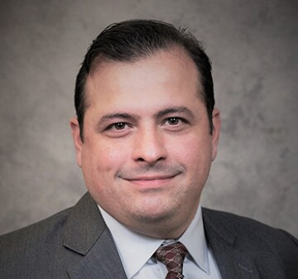
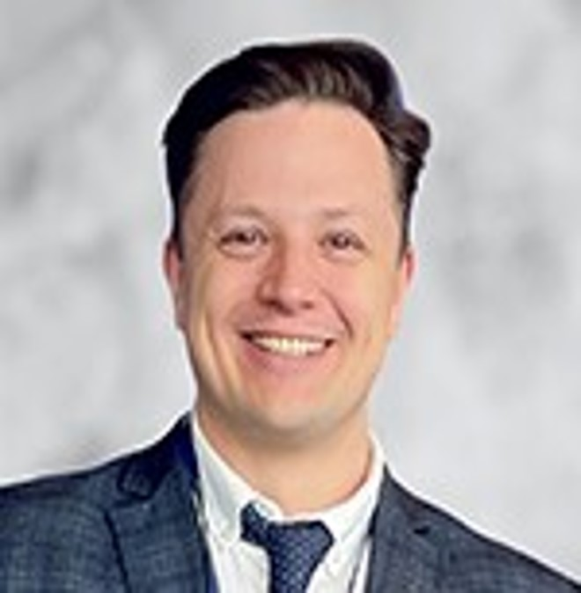
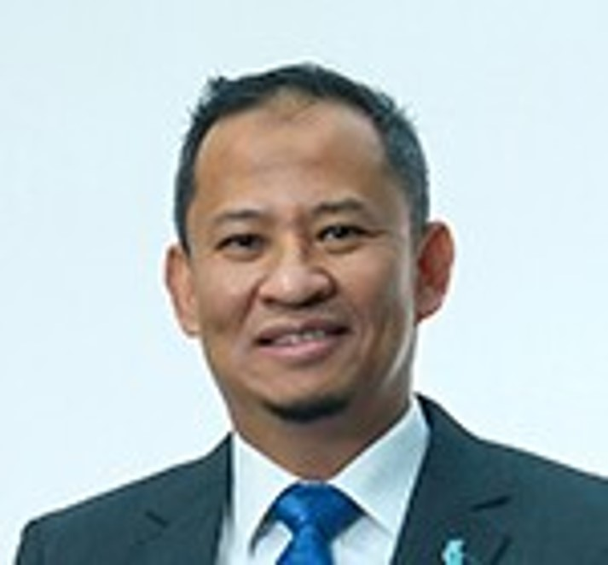
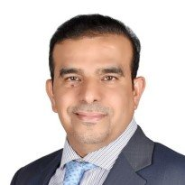
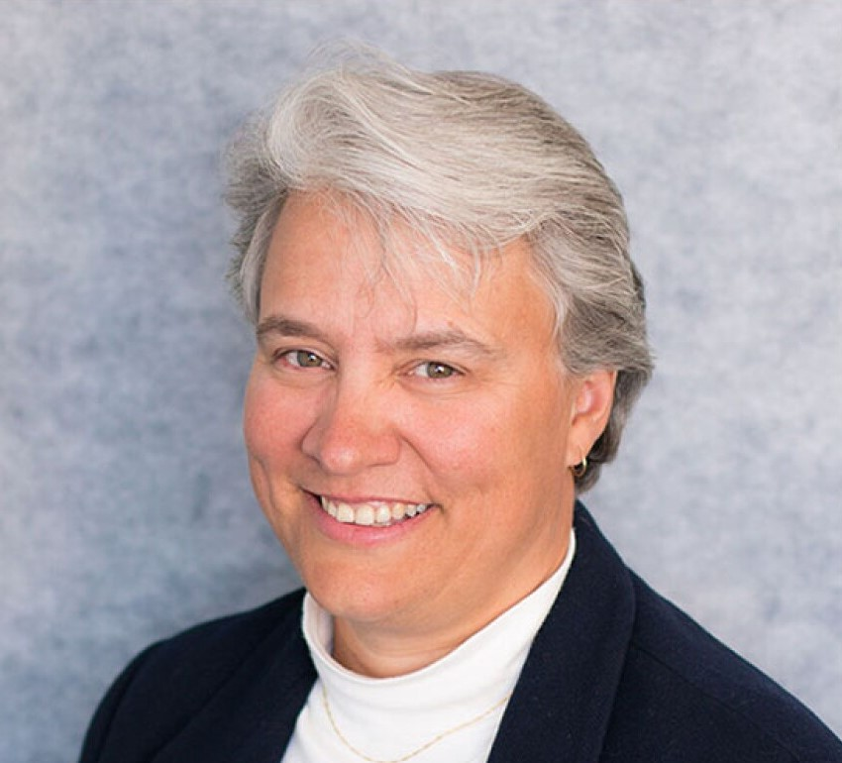
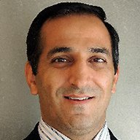
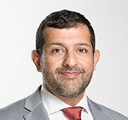
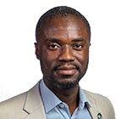
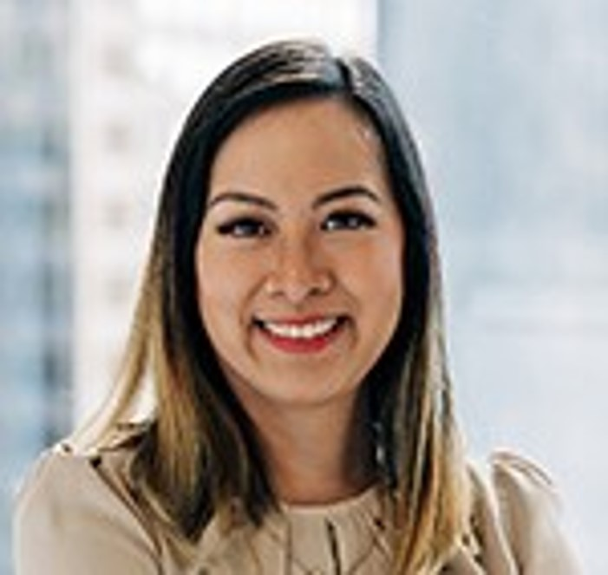
Membership & Engagement – April 2025
Approved and recommended to the Board of Directors:
The principle of a member consultation and the formation of a workgroup to explore questions and conditions
The revised Code of Conduct and policy as submitted by the Engineering and Professionalism Standing Committee with edits from the SPE external legal counsel
A process for allocating funds to students who require visas to attend the Petrobowl Championship Final to prevent the misuse of funds
The merger of the two current European regions: North Sea and South Central and Eastern Europe, into one Europe region
The principle of the creation of a Strategic Advisory Council
Other Items covered included the following:
The Board Committee on Membership and Engagement not to proceed with a membership consultation at the current time
Staff presented an overview of section level student conversion activities, feedback from the Young Professional Standing Committee, and SPE’s social media
It was agreed a workgroup be formed, consisting of RD’s and staff, to address student strategy
Data was presented on 11 different touch points for member engagement. Work still to be done, but initial numbers indicate a max of 2,080 Life Members with no touch points in the last 5 years
Board Members presented work they are undertaking to analyze current program expenses & staff hours to assist in making data driven decisions about efficiency, budgets, and maximum value to members
Robert Martinez
Chair
Alexey Borisenko
Hazli Kassim
Hamad Al Marri
Rahim Masoudi
Jennifer Miskimins
Abdullatif Al Omair
Riverson Oppong
Kim Oracheski

Slide 3
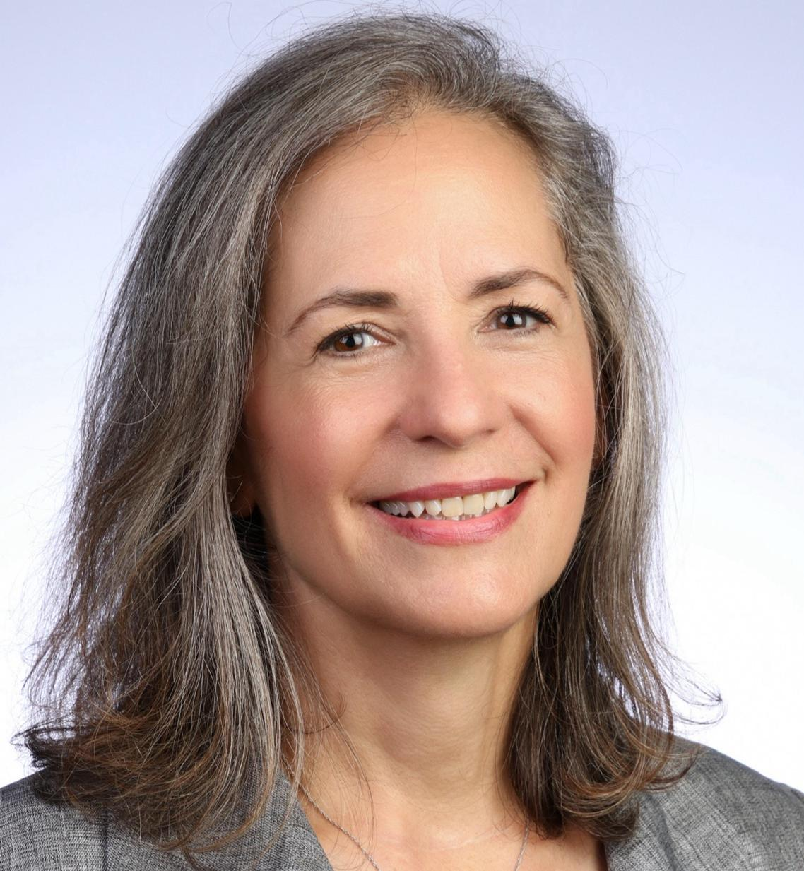
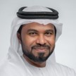
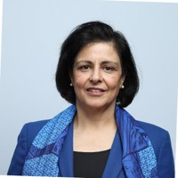
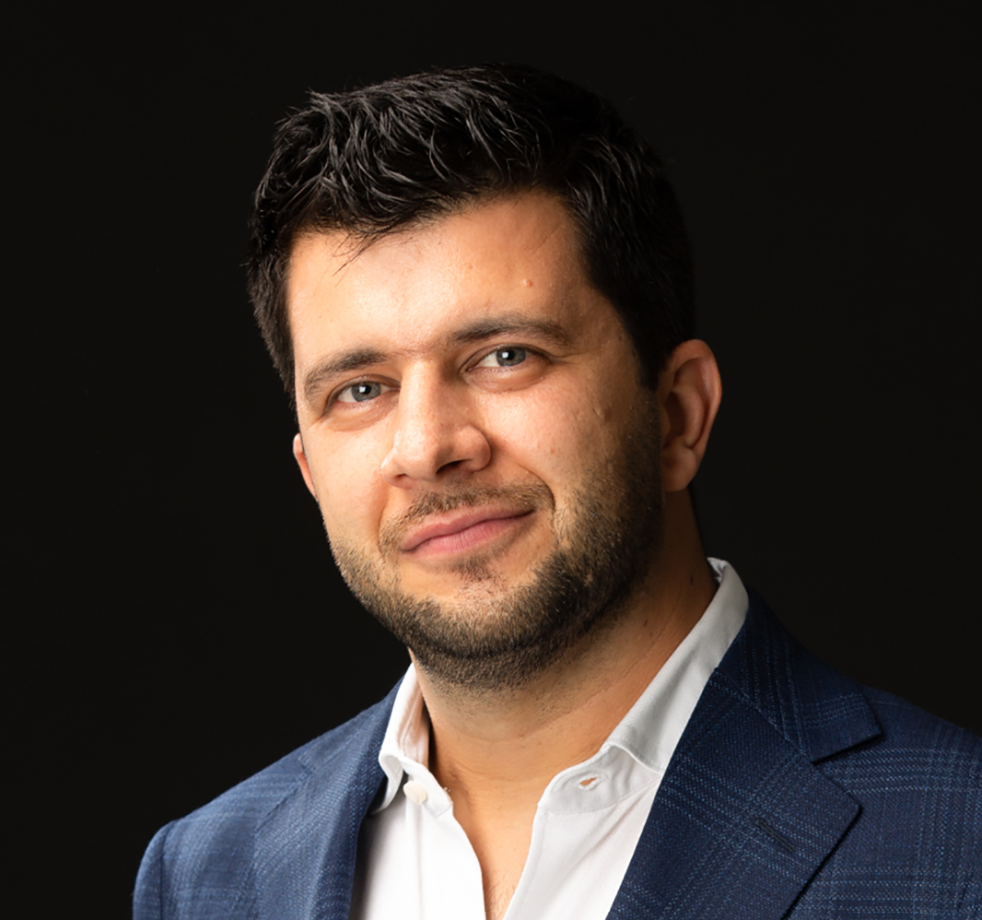
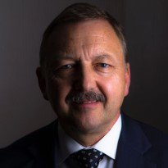
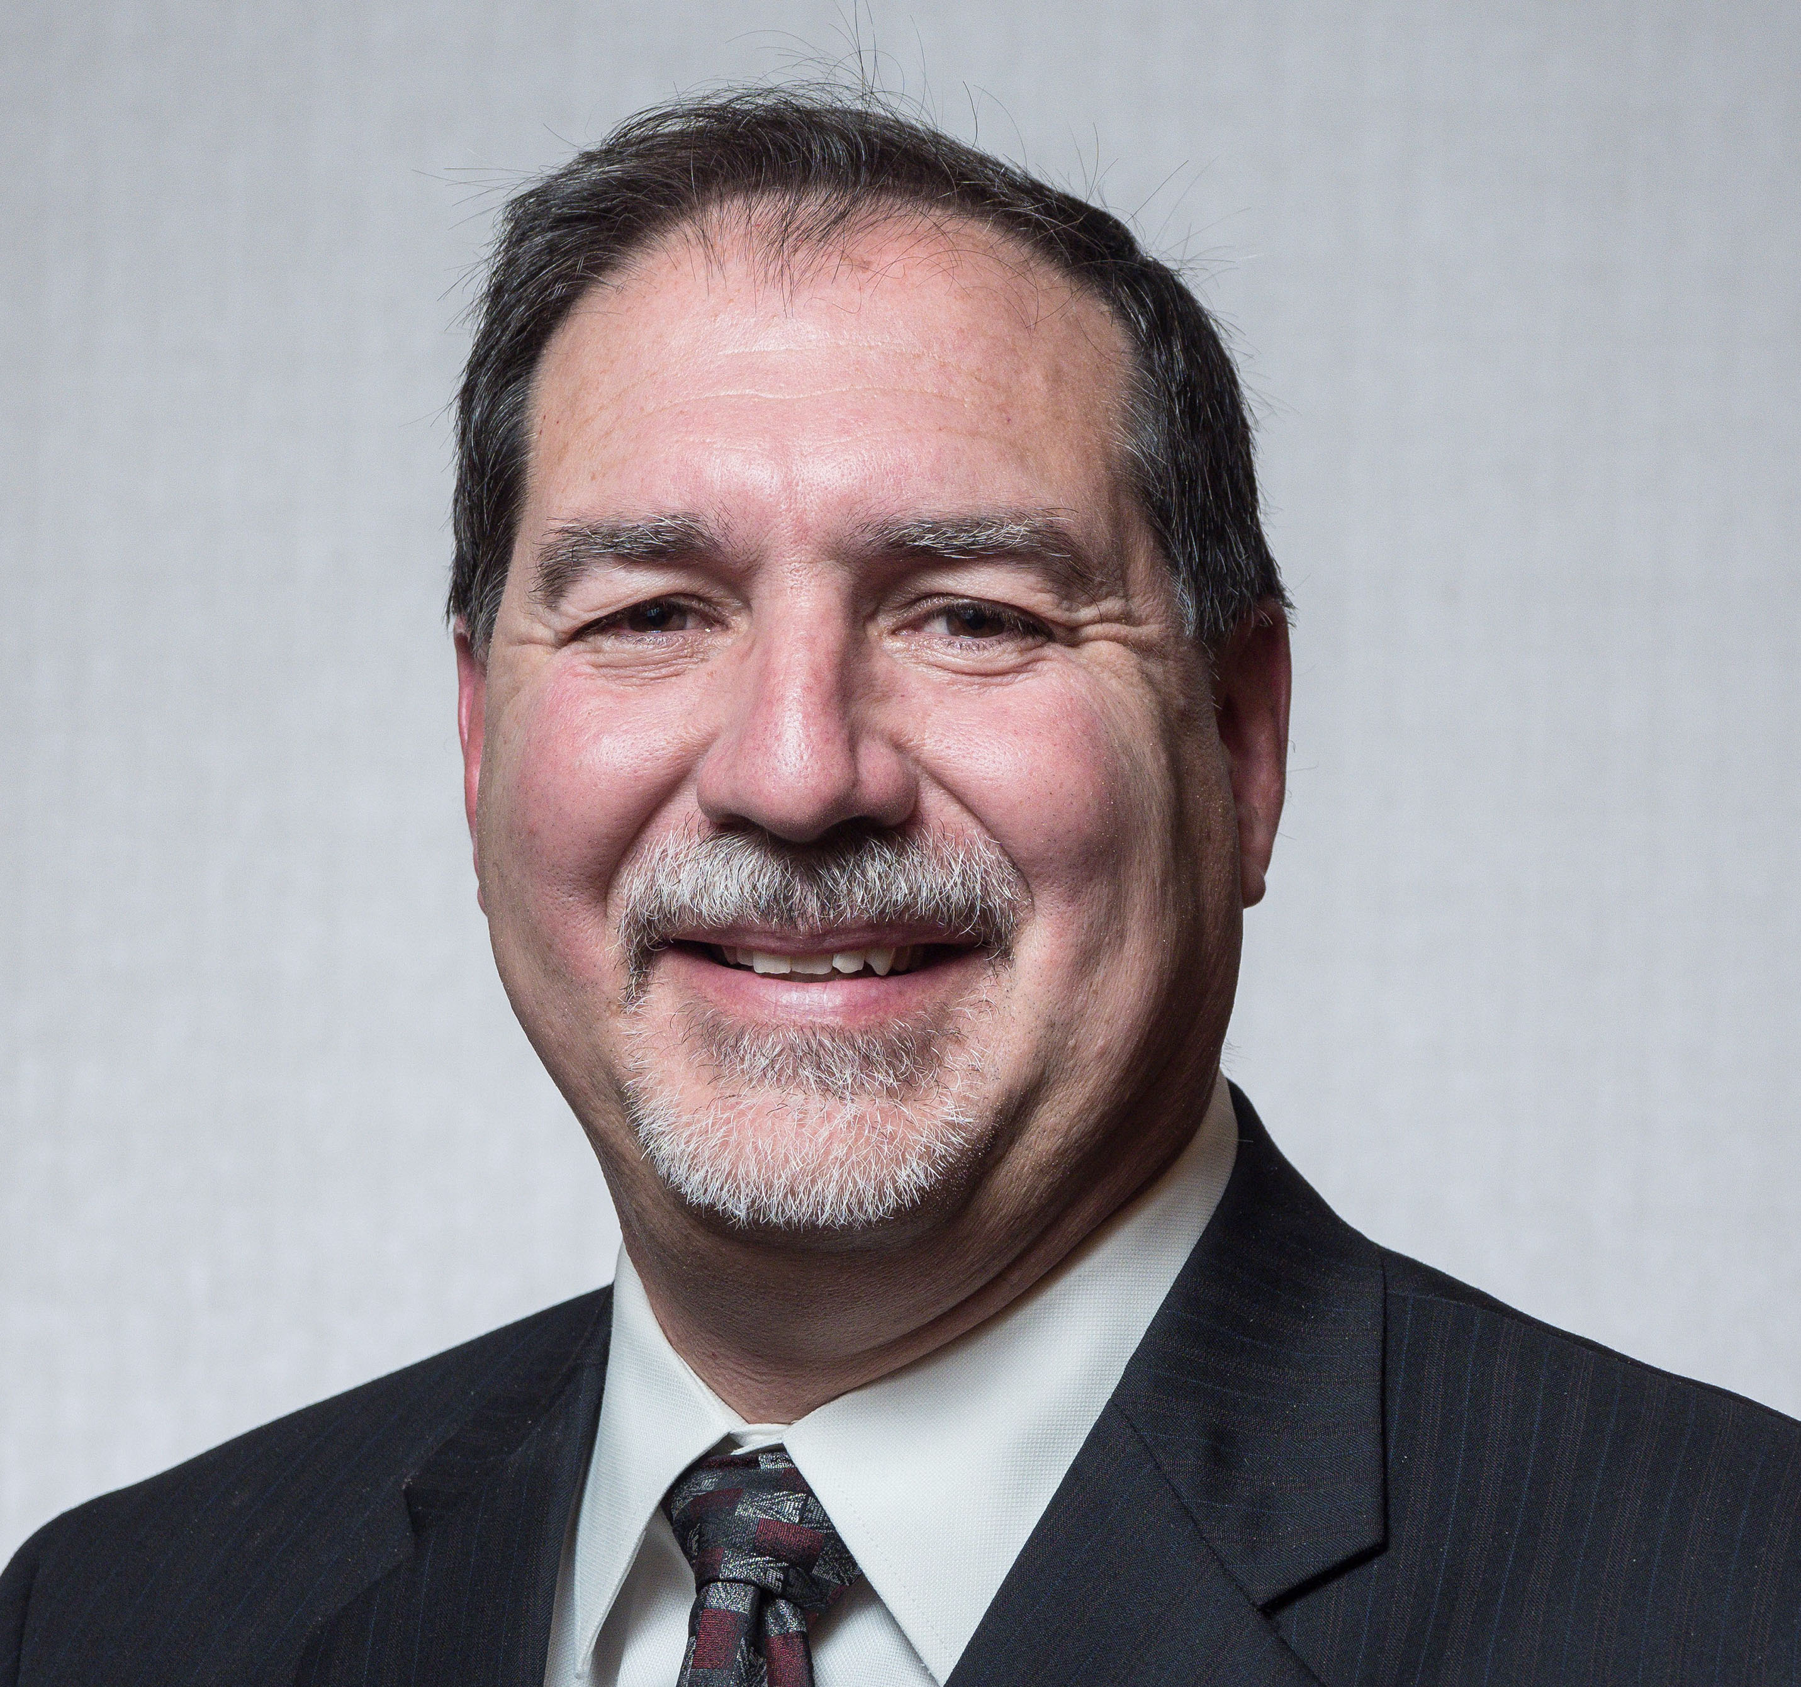

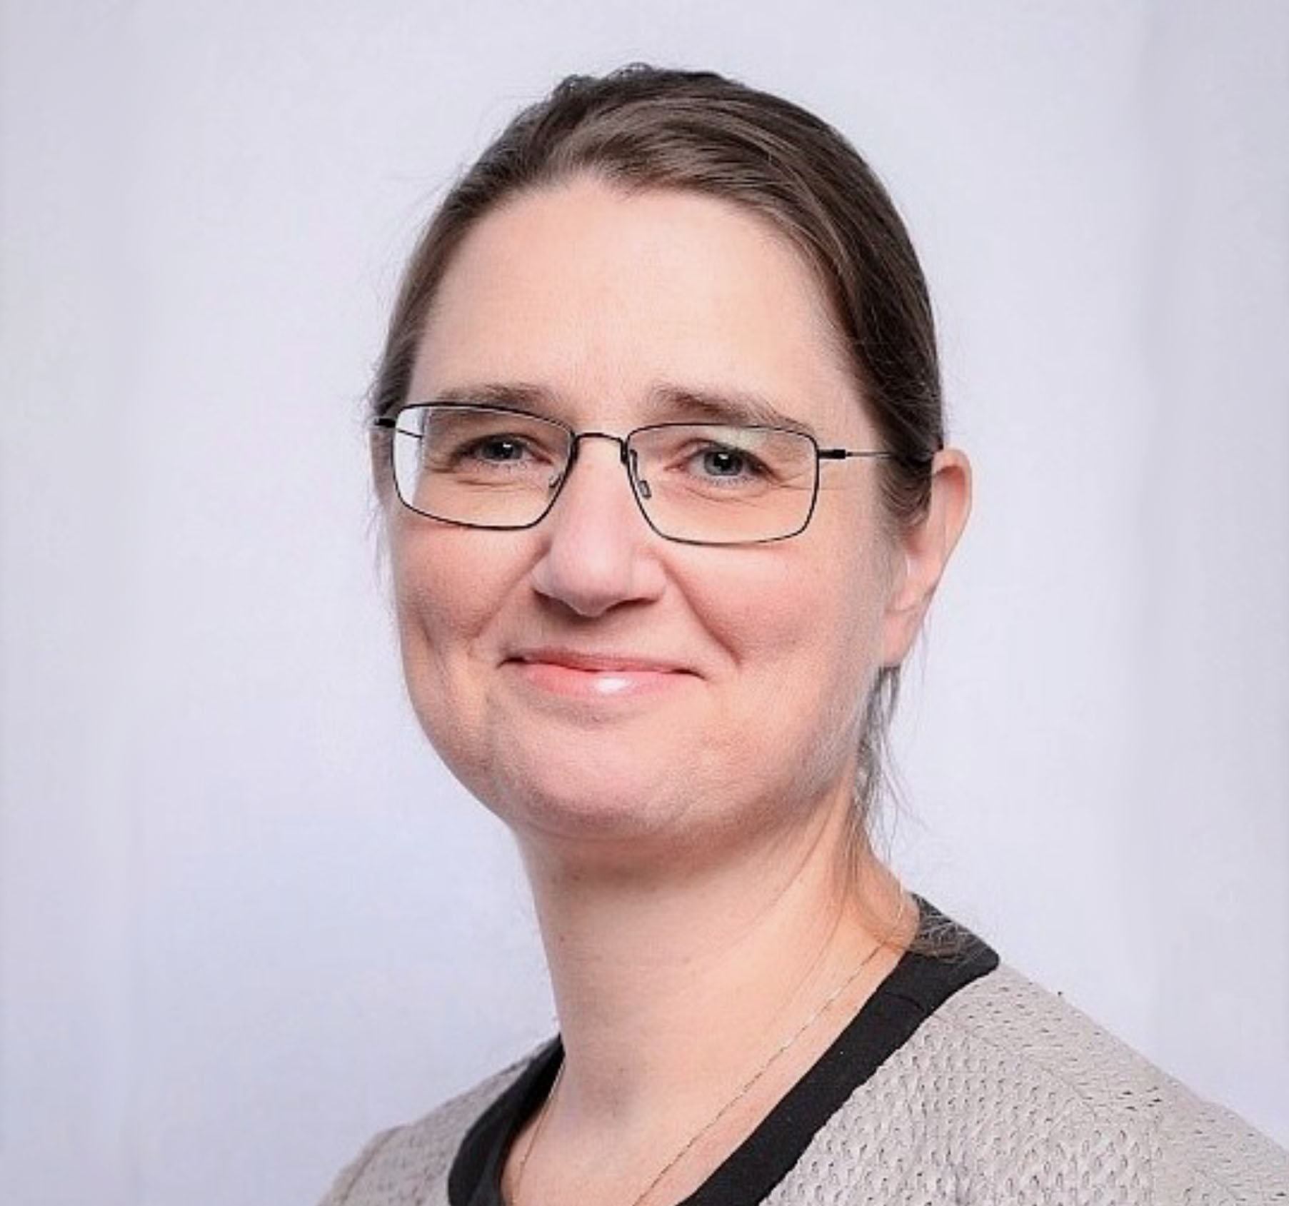
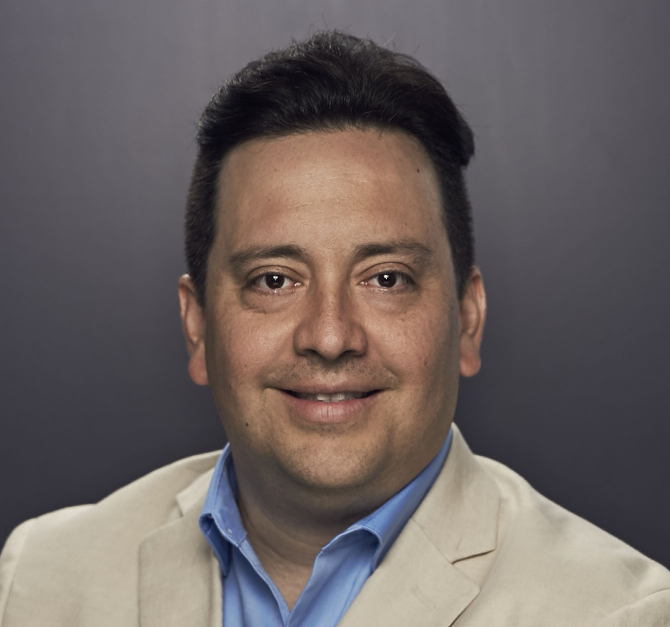
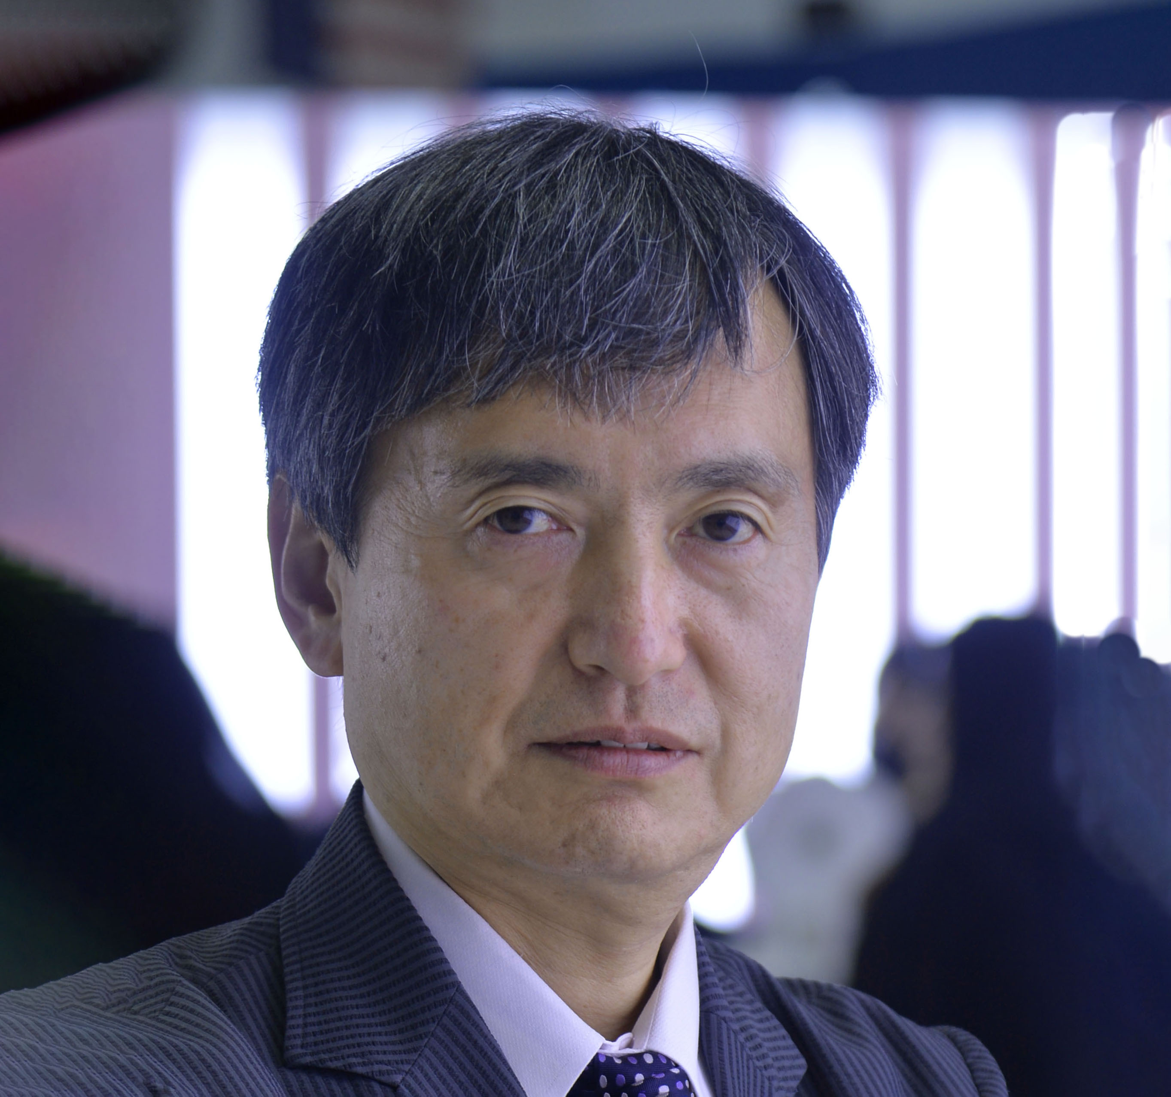
Technical Content – April 2025
Approved and recommended to the Board of Directors to approve:
a 5% increase on OnePetro member pricing.
candidate Silviu Livescu for the position of 2025-2028 SPE Journal Editor-in-Chief.
Approved ERF for the Africa Technology Conference in Dakar, Senegal.
Received updates on:
ATCE 2025 Planning and ATCE 2026/2027 including its future rotation.
the 2025 Technical Content Committee Goals.
SPE.org and JPT website enhancements.
Geothermal Events and Activities (GEODE) Advisory Committee.
the ATCE Workgroup, the Instructor-Led Training Courses Workgroup, the Paper Quality Workgroup and the Ratification of Energy Transition and Climate Change Workgroup.
the INTEK DOE Grant.
A workgroup was formed to strategically look at events. In conjunction with staff, the workgroup will develop a mission statement and workgroup charge.
The Technical Content Committee approved an update to the OGRC Governance document.
Sue Staley, chairperson of the Technical Content Committee, shared she had approved a Program Committee exception for the 2026 Drilling Conference. The Drilling Conference Program Committee asked to retain 7 of the 14 members for an additional year to support the transition process. This request complies with the Policy on Program Committee Development.
Sue Staley
Chair
Mohamed Al Marzouqi
Sushma Bhan
Pierre Emmanuelle D-Huart
Robin Macmillan
Terry Palisch
Carlos Pedroso
Peggy Rijken
Carlos Torres
Koji Yamamoto

Slide 4
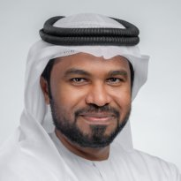

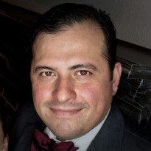

Regional Directors – April 2025
A workgroup is to be formed with TD/RD participation to review the SPE Connect platform and report out to the Membership and Engagement Committee in July, with recommendations expected in October
Staff reported out on action items from the January RD meeting:
- Staff have adopted the suggestions for ‘RD Onboarding’
- Successful collaboration between RDs/TDs, with first joint virtual meeting held last March and quarterly meetings to take place moving forward
Staff gave a general update on the certification programme
An update on how SPE is managing sanctions was provided after staff consultation with external legal counsel
Staff presented suggestions to streamline the Regional Awards programme, including ideas relating to RD’s involvement in the judging process
Mohamed Al Marzouqi
Lead
Alexey Borisenko
Pierre D-Huart
Hazli Kassim
Robert Martinez
Abdullatif Al Omair
Kim Oracheski
Riverson Oppong
Carlos Pedroso
Carlos Torres
Koji Yamamoto

Slide 5

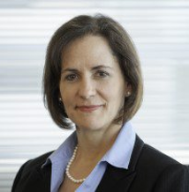
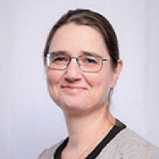
Technical Directors – April 2025
The Technical Section (TS) sign-up process will be streamlined, shifting to an opt-out model for membership.
The TS leadership structure will be updated to encourage adding a Regional Membership Chair and require creating a leadership position for at least one Young Professional (YP).
The Management Technical Section is being renamed to the Asset Management Technical Section to better reflect its goals, effective after ATCE.
A future discussion is planned regarding a potential name change for the associated Discipline.
A proposal introduces four new TS award categories: Innovation, Student Engagement, Knowledge Sharing & Collaboration.
Technical Directors (TDs) will develop metrics for these new award categories before the July Board of Directors (BoD) meeting.
Will explore the Open Subsurface Data Universe (OSDU) to define SPE's role and mutual benefits.
Robin Macmillan
Lead
Hamad Al Marri
Sushma Bhan
Sue Staley
Rahim Masoudi
Peggy Rijken

Slide 6
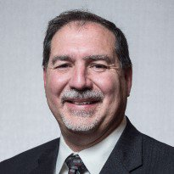

Finance – April 2025
Approved the recommendation to establish a Global Sponsorship Program.
Received an update on SPE’s investment portfolio through March 2025 of $34.8 million.
Received an update on FY202, noting that March books and final FY2025 results have not closed at the time of the April Board meeting.
Received an update on the FY2026B and FY2027 Budget Timeline.
12 May 2025 – budget work begins
3 July 2025 – FY2026B budget book available to the Board of Directors
11 July 2025 - FY2026B and FY2027 budgets will be presented to the Finance Committee
September Virtual Meeting – FY2026B budget approval
Received an update on marketing efforts to promote the sell of the Richardson building.
Terry Palisch
Chair
Olivier Houzé
Jennifer Miskimins
Hamad Al Marri
Robert Martinez
Sue Staley

Slide 7
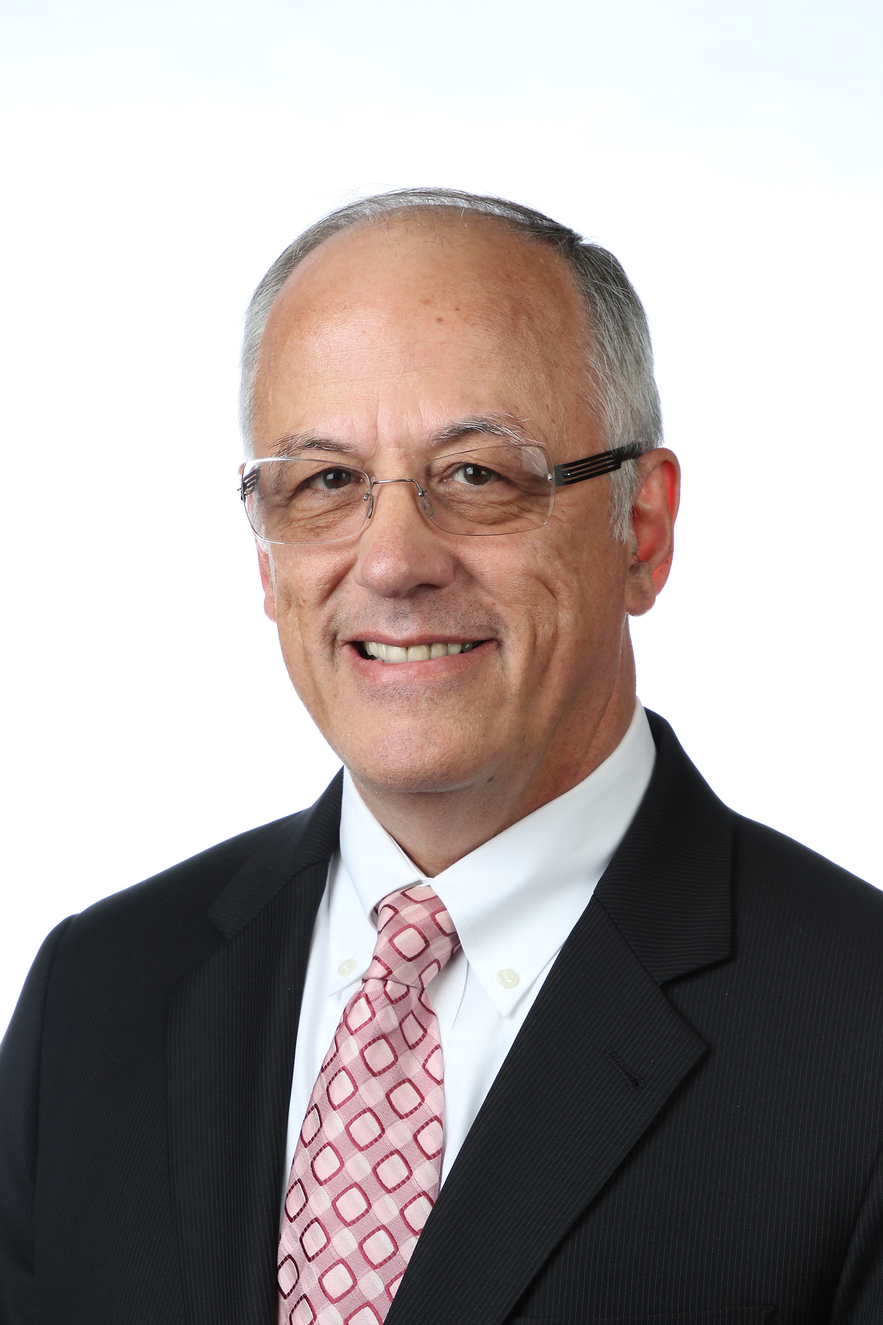
Audit – April 2025
Received an update on the Grant Thornton cybersecurity audit project and timeline.
Reviewed the SPE Legal Affairs Policy and areas requiring updates due to the recent change in SPE general counsel. Grant Thornton will advise in best practices moving forward.
Reviewed the FY2025 financial audit schedule to begin May 2025 and complete in October with a final report out during the Fall Board of Directors meeting.
Discussed SPE’s external audit needs in the upcoming years.
Hamad Al Marri
Chair
Sushma Bhan
Pierre d’Huart
Terry Palisch
Roland Moreau

