Slide 1
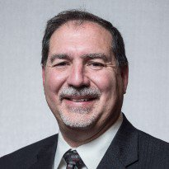
SPE Board of Directors Meeting, July 2024
Sharing highlights from the following board committees:
Membership and Engagement
Technical Content
Finance
Audit
Coordination meetings held for:
Regional Directors
Technical Directors
Please send feedback to president@spe.org
Terry Palisch
2024 SPE President

Slide 2
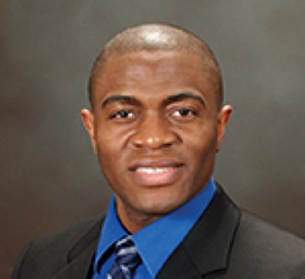
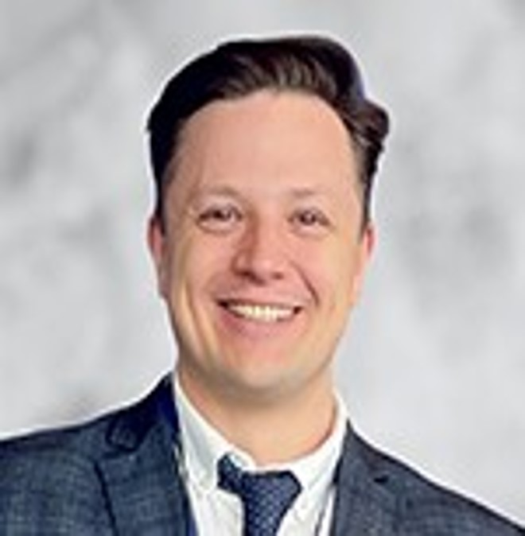
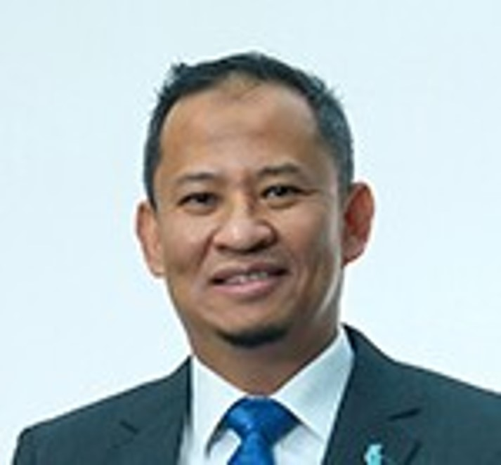

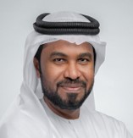

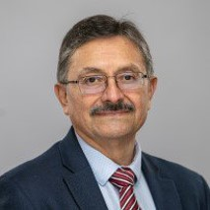
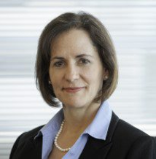

Membership & Engagement – July 2024
Approved and recommended to the Board of Directors:
The 2024 Agreement of Cooperation between Engineers Australia and the Australia/New Zealand/Papua New Guinea Council of SPE.
Increase the Certification Exam fee from USD 250 to USD 325, increasing the Certification Renewal fee from USD 40 to USD 60. The fees should be reviewed no less than every 3 years. This is first fee increase since 2006.
The 2024 SPE International Awards.
The Stephen A. Holditch Award.
Delaying implementation of the 2024 World Bank Country Group changes (increases) until 2026.
The name change of the ‘Erbil Section’ to the ‘SPE Northern Iraq Section’.
The name of the newly established section in Timor-Leste to be the ‘Timor-Leste Section’.
Reinstating rebates for geographical sections with funds on account exceeding USD $500K.
The revision of the Regional Director Travel Policy to allow them have the option to dedicate no more than 50% of their annual travel allowance to assist with section officer travel to Regional Section Officer Meetings.
Staff presented an overview of the OnePetro pricing structure and review process, a general program review, and work conducted to develop SPE’s data driven Membership Value Proposition Statement.
The Board Committee conducted a high-level SWOT analysis on a selection of Member Programs.
Simeon Eburi
Chair
Alexey Borisenko
Hazli Kassim
Kim Oracheski
Mohamed Al-Marzouqui
Olivier Houzé
Pierre Emmanuelle
D’Huart
Rodolfo Camacho
Sue Staley

Slide 3
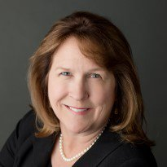
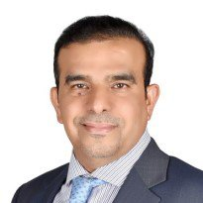
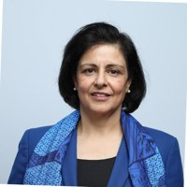
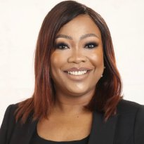
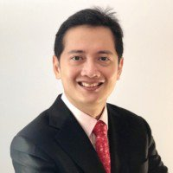
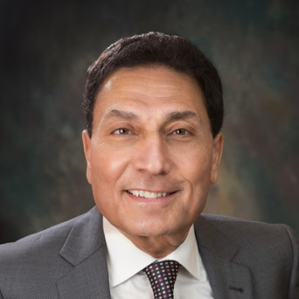
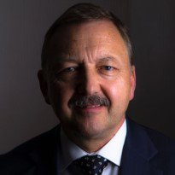
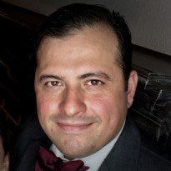

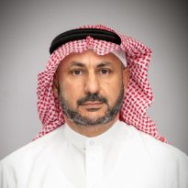
Technical Content – July 2024
Approved and recommended to the Board of Directors:
to sunset the PetroWiki platform and migrate all the pages to OnePetro. All content preserved in OnePetro.
the use and objectives of the “Solutions. People. Energy.” tagline for wider usage, following the proposed logo objectives and guidelines; that the logo with the tagline be available to Sections and Chapters, on a request basis; to sunset the usage of the “Society for Professionals in Energy” tagline; and that the Regional and Technical Directors begin outreach by announcing the tagline logo to their respective sections.
to approve the text edits to the AI-Generated Content in Publications policy.
that the draft SPE CO₂ Storage Resources Management System (2024) document be opened for public comment.
Reviewed and approved the Asia Pacific CCUS Conference and Exhibition Event Request (ERF).
Received updates on ATCE 2024; SPE International HSE and Sustainability Conference and Exhibition; Utilizing Member Value and Other Data to Evaluate SPE Offerings; the Geothermal Events and Activities (GEODE) Advisory Committee; and OnePetro Subscription Pricing.
During the committee goals review, added a workgroup to review SPE’s training offerings for relevance and a way forward; requested that Simon Seaton provide an update of the Strategic Plan relative to the Technical Content Committee at the September Board Meeting; and plan to add a workgroup after ATCE to review the 100+ ancillary events during ATCE.
Discussed the use of AI “notetaking tools” in virtual SPE staff-managed committee meetings, like otter.ai (Staff received approval to draft guidelines for committee use.); and cost concerns for SPE’s Technical Community.
Karen Olson
Hamad Al-Marri
Sushma Bhan
Oghogho Effiom
Henricus Herwin
Med Kamal
Robin Macmillan
Robert Martinez
Carlos Pedroso
Hisham Zubari

Slide 4
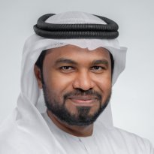
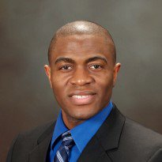

Regional Directors – July 2024
Staff gave proposed updates to the newly revised Student Chapter Awards program following the completion of the first cycle. A full recommendation of the updated program will be presented to M&E in September.
Staff presented results from their brainstorm workgroup to raise the prestige of the Regional Awards program, quality of nominations, and number of nominations, and the Regional Directors continued idea generation.
Received a presentation that SPEI develop a Hackathon program as a revenue generator, based on the huge success and popularity of section and regional hackathons, including the GOTECH event.
It was agreed that Regional Blogs are to become a mandatory responsibility for RDs.
Discussion on the travel allowance usage and policy for RD’s, resulting in a recommendation escalated to the Board Committee on Membership & Engagement.
Staff provided details of sections and chapters established and disestablished since the April Board meeting.
Staff updated on Student Conversion Best Practice Toolkits being developed for sections with tips and tricks. Staff are looking at best process to work with Student Liaison Officers to task sections to contact recent graduates from sponsored chapters to encourage conversion.
Sections and Chapter staff team running round tables to define the different types of ‘support’ sections require from SPE e.g. financial, staff support, physical visits, event support, training etc.
Staff updated on an Eastern and Mid-Continent Region Section Officers community created in SPE Connect and fixing Connect access in the SPE app, to ensure officers can access their community through the app.
Staff updated on development of regional websites to provide regional communities and ‘homes’ for sections and chapters. Piloting North America to replace the Virtual Section.
Mohamed Al Marzouqi
Simeon Eburi
Oghogho Effiom
Henricus Herwin
Hazli Kassim
Robert Martinez
Pierre Emmanuelle
D-Huart
Carlos Pedroso
Kim Oracheski
Alexey Borisenko
Hisham Zubari
Lead

Slide 5
Technical Directors – July 2024
Received updates from all TDs on global activity.
TDs were presented and approved the Integrated Reservoir Management technical section.
Discussed technical section marketing opportunities to include a technical calendar that would showcase geographical discipline opportunities.
Further discussed alignment opportunities between the technical sections and technical disciplines.
Robin Macmillan
Lead
Hamad Al Marri
Sushma Bhan
Sue Staley
Rodolfo Camacho
Karen Olson

Slide 6
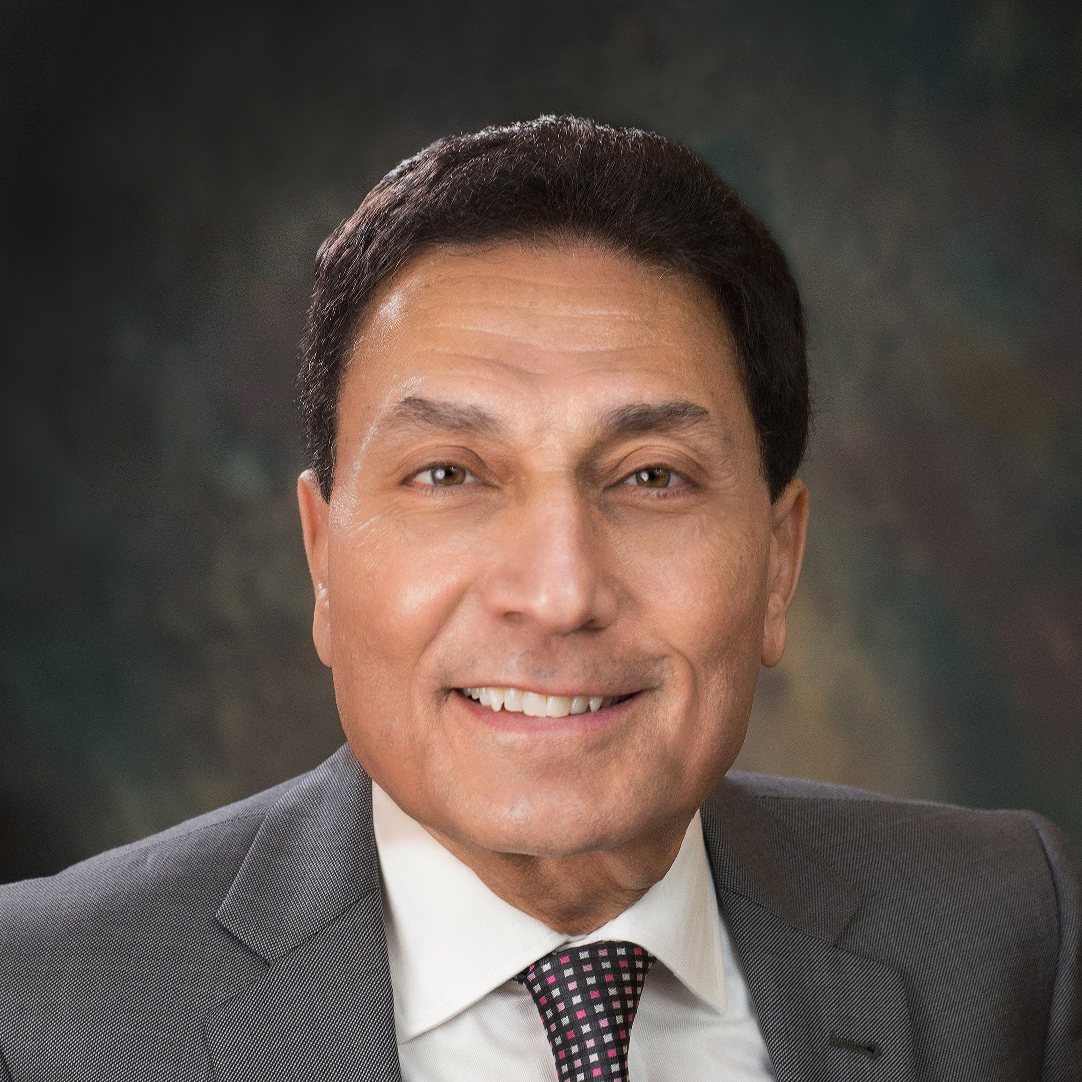
Finance – July 2024
Approved and recommended to the Board:
The SPE Budget process rework to change the fiscal year from 31 March to 30 September.
Provided an update on SPE’s investment portfolio through June 2024 of $35.4 Million.
Received an update on the unaudited FY2025 performance of $1.6 Million net surplus.
Received an update on fundraising/consortium opportunities to generate additional support from stakeholders.
Received an update on the marketing of SPE Richardson Building.
Med Kamal
Chair
Terry Palisch
Olivier Houzé
Karen Olson
Simeon Eburi
Oghogho Effiom

Slide 7
Audit – July 2024
Received an update on the Grant Thornton internal audit findings, including good practices, areas of improvement and potential IT risks.
Received an update on the financial audit conducted by RSM. No significant findings have been reported. A detailed report will be presented in September.
Received an update on the SPE Whistleblower Hotline provided to SPE staff.
Received an update from the Conduct Review Committee (CRC) on a recent matter that was investigated and settled.
Oghogho Effiom
Chair
Med Kamal
Robin Macmillan
Simeon Eburi

