Slide 1

SPE Board of Directors Meeting, July 2025
Sharing highlights from the following board committees:
  Membership and Engagement
  Technical Content
  Finance
  Audit
Coordination meetings held for:
  Regional Directors
  Technical Directors
Please send feedback to president@spe.org
Olivier Houzé
2025 SPE President

Slide 2
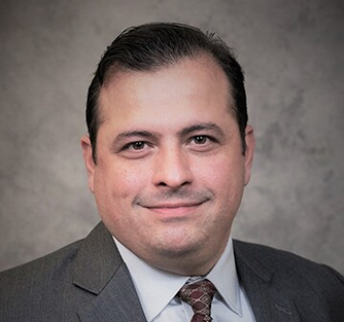
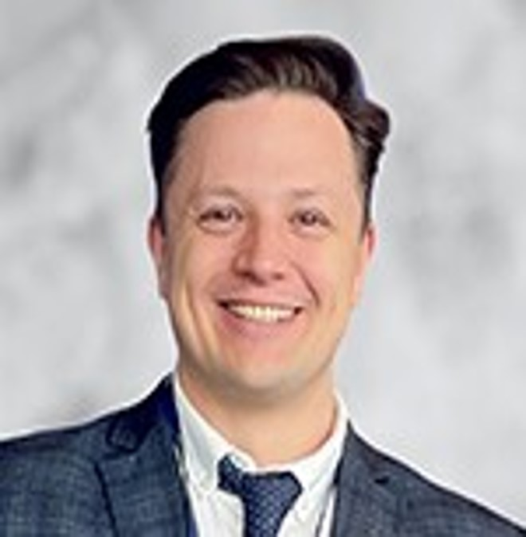
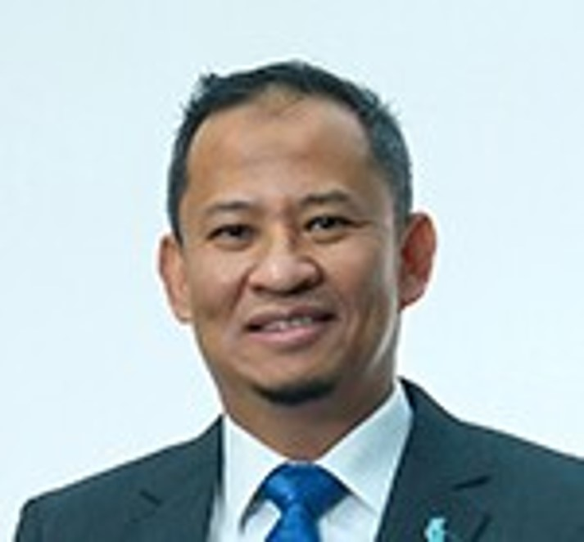
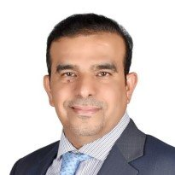
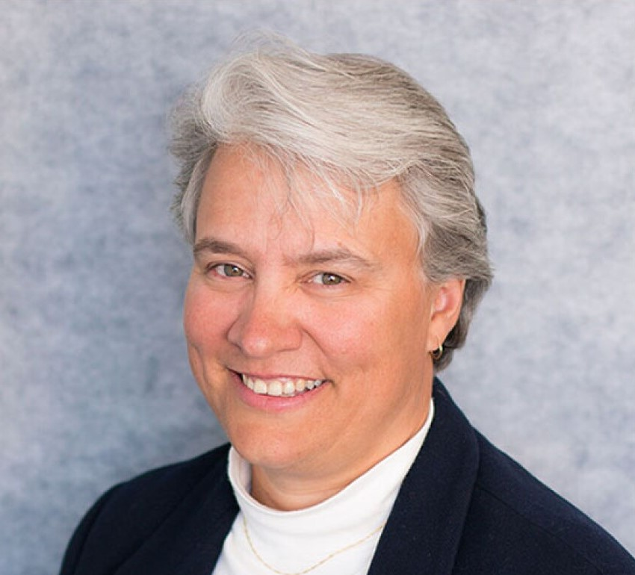
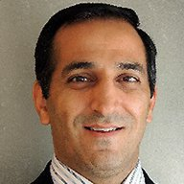
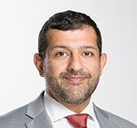

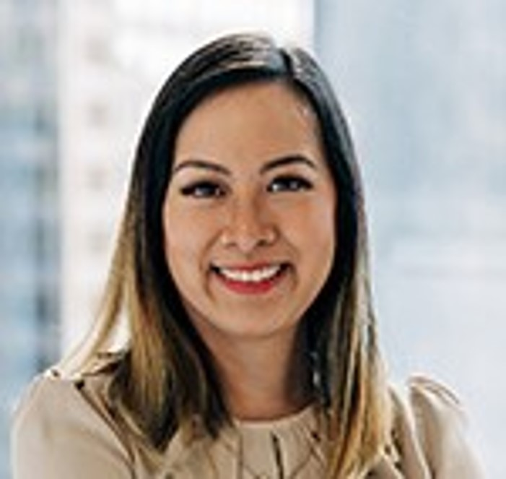
Membership & Engagement Committee – July 2025
Approved and recommended to the Board of Directors:
  the 2025 SPE International Awards committee recommendations
  the rule change to allow regional qualifying students to compete in finals, even after graduation so long as they’re current members
  renaming the ‘Management Discipline’ to ‘Asset Management Discipline’ for clarity
  a Sudan Section dues waiver for the remainder of 2025 and all of 2026
  a $10/year increase for Country Group 1 (from $130 → $140 in FY2026; $150 in FY2027)
  M&E to review dues structures, including associate/YP tiers and multi-year discounts
Other items covered included the following:
  Declined recommendation from the E&A Standing Committee to launch Energy Transition survey and will revisit after clearer objectives and potential COIs are addressed
  Positive response to ‘NextGen – Early Career Lectures’ pilot proposal presented by Susan Howes
  Ongoing review of SPE Connect and Higher Logic platform
  Nairobi Section renamed to Kenya Section; section naming policy to be reassessed
  Student dues and long-term student strategy under evaluation
  Review of FY25 expenditures; potential program freezes for FY26B/FY27
  Exploring partnership with Switch Energy Alliance to support energy education
Robert Martinez
Chair
Alexey Borisenko
Hazli Kassim
Hamad Al Marri
Rahim Masoudi
Jennifer Miskimins
Abdullatif Al Omair
Riverson Oppong
Kim Oracheski

Slide 3
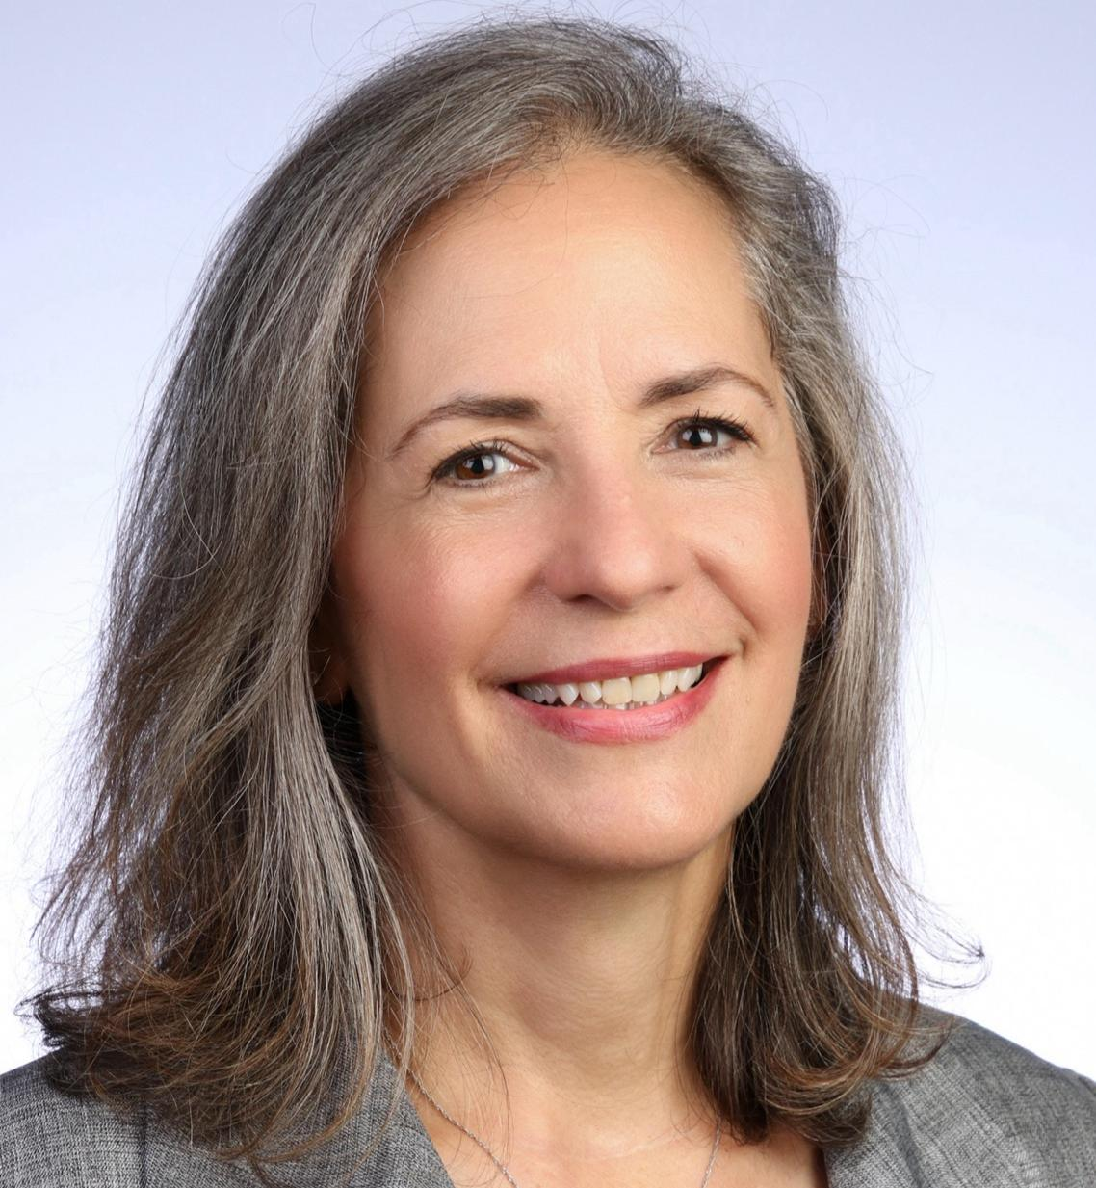
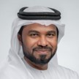
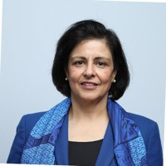
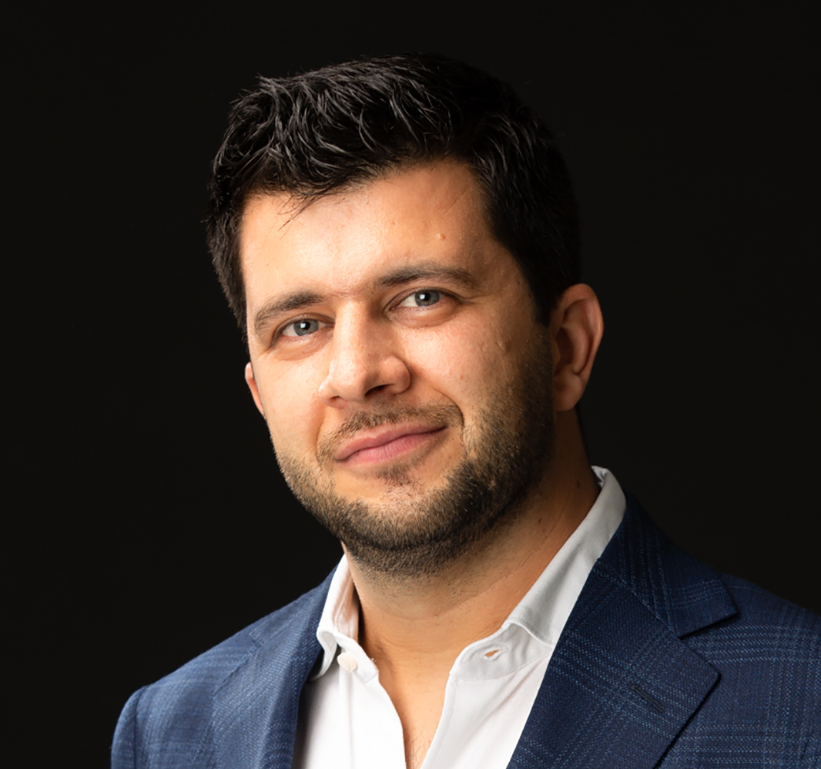
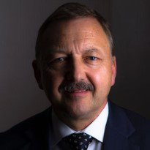
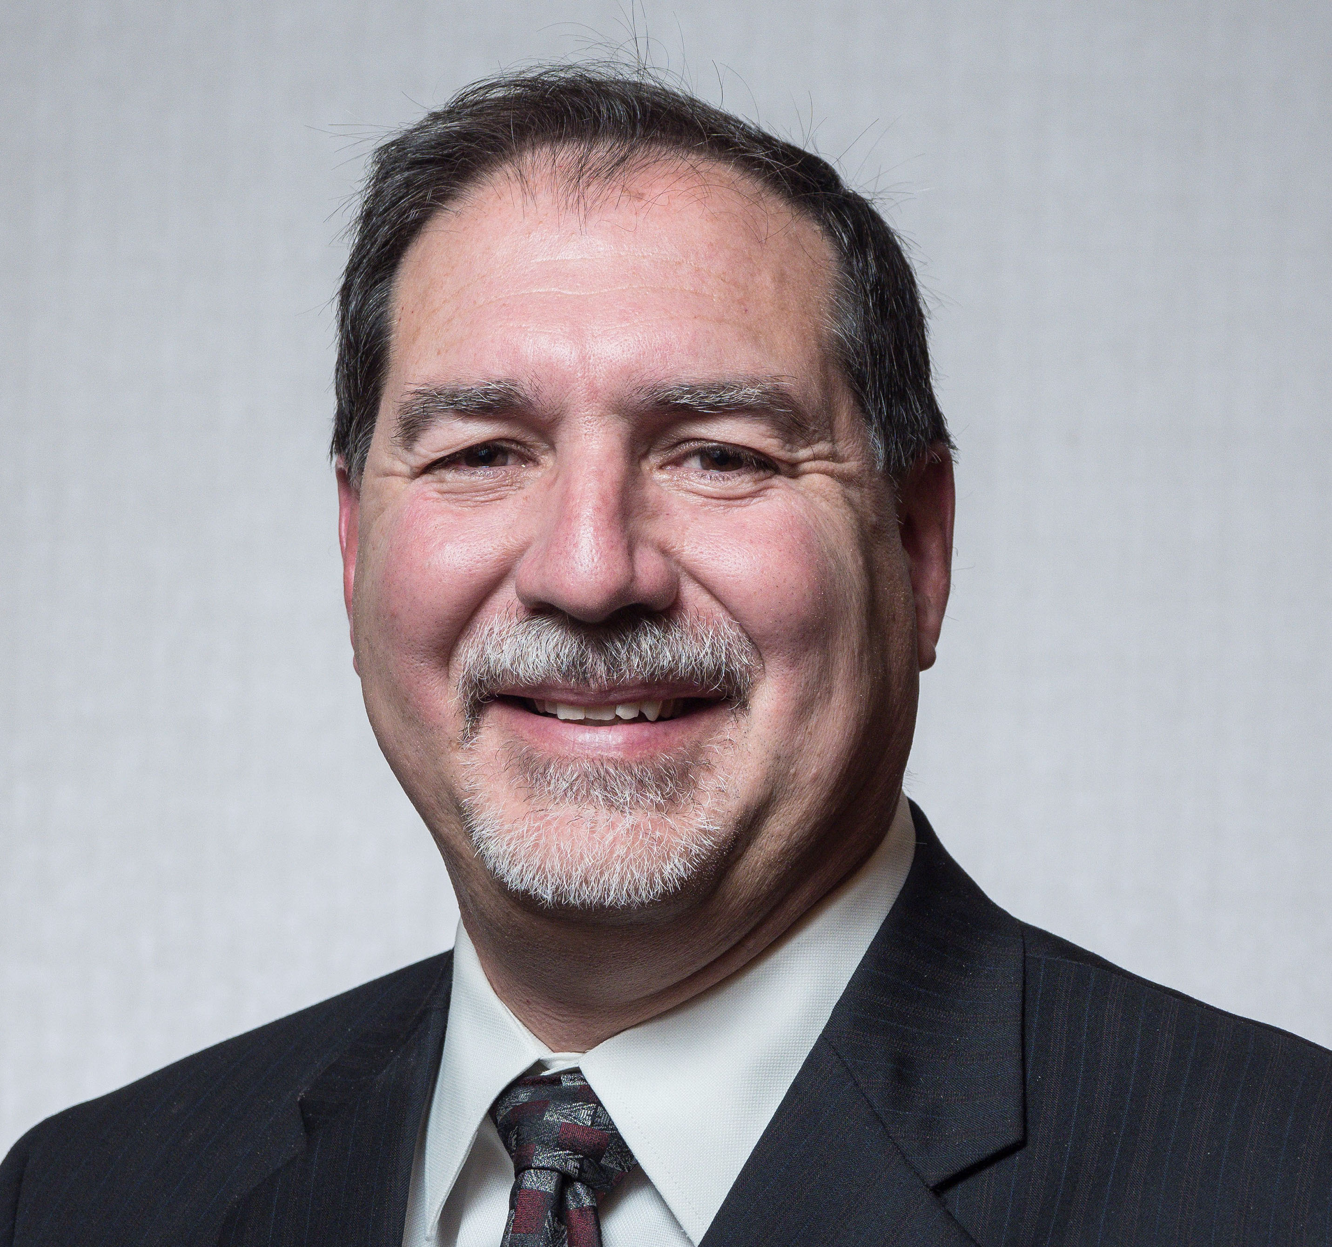

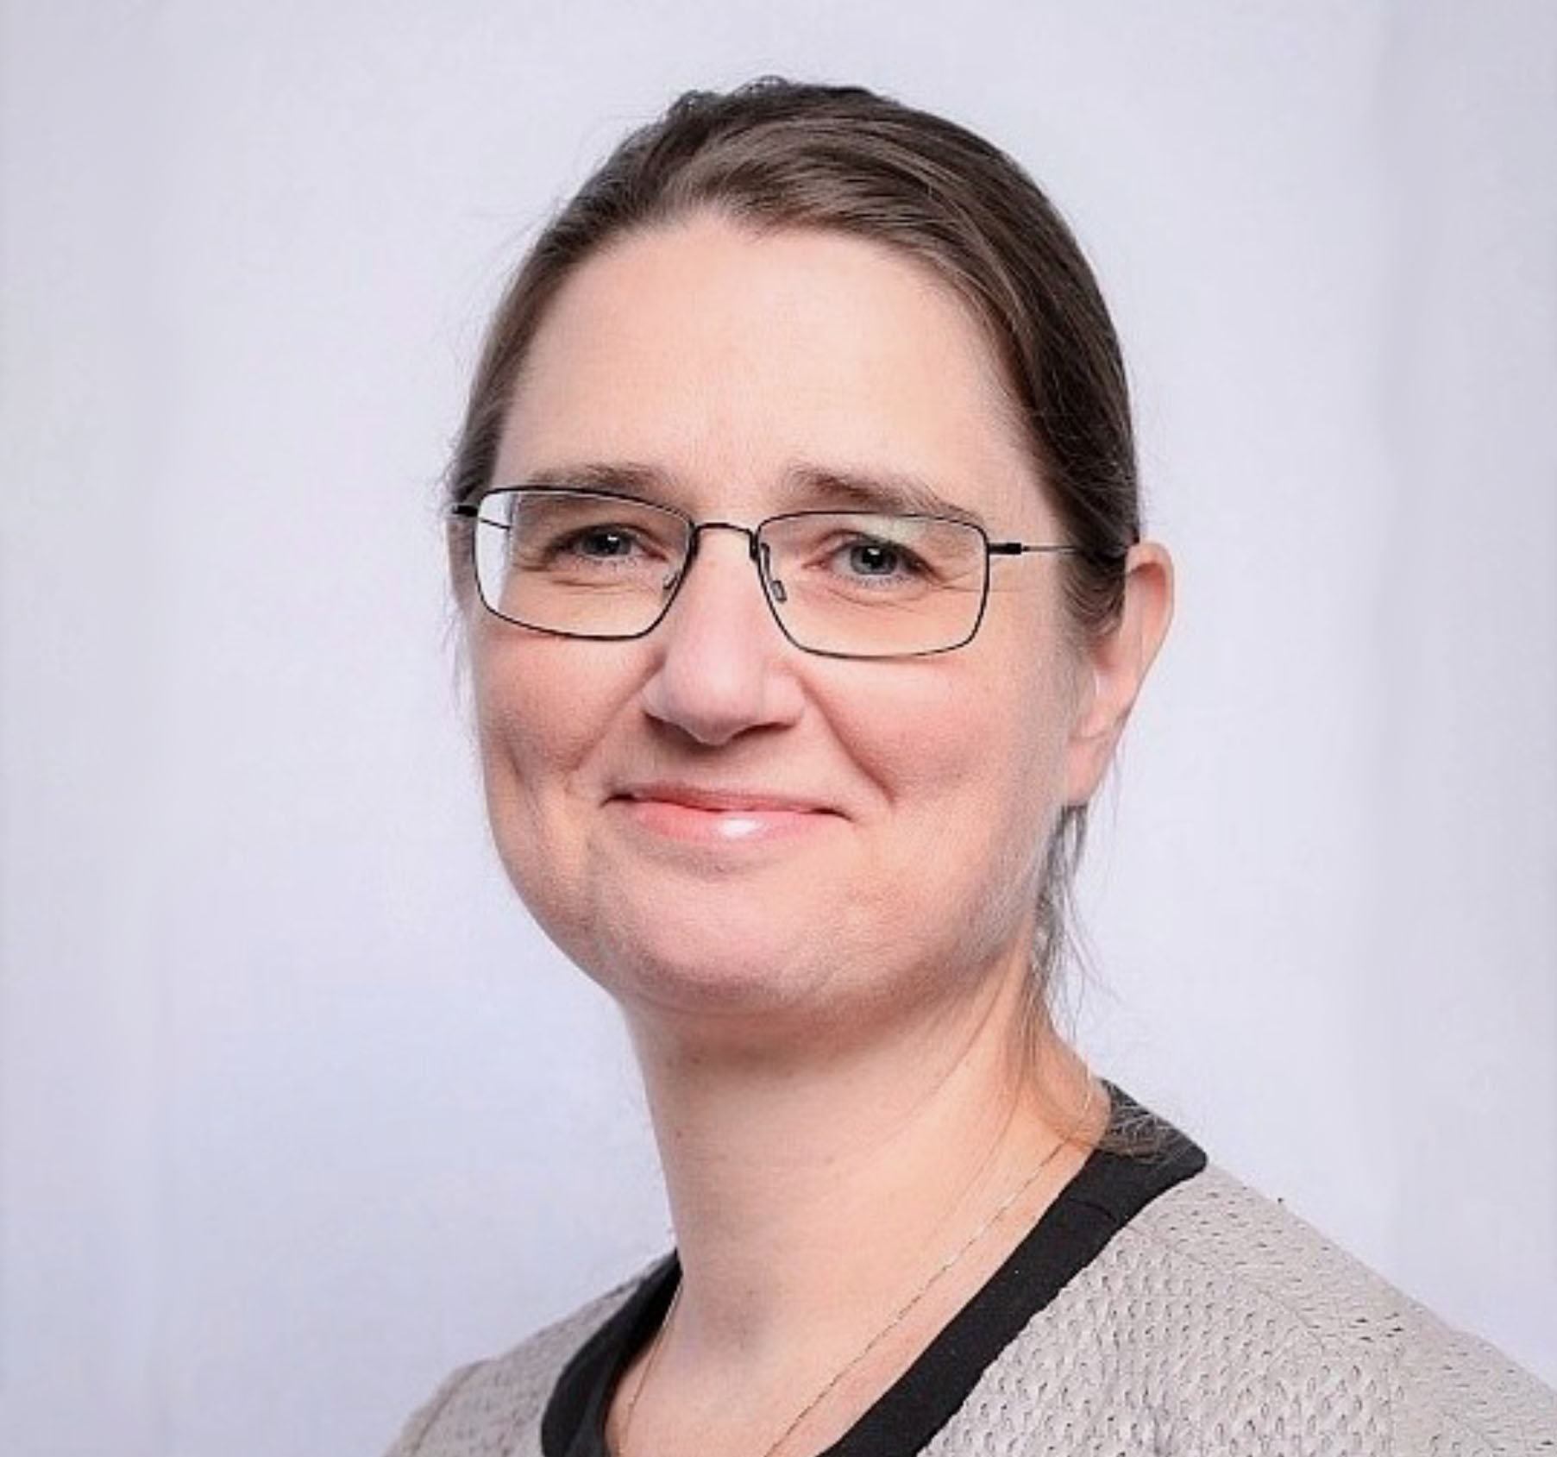
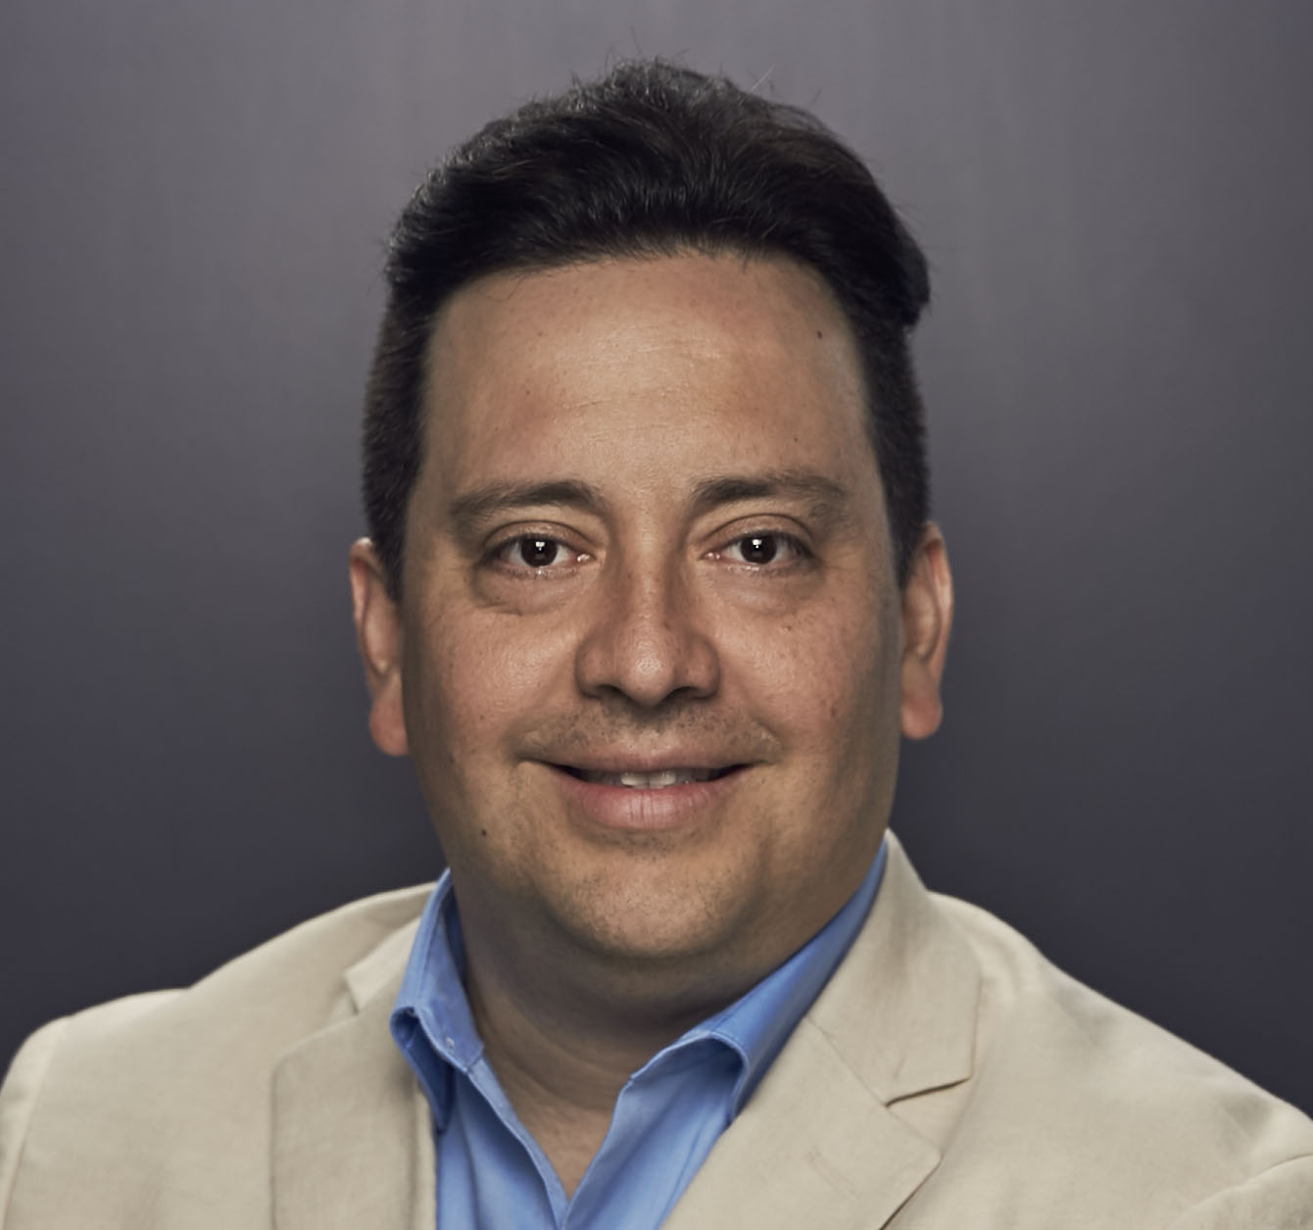
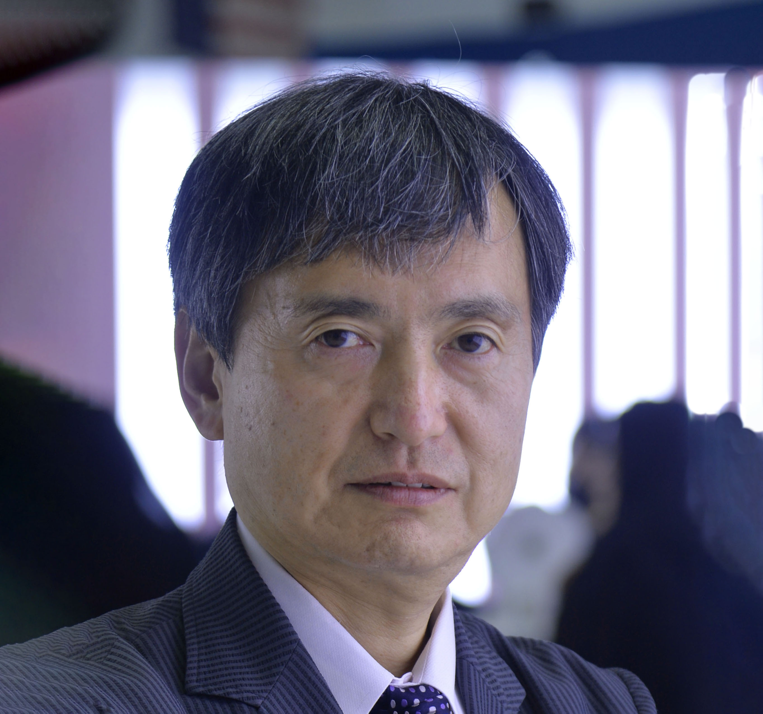
Technical Content Committee – July 2025
Approved and recommended to the Board of Directors to approve the:
  ATCE rotation locations as: Houston, Texas, followed by an international location, or as a backup, another US city, followed by an international location.
  discontinuation of Instructor-Led Training by SPEI.
  sunsetting of the HSE Now, Data Science & Digital Engineering, and Oil & Gas Facilities online publications.
  use of the following categories and definitions by SPE globally: Core – Low Carbon – New Energy
Approved ERF for the International CCUS Conference in The Netherlands
Paper Quality Workgroup recommended, and the TC Committee approved the Workgroup to move forward with:
  Committee Member Qualifications
  Formal Quality Definition Criteria Adoption
  SPE’s AI Policy Updates
Received updates on:
  ATCE 2025 Planning
  ATCE Workgroup, including ATCE 2026 and beyond
  Budget and Event Portfolio Review
  Publishing and Multimedia – outsourcing of digital sales to Naylor; pausing webinars/focusing
  on SPE Lives
  GEODE Advisory Committee
  Approval of the Program Committee exceptions for the 2026 Hydraulic Fracturing Conference and 2026 Artificial Lift Conference
  2025 TC Committee Goals
Sue Staley
Chair
Mohamed Al Marzouqi
Sushma Bhan
Pierre Emmanuelle
D-Huart
Robin Macmillan
Terry Palisch
Carlos Pedroso
Peggy Rijken
Carlos Torres
Koji Yamamoto

Slide 4
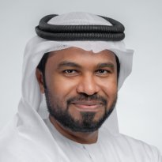

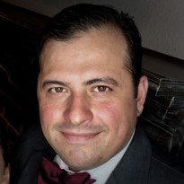

Regional Directors – July 2025
Staff Updates on April Action Items
SPE Connect Workgroup: Ongoing cost analysis of Higher Logic platform; update expected in October
Regional Data Use: Shared with RDs to promote certification programme
Regional Awards: Staff discussions underway; recommendations to come in October
Student Membership Strategy
Chevron Funding Withdrawn: No support for student memberships by 2026
Student Membership Fee: Consider aligning with professional fees by country
Programme Review: Sunset or shift student initiatives (e.g., PetroBowl, Paper Contests) to sections/chapters
Next Steps:
  Discuss student dues in M&E meeting
  Form student workgroup for strategy development
  Goal: Submit recommendations to M&E for FY2026/27 budget planning
Mohamed Al Marzouqi
Lead
Alexey Borisenko
Pierre D-Huart
Hazli Kassim
Robert Martinez
Abdullatif Al Omair
Kim Oracheski
Riverson Oppong
Carlos Pedroso
Carlos Torres
Koji Yamamoto

Slide 5

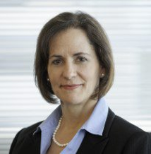
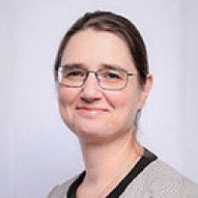
Technical Directors – July 2025
Student Engagement & Competitions
  New competition ideas (robotics, scholarships) encouraged, potentially sponsor-funded.
  Student chapter contact info to be shared with Technical Sections (TSs) by early August.
  Exploring SPE-SEG EVOLVE collaboration for mentor roles and multidisciplinary teams.
Cross-Discipline Collaboration & Innovation
  Production & Facilities: Launched CCUS mentoring with DSEA and HSES.
  Data Science & Engineering Analytics: Expanding "global collaboration" and "cross-sector alliances" (e.g., SpaceX, NVIDIA).
  Drilling: Focusing on AI/ML for data aggregation automation (reducing planning time) and safety automation (pipe handling).
  Completions: Creating AI-drafted best practice papers to lower entry barriers.
  HSES: Successful methane emissions JPT article from a forum.
  Reservoir: Joint Live Series with Completions, planned DSEA event, and global industry gap survey launched.
Integrated Reservoir Management (IRM) Proposal
  Core Idea: Position IRM as a strategic platform to integrate multi-disciplinary technical excellence (reservoir, drilling, completion, production, facilities) for greater impact.
  Concept endorsed, but clarification needed on exact nature, scope, and how it addresses existing gaps.
  Detailed review planned for interim TD meeting in mid-August.
Robin Macmillan
Lead
Hamad Al Marri
Sushma Bhan
Sue Staley
Rahim Masoudi
Peggy Rijken

Slide 6
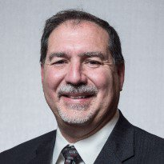

Finance Committee – July 2025
Received a preliminary look at FY26A results through June remain unchanged from May.
  SPEI is expected to have a slight loss (as compared to budget of $1.5 M surplus)
  This is due to a pullback in event revenues (registration, exhibition & sponsorship)
Staff presented a first pass on the FY2026B and FY2027 budgets:
  Expectations are for continued softness in SPE events and inflationary costs
  Professional membership also trending down ~3%
  This results in a first pass 26B & 27 budgets to be negative
Next steps are for Staff and the Board committees (Finance, M&E & TC) to work together to eliminate (or significantly reduce) this deficit.
  A hard look will be taken at all SPE programs and events, as well as costs
The Finance Committee will review/approve the final FY2026B budget and forward to the Board of Directors in September for approval.
Sale of the Richardson building remains uncertain, with minimal interest in last few months.
Terry Palisch
Chair
Olivier Houzé
Jennifer Miskimins
Hamad Al Marri
Robert Martinez
Sue Staley

Slide 7
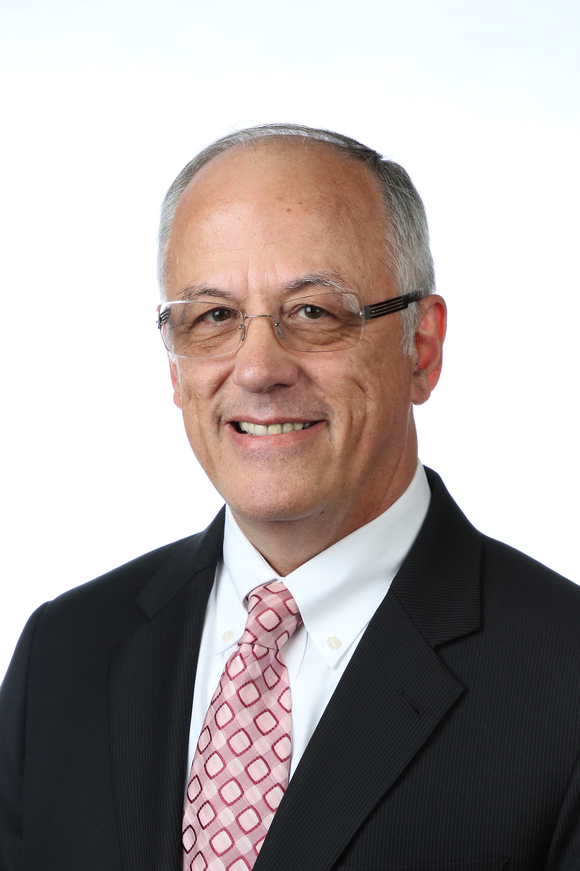
Audit Committee – July 2025
Received an update on the progress of SPE’s FY2025 financial audit conducted by RSM. Noting, no major findings have been discovered.
Reviewed SPE Section’s with asset balances exceeding $500 thousand and agreed upon procedures to ensure compliance.
Reviewed the SPE Legal Affairs Policy and areas requiring updates due to the recent change in SPE general counsel.
Hamad Al Marri
Chair
Sushma Bhan
Pierre d’Huart
Terry Palisch
Roland Moreau

