Slide 1
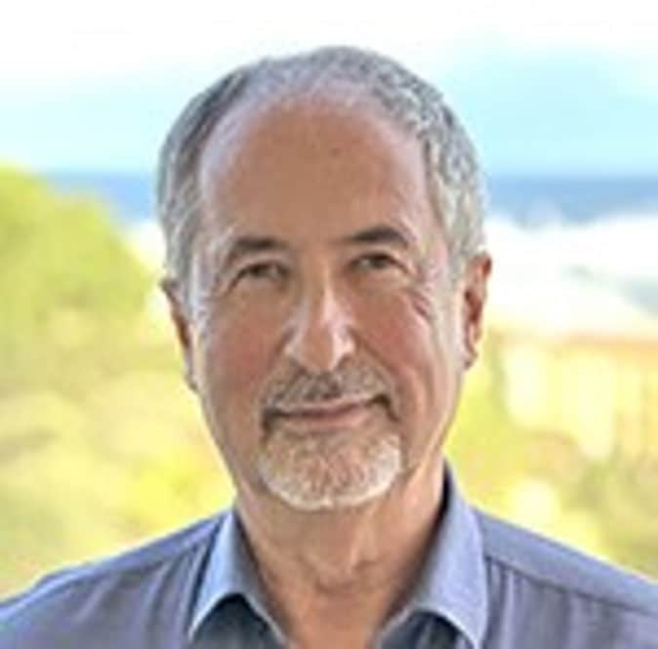
SPE Board of Directors Meeting, January 2025
Sharing highlights from the following board committees:
Membership and Engagement
Technical Content
Finance
Audit
Coordination meetings held for:
Regional Directors
Technical Directors
Please send feedback to president@spe.org
Olivier Houzé
2025 SPE President

Slide 2
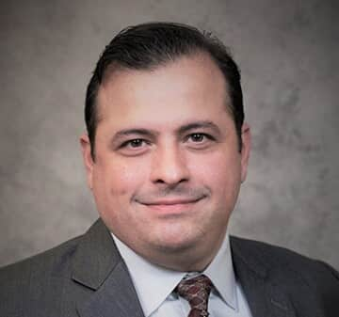
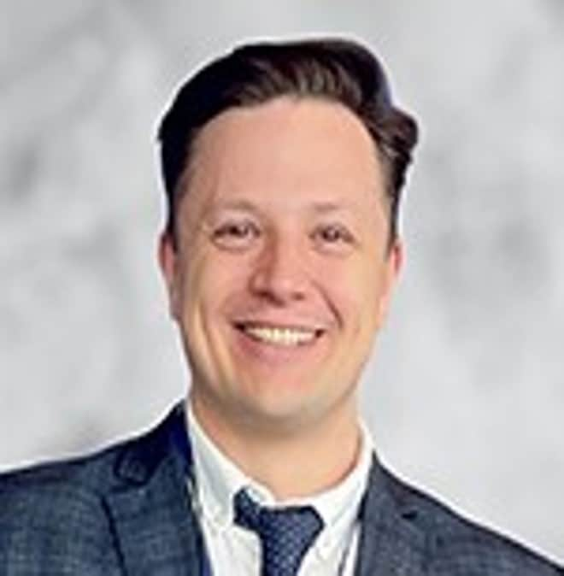
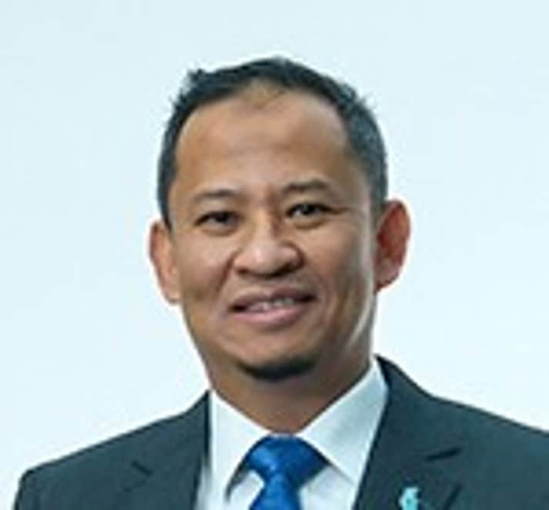
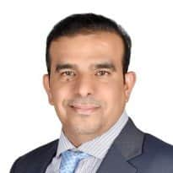
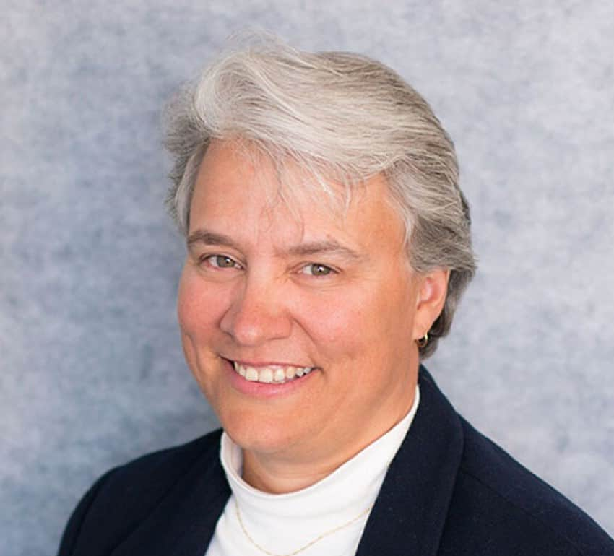
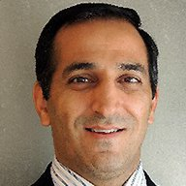
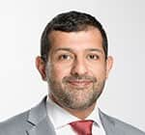
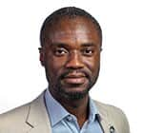
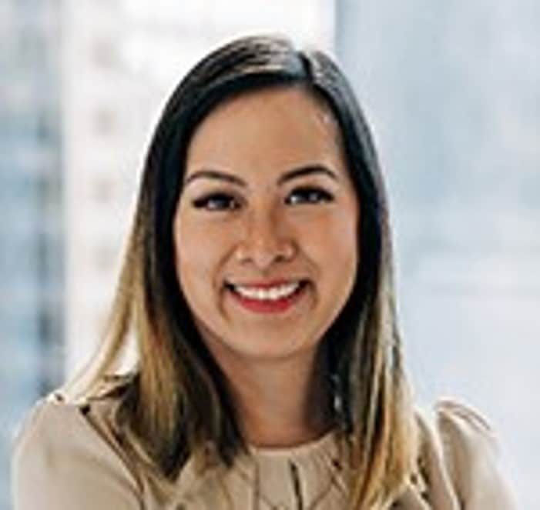
Membership & Engagement – January 2025
Approved and recommended to the Board of Directors:
The principle of a member consultation and the formation of a workgroup to explore questions and conditions.
The organization of the Petrobowl Regional Qualifiers be led by SPE Regional Activities Managers (SPE staff) to facilitate more participation in the Petrobowl championship.
Additional funding, where required, of up to $25,000USD to support visa applications for students attending the ATCE Petrobowl final. Funding is subject to the process and procedure to ensure fair distribution of funds.
Approved updates to the SPE bylaws on professional membership requirements and the special classes of senior and life members.
Received updates on the Energy4Me program and the formation of a STEM Advisory Committee.
Discussion on the committees 2025 objectives and goals, to include –
The development of social media outreach and prioritizing membership engagements through channels such as TikTok Instagram, and Telegram.
Understanding Student to Professional conversion metrics
Formalizing tasks for Youn Professionals Committee to engage YP’s and develop a strategy to best engage YP’s and prospective high school students
Received an updated on the Energy4Me program and the formation of an advisory committee to update and facilitate the programs needs.
Discussed SPE events in Russia to increase member engagement and retention.
Robert Martinez
Chair
Alexey Borisenko
Hazli Kassim
Hamad Al Marri
Rahim Masoudi
Jennifer Miskimins
Abdullatif Al Omair
Riverson Oppong
Kim Oracheski

Slide 3
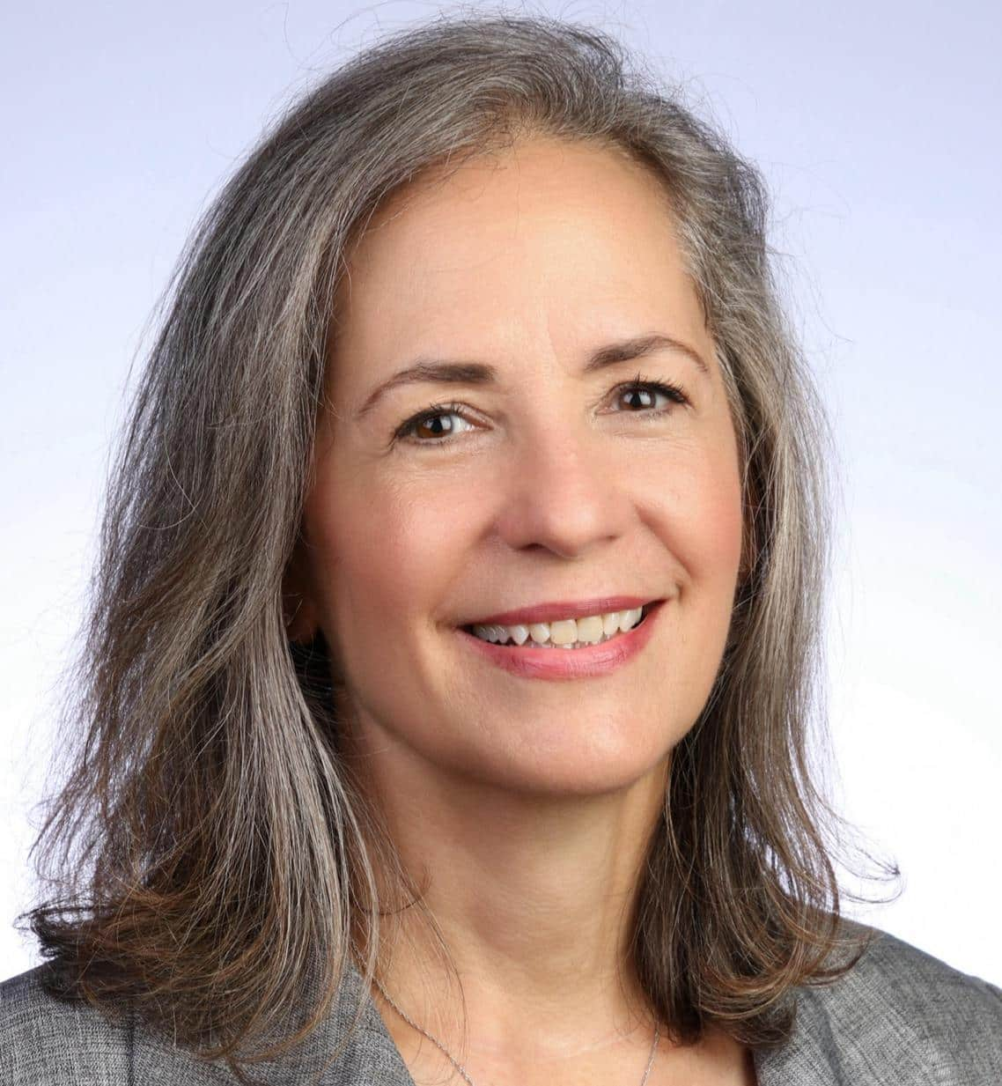
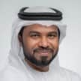
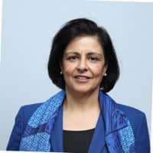
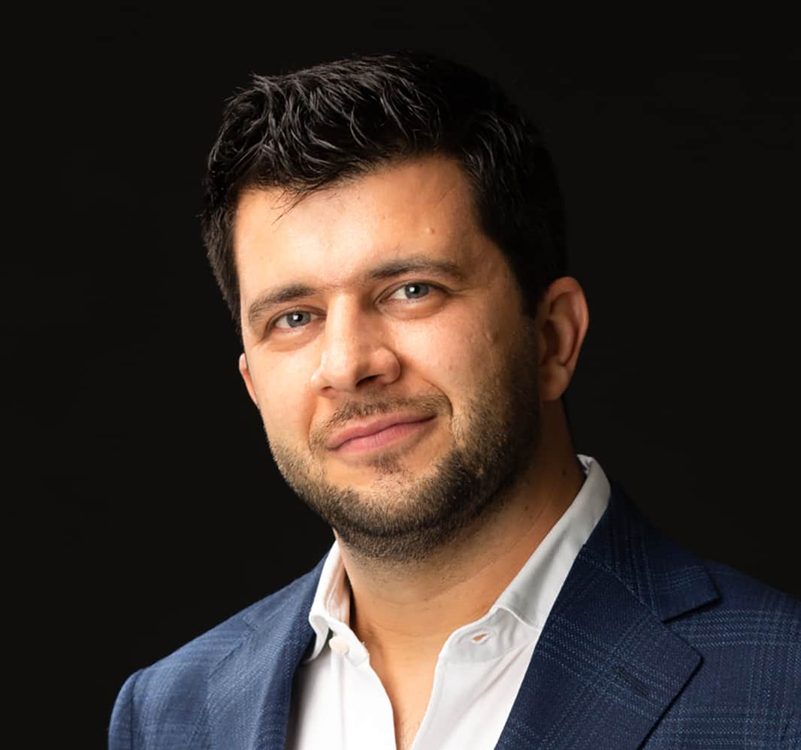
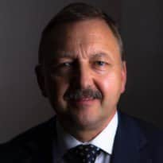
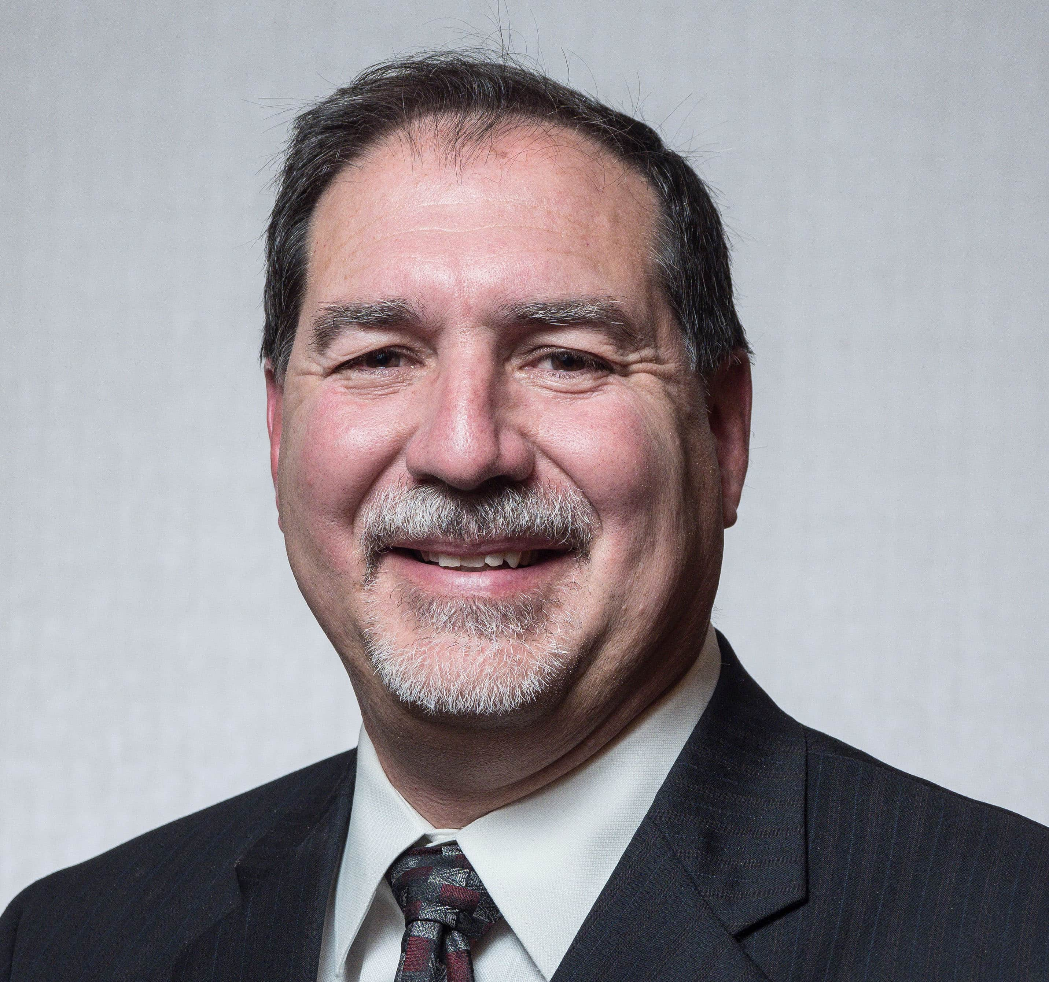
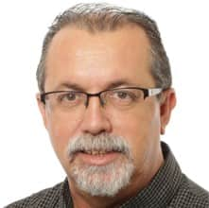
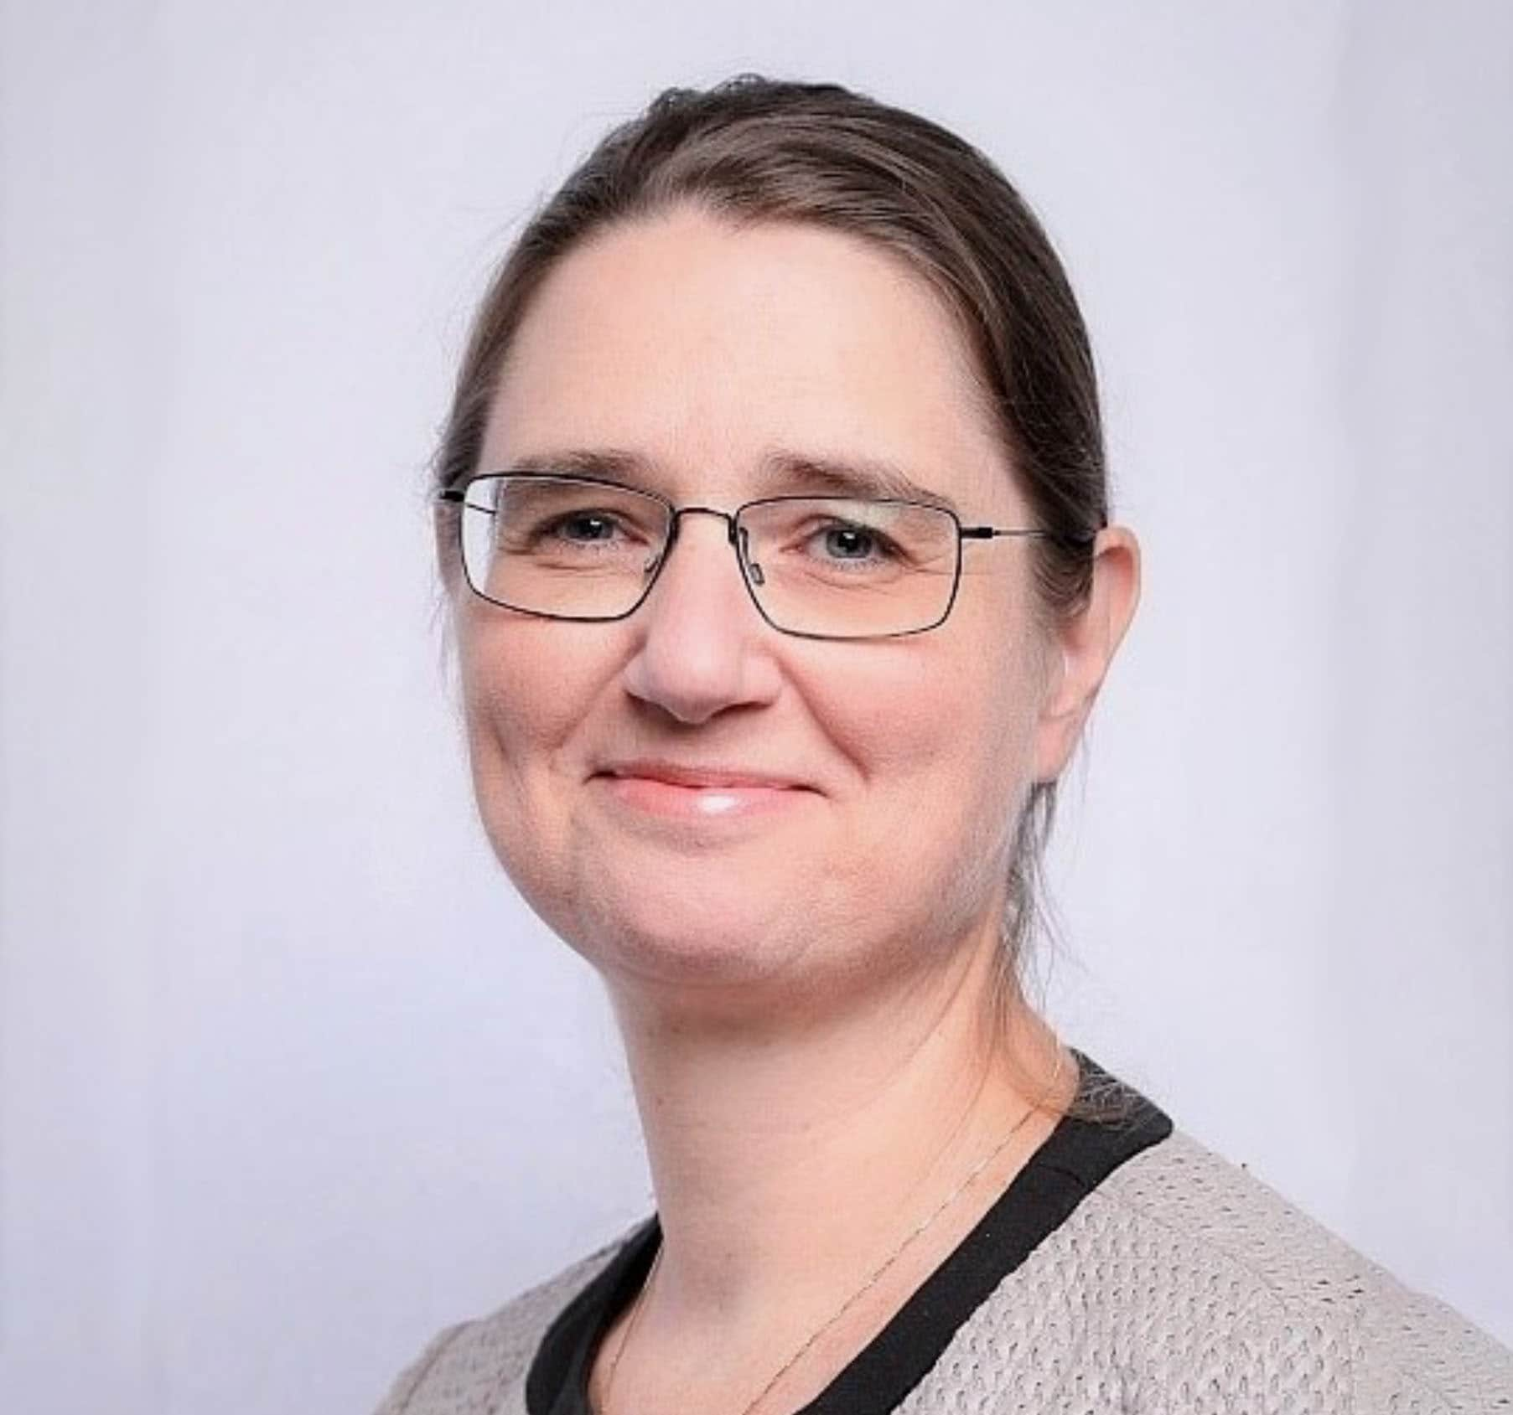
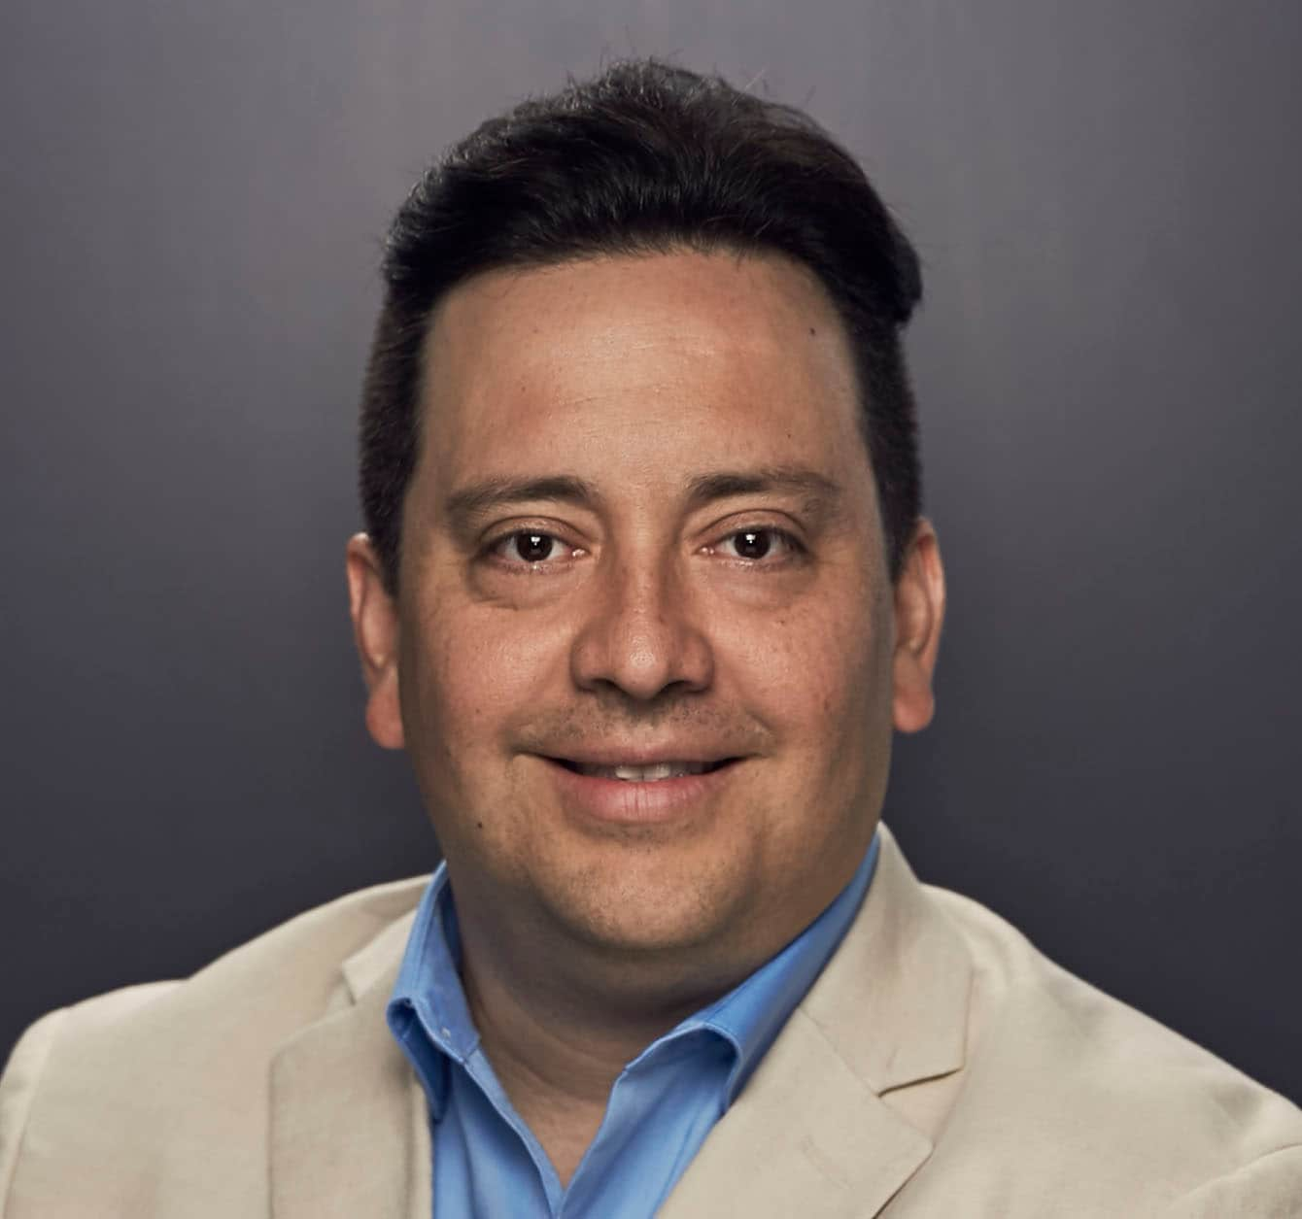
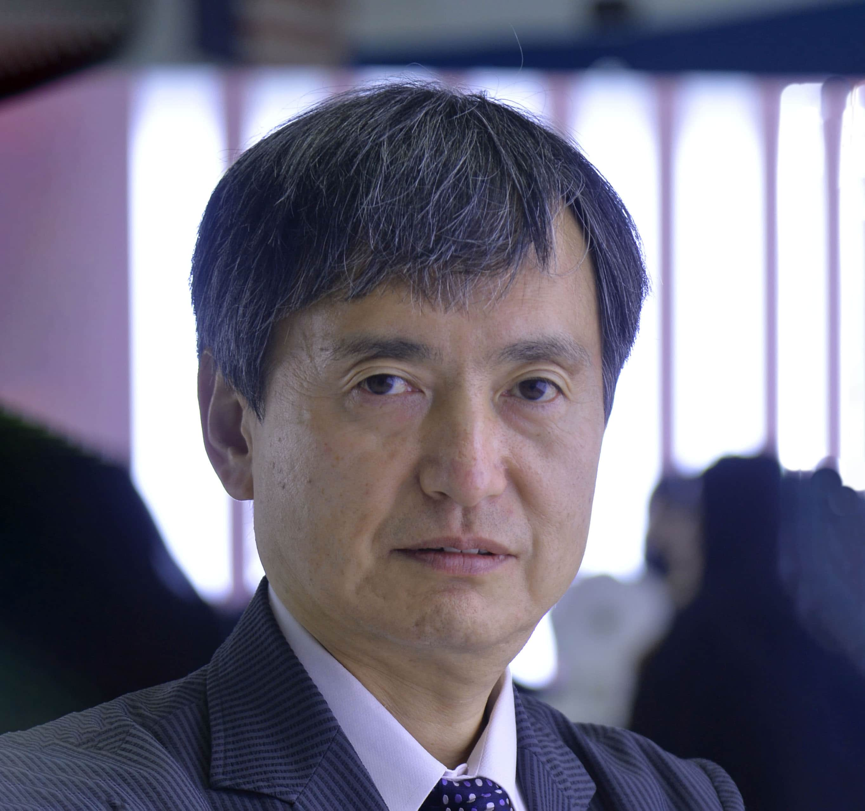
Technical Content – January 2025
Approved and recommended to the Board of Directors to approve:
the final draft for the 2025 edition, CO₂ Storage Resources Management System.
that staff can use the tagline version of the SPE logo across global marketing and communication channels where appropriate.
Approved ERFs for the SPE Symposium and Exhibition: Well Intervention and Abandonment in Kuala Lumpur, and the SPE Symposium: Waterflooding Development in Abu Dhabi.
Received updates on ATCE 2025 Planning and ATCE 2026/2027 including possible locations; the 2025 Technical Content Committee Goals; Publishing highlights, including the PetroWiki migration to OnePetro, an SPE books update and an JPT update; Member Feedback and Path Forward for the SPE Tagline; Geothermal Events and Activities (GEODE) Advisory Committee; OGRC Board Liaison Replacement Need; SPE International Health, Safety, Environment and Sustainability Conference and Exhibition; 2026 IPTC; the ATCE Workgroup and the Instructor-Led Training Courses Workgroup.
A workgroup was formed to review the Quality of Publications initiative.
A workgroup was formed to review the Ratification of Energy Transition and Climate Change Policy.
Concerning the Grant Thorton (GT) Recommendation to the Audit Committee: Term Limits for Committee Members, the Technical Content Committee stated that there is a current policy in place. The Technical Content Committee approved enforcing the Program Committee term limits as outlined in the current policy. Anyone who has served more than 6 years on a committee must be rotated off for at least one event cycle.
Concerning the Grant Thorton Observation to the Audit Committee: Blind Selection, the Technical Content Committee declined GT’s observation for blind selection. SPE’s current process works well and enhances quality.
Sue Staley
Chair
Mohamed Al Marzouqi
Sushma Bhan
Pierre Emmanuelle D-Huart
Robin Macmillan
Terry Palisch
Carlos Pedroso
Peggy Rijken
Carlos Torres
Koji Yamamoto

Slide 4

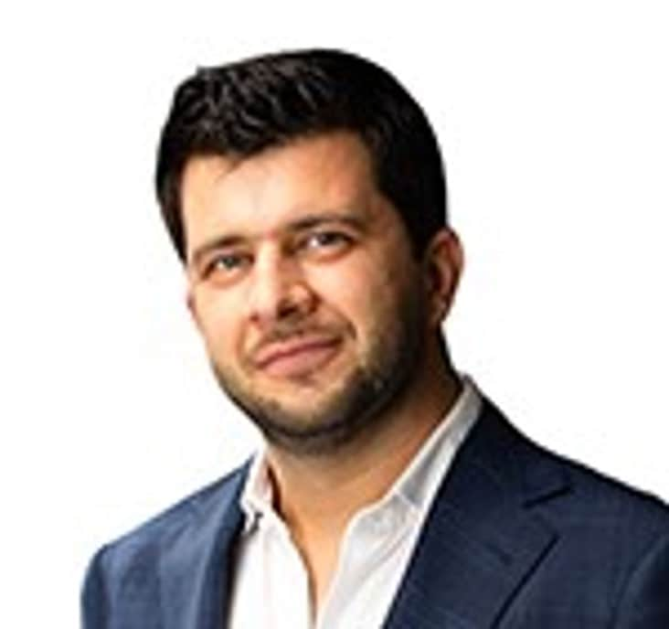
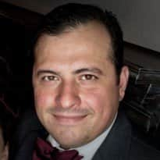
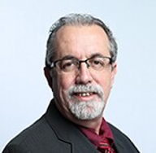
Regional Directors – January 2025
Discussion on SPE Connect and the need to revitalize the platform.
Discussion on Regional Director and Section resource and the need for SPE staff to ensure members are aware of this resource.
A review of the Regional Director onboarding process and areas to improve the process to ensure processes are followed.
The Regional Directors presented their 2024 highlights and achievements and reviewed 2025 regional objectives.
Extended conversation around the need for Regional and Technical Directors to collaborate.
Mohamed Al Marzouqi
Lead
Alexey Borisenko
Pierre D-Huart
Hazli Kassim
Robert Martinez
Abdullatif Al Omair
Kim Oracheski
Riverson Oppong
Carlos Pedroso
Carlos Torres
Koji Yamamoto

Slide 5

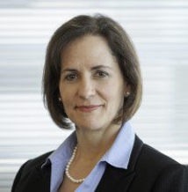

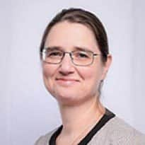
Technical Directors – January 2025
Member engagement is improving by clarifying technical disciplines and promoting section events.
Technical content is enhanced by addressing the decline in peer-reviewed papers and improving quality.
Student outreach is expanding through discipline-specific competitions and hackathons.
Key initiatives include an AI knowledge tool and a potential OSDU partnership.
Robin Macmillan
Lead
Hamad Al Marri
Sushma Bhan
Sue Staley
Rahim Masoudi
Peggy Rijken

Slide 6
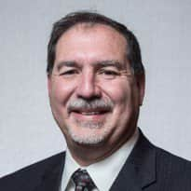

Finance – January 2025
Provided an update on SPE’s investment portfolio through December 2024 of $34.8 million.
Received an update on SPE’s FY2026A and FY2026B budget timelines and key assumptions.
FY2025: Ends 31 March 2025
FY2026A: 1 April – 30 September 2025
FY2026B: 1 October – 30 September 2026
The FY2026A/B budget cycle projects a $525 thousand surplus over the full eighteen-month period.
Received an update on the Global Sponsorship program. Confirming the interest of NOCs and next steps to engage additional companies and forming an SPE Strategic Advisory Council to support the initiative.
Received an update on marketing efforts to promote the sell of the Richardson building.
Terry Palisch
Chair
Olivier Houzé
Jennifer Miskimins
Hamad Al Marri
Robert Martinez
Sue Staley

Slide 7
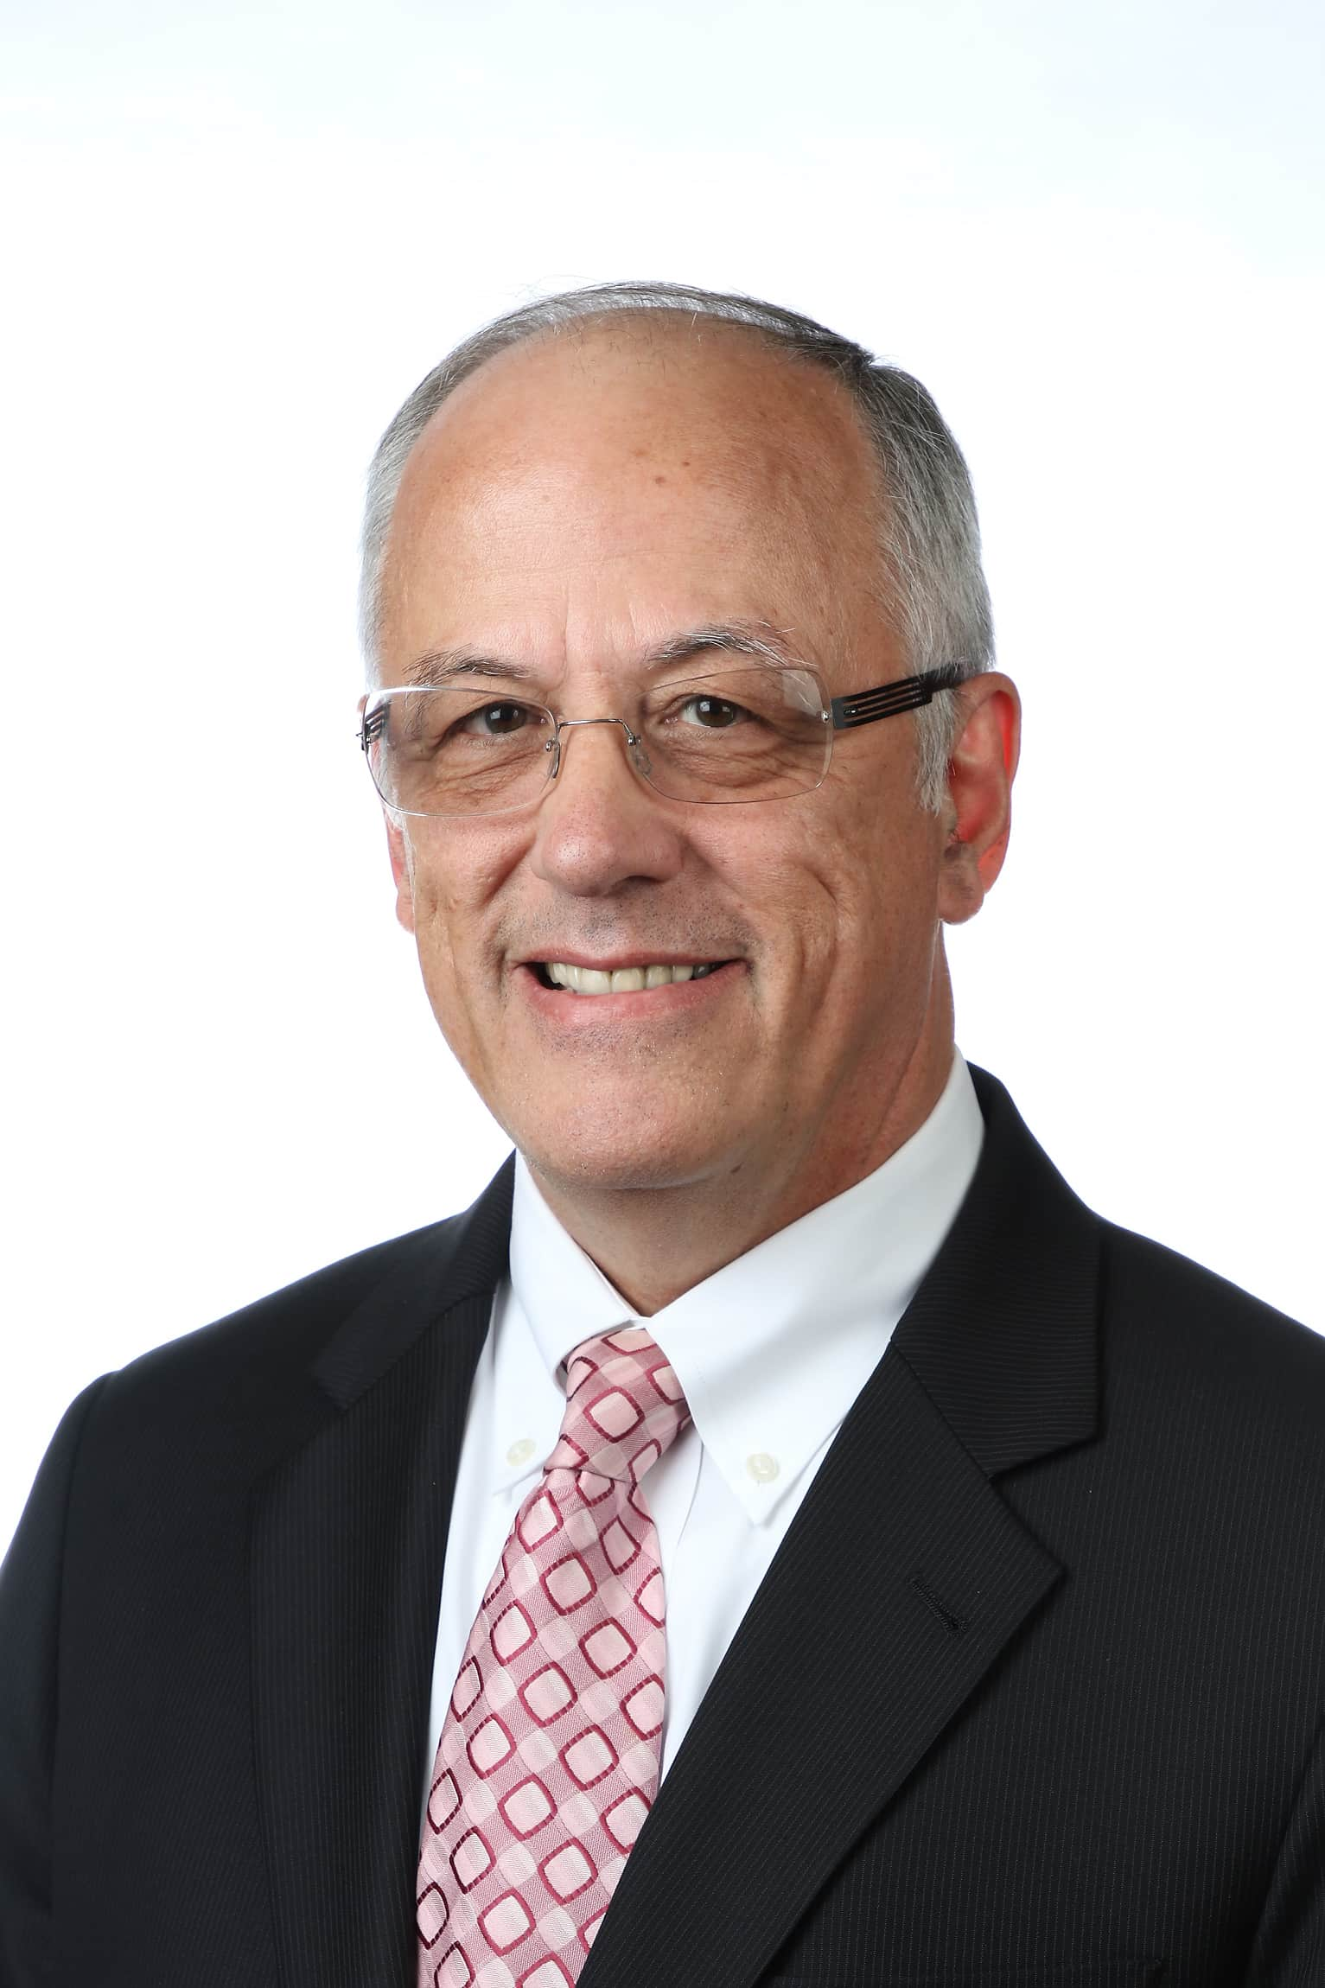
Audit – January 2025
Received an update on the Grant Thornton internal audit, with cybersecurity being the primary focus for FY2026A.
Discussed the possibility of providing Section audits for SPE Sections with more than $500 thousand in assets.
Reviewed the Code of Conduct review policy.
Hamad Al Marri
Chair
Sushma Bhan
Pierre d’Huart
Terry Palisch
Roland Moreau

