Slide 1
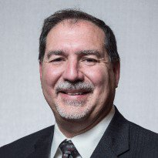
SPE Board of Directors Meeting, September 2024
Sharing highlights from the following board committees:
Membership and Engagement
Technical Content
Finance
Audit
Coordination meetings held for:
Regional Directors
Technical Directors
Please send feedback to president@spe.org
Terry Palisch
2024 SPE President

Slide 2
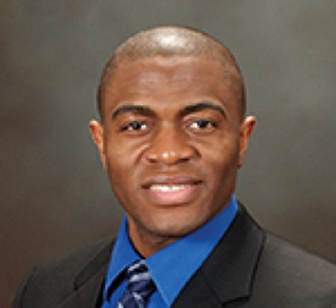
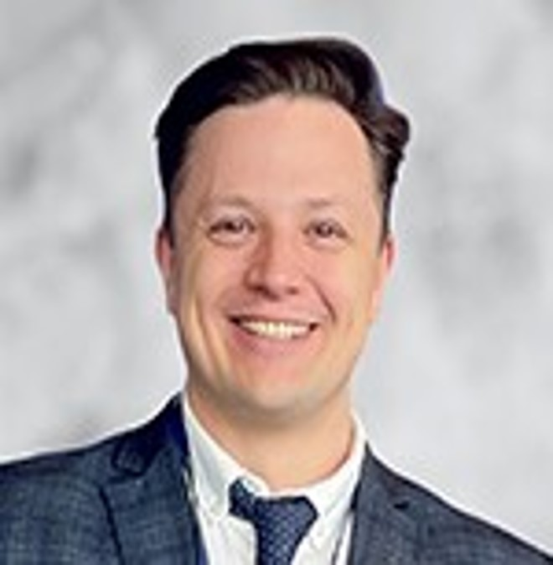
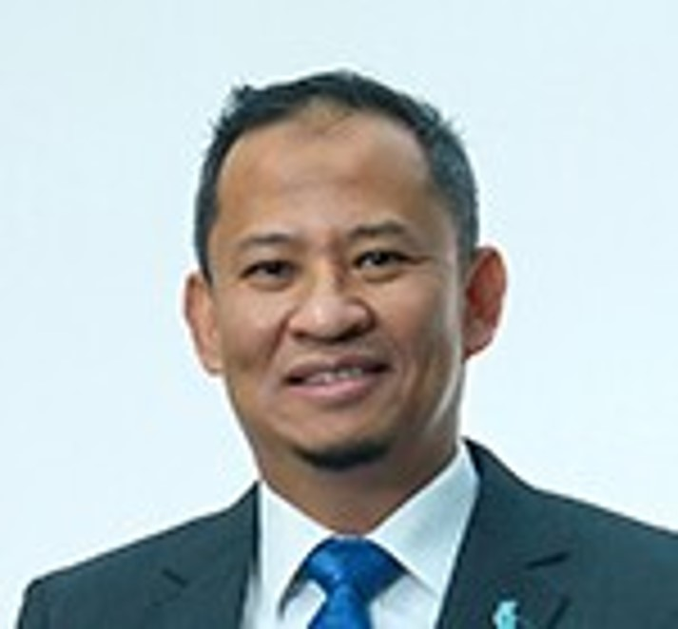
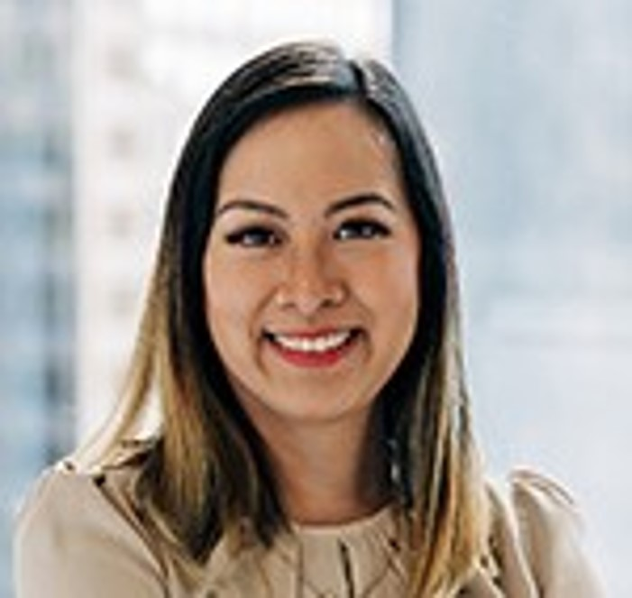
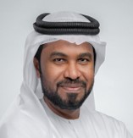

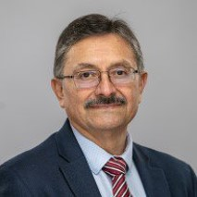
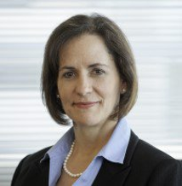

Membership & Engagement – September 2024
Approved and recommended to the Board of Directors:
The 2025 dues waiver for the Central Ukraine Section.
An updated Nomination Policy requirement that Board Members cannot serve as section officers or official advisors during their three-year term and must resign from any active section officer or advisor position as soon as their tenure commences.
Amended wording to the SPE Bylaws nominating committee under Article XII.
Amended wording to the SPE Bylaws membership under Article IV, Section 4.
Received updates on the Energy4Me program and the formation of a STEM Advisory Committee.
Discussion on the standing committee formed to review criteria for the SPE bylaws membership section.
Reviewed survey questions on the student paper contest development.
Received annual reports from the Engineering and Professionalism and Distinguished Lecturer standing committees.
Reviewed outstanding items to be moved to the 2025 roadmap and welcomed the incoming M&E Committee members.
Simeon Eburi
Chair
Alexey Borisenko
Hazli Kassim
Kim Oracheski
Mohamed Al-Marzouqui
Olivier Houzé
Pierre Emmanuelle
D’Huart
Rodolfo Camacho
Sue Staley

Slide 3
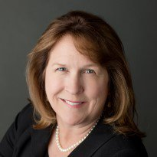
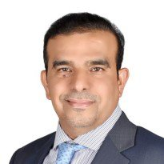
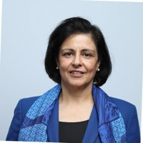
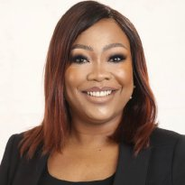
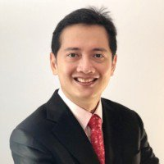
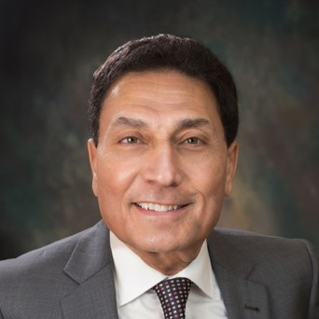
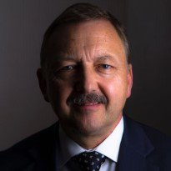
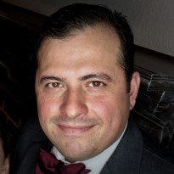

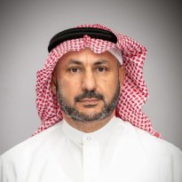
Technical Content – September 2024
Approved and recommended to the Board of Directors:
the confirmation that JPT’s primary objective remains to serve SPE’s membership.
the elimination of the monthly PDF and digital flipbook and reallocate funds to enhance the online experience, including monthly content, of jpt.spe.org.
that the “IOR and EOR Terminology Clarifications and Recommendations” Technical Report be moved to production and publication.
the “Guidelines for Committee Use of AI Assistants During SPE Committee Meetings.”
Received updates on ATCE 2025 Planning; SPE International HSE and Sustainability Conference and Exhibition; Geothermal Events and Activities (GEODE) Advisory Committee; 2024 SPE Energy Transition Symposium; the Strategic Plan; the Staff Hourly Billing Rate; and the Instructor-Led Training Courses Workgroup.
A work group was formed to review ATCE features and consider enhancements.
Within “Other Business,” the topics from the Audit Committee meeting of event committee term limits and a blind selection process were discussed. These topics will be further discussed at the January and April Technical Content Committee meetings.
Reviewed committee goals and handover documents for 2025 TC leadesrhip.
Received annual reports from the:
Standing Committees - Forum Series Coordinating Committee; Oil and Gas Reserves Committee; and PetroWiki Committee
Flagship Event Committee Reports - International Petroleum Technology Conference (IPTC) ; SPE Hydraulic Fracturing Technology Conference (HFTC); Offshore Technology Conference (OTC); SPE Annual Technical Conference and Exhibition (ATCE) and Unconventional Resources Technical Conference (URTeC.
Karen Olson
Hamad Al-Marri
Sushma Bhan
Oghogho Effiom
Henricus Herwin
Med Kamal
Robin Macmillan
Robert Martinez
Carlos Pedroso
Hisham Zubari

Slide 4
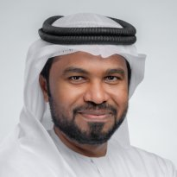
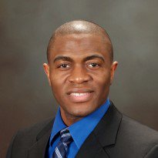

Regional Directors – September 2024
Staff presented SPE’s Energy Stream and the its ability to promote Sections and Chapters, as well as utilizing the platform to promote regional specific industry activities.
Discussion on the Awards Program and opportunities to improve the process, including: encouraging Sections to form their own committees, providing data to judging committees about previous winners, and looking into how the number of awards via the membership demographics within a region.
Staff provided an overview of SPE Connect and discussed the platform’s ability to engage sections and access or promote information on regional events.
Outgoing Regional Directors reviewed their three-year tenure on the Board.
Mohamed Al Marzouqi
Simeon Eburi
Oghogho Effiom
Henricus Herwin
Hazli Kassim
Robert Martinez
Pierre Emmanuelle
D-Huart
Carlos Pedroso
Kim Oracheski
Alexey Borisenko
Hisham Zubari
Lead

Slide 5
Technical Directors – September 2024
Received updates from all TDs on global activity. Including the recent International HSES Conference & Exhibition in Abu Dhabi.
Discussed taxonomy on the PetroWiki platform.
Reviewed the TD travel policy and received clarities on allowable spending whilst ensuring adequate representation is achieved among all disciplines.
Outgoing Technical Directors reviewed their three-year tenure on the Board.
Robin Macmillan
Lead
Hamad Al Marri
Sushma Bhan
Sue Staley
Rodolfo Camacho
Karen Olson

Slide 6
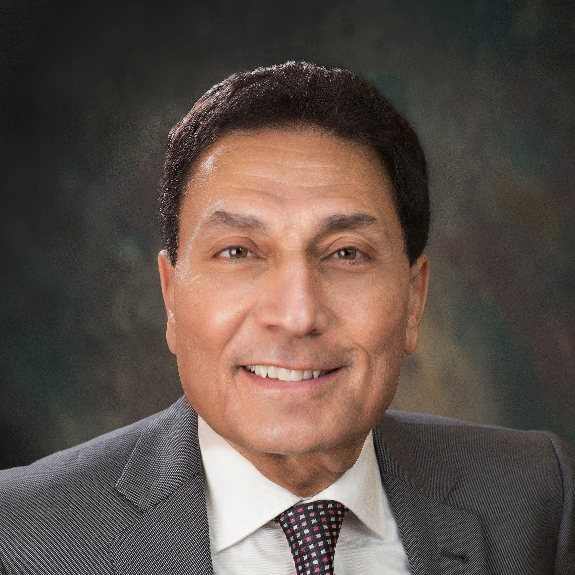
Finance – September 2024
Provided an update on SPE’s investment portfolio through August 2024 of $34.6 million.
SPE’s YTD return is 11.26% net of fees, policy benchmark 10.72%
Received an update on SPE’s Financial Year 2024 ( April 1, 2023 – March 31, 2024) financial outcome.
Operating loss of $3.6 million compared to the budget surplus of $200 thousand
Total net assets of $52.1 million as of 21 March 2024
Received an update on SPE’s FY2025 (April 1, 2024 – March 31, 2025) showing a net surplus as of 31 August 2024 of $1.5 million.
Received an update on the FY2025B, FY2026, and FY2027 budget timelines.
FY2025B: April 1, 2025 to September 20, 2025
FY2026: October 1, 2025 to September 30, 2026
FY2027: October 1, 2026 to September 30, 2027
Med Kamal
Chair
Terry Palisch
Olivier Houzé
Karen Olson
Simeon Eburi
Oghogho Effiom

Slide 7
Audit – September 2024
Approved and recommended to the Board:
SPE staff Whistleblower Policy
FY2024 RSM conducted external audit
Received an update on the Grant Thornton internal audit findings, including current best practices.
Reviewed the SPE Conduct Review committee’s current practices and proposed changes to be workshopped during the next audit committee meeting.
Oghogho Effiom
Chair
Med Kamal
Robin Macmillan
Simeon Eburi

