Slide 1
Notes:
This slide template is for School aged students (pre-University)

Slide 2
Guidance (FOR SPEAKER) DELETE SLIDE WHEN IN USE What is the Ambassador Lecturer Program? The Ambassador Lecturer Program is where a young professional member of SPE visits an SPE Chapter, a University or higher level School to deliver a 30-45 min inspiring and informative presentation to students aiming to join the industry. YPs share their own experiences, advice and relevant updated in the industry to help Students prepare for a successful career. Do I have to use these slides? No, these slides are designed to be a resource to help SPE facts and industry figures. You are very welcome to start your own slides, add and remove slides or use new images as you see fit. It’s you the students want to hear from about being part of the industry. All of the following slides are completely optional. Look out for RED TEXT where information should be removed before presenting! Is there any other advice available for public speaking? Yes, on the ALP resources webpage we have presentation guides and guides to help you set up your presentation and connect with local Schools and Universities. If you cannot access this email alp@spe.org for more information. *** Once completed submit your feedback online so we can record your visit. ***
Notes:
Further guidance – consider inserting pictures throughout this presentation of you in the field, at work, at Uni – students love photos and getting to see evidence of what you’re talking about.

Slide 3
Your Name Company & Position
Your role in SPE,
SPE Section Affiliation
Notes:
Add any interesting or exciting photos which show your role in the industry, when explaining your role try to include what you do on a day to day basis.

Slide 4
Who am I?
My background
Where I come from
My university
My past and current jobs
More personal details that may be interesting to the audience
Notes:
Personalise to you. Consider putting in things like your interests, hobbies, what were your favourite subjects at school – things the students can relate to.

Slide 5
To talk about…
Why am I here?
My career in the Energy Industry, what its really like to work in oil and gas.
Our industry, its challenges and future projections
What is SPE
Career advice (optional)
Anything else you would like to know more of or are curious about
Notes:
Brief overview - the objectives of an ALP visit, amend as you add or remove slides

Slide 6
What do I do?
Amend the details below to reflect you, add pictures etc.
Your job title your organization and what area of the industry you are in
A life in the day of… describe what you do on a typical day in your job
What choices did you make throughout your education and career to get to where you are today, eg school subjects, degree choice etc.
Notes:
Personalise to you – all of these are suggestions and you should tailor to suit
Describe your job title and what area of the industry you are in
A life in the day of… describe what you do on a typical day in your job
What choices did you make throughout your education and career to get to where you are today, eg school subjects, degree choice etc.

Slide 7
Why do I do it?
Amend the details below to reflect you, add pictures etc.
What interested you about this area of the industry
What do you love most about your job? Talk about benefits other than pay/salary such as travel opportunities (for example)
Maybe what would you have done differently to get started in O&G..?
Notes:
Personalise to you – all of these are suggestions and you should tailor to suit
What interested you about this area of the industry
What do you love most about your job? Talk about benefits other than pay/salary such as travel opportunities (for example)
Maybe what would you have done differently..?

Slide 8
General Industry Technology
Here you can talk about projects you have worked on or currently working and showcase new innovations in your work
Notes:
Optional – think about what’s been in the news recently or a topic of discussion the students may have on their minds while watching your presentation. Start of by addressing this so they begin with open minds.

Slide 9
Where am I going?
This slide should describe where you want to be in the next 5 or 10 years on a professional level not only within your company, but also within SPE.
The slide may also include elements on home/work life – remember, it is important to connect with the audience. For example: I am looking forward to working a more regular schedule, so I can coach youth soccer in the evening
Notes:
Personalise to you – all of these are suggestions and you should tailor to suit.

Slide 10
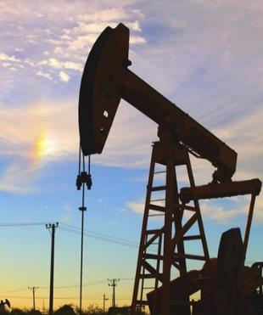
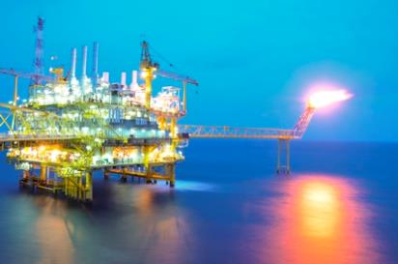
Oil and Gas
Notes:
These next slides will discuss the industry in general

Slide 11
What’s happening in the industry today?
In E&P there are several key factors that are regularly discussed which effect the industry in a big way. Our industry tackles these head on to ensure a secure energy market for the future.
Market volatility (price of oil and job security)
Increasing efficiency and unconventional resources
Environmental impact and sustainability
Public perception and changing regulations
Increased innovation and use of technology and data
Notes:
Discuss impacts on each point, you can describe how these issues have impacted your job specifically if possible.

Slide 12
Grand Challenges Facing the E&P Industry
SPE has identified specific challenges which can be resolved to help support wider industry concerns. SPE has teams of experts who research and promote technical development in these areas to help;
Higher Resolution Subsurface Imaging
Challenges in Reusing Produced Water
In-Situ Molecular Manipulation
Increasing Hydrocarbon Recovery Factors
Carbon Capture and Sequestration
Notes:
You can briefly discuss each point and its impact on the wider industry, information on this is available at http://www.spe.org/industry/globalchallenges.php - This slide can be removed for School Level Students

Slide 13
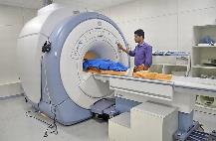
Why do we do it?
The reason O&G professionals do all this is because of all the benefits a strong energy industry can bring!
Making reliable
energy available to all…
increases what vital services society can provide…
while keeping people
connected…
because of amazing engineers!
Engineers are the worlds problem solvers, and they allow for the services and products we often take for granted. As new generations become more reliant on energy and plastics our role grows more important!
Notes:
Explore what the oil and gas industry means to you and what you want to achieve as an oil and gas engineer.

Slide 14
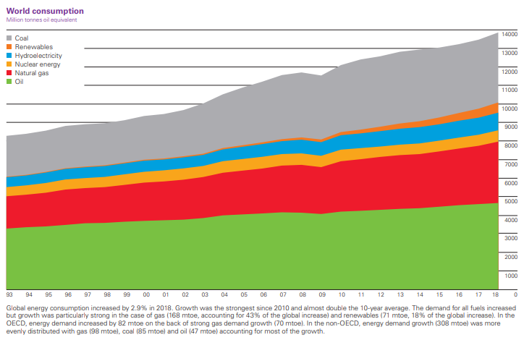
Current Trends in the Industry – part 1
World Energy Consumption 1993-2018
BP Statistical Review of World Energy 2019
Notes:
Explain what this graph means, highlight trends in growing renewables and decreases in coal. However oil and gas still makes up over half of all energy consumption which continues to increase as population, economic development and energy consumption continues to grow.

Slide 15
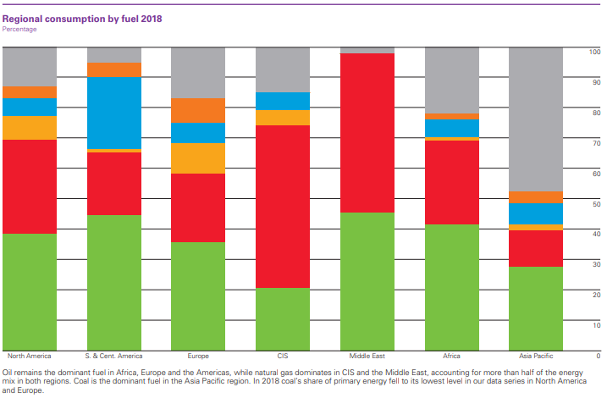
Current Trends in the Industry – part 2
Regional Energy Consumption 2018
BP Statistical Review of World Energy 2019
Notes:
Oil remains the dominant fuel in Africa and the Americas, while natural gas dominates in Europe & Eurasia and the Middle East. Coal is the dominant fuel in the Asia Pacific region, accounting for 49% of regional energy consumption. In 2016, coal’s share of primary energy fell to its lowest level in our data series in North America, Europe & Eurasia and Africa.

Slide 16
Current Trends in the Industry – part 3
What does all this mean?
More than 70% of the world’s current energy needs are currently met through fossil fuels such as coal, oil and natural gas. Demand for energy is projected to increase primarily in developing countries that are beginning to use more electricity and develop technologically.
Does this mean we will run out of fossil fuels?
Not for a very long time, the industry continues to get more efficient and make the most of natural resources. But as a result of growing technological demands, expansion of all economic energy sources are will be needed: coal, nuclear, biomass, other renewables, unconventional oil and natural gas will all be part of the solution.
Notes:
http://www.energy4me.org/energy-facts/energy-sustainability/

Slide 17
What opportunities exist
Our Industry is multidisciplinary…
Subsurface specialist
Seismologists
Geochemists
Physicists, Chemists and Biologists
Management
Software Developers/IT
HR, Legal and Support
Mathematicians
Petroleum Engineers
Well Engineers
Petrophysical and Geological Engineers
Reservoir Engineers
Production Engineers
Finance
Notes:
Feel free to add to this, explore where your role fits into this.

Slide 18
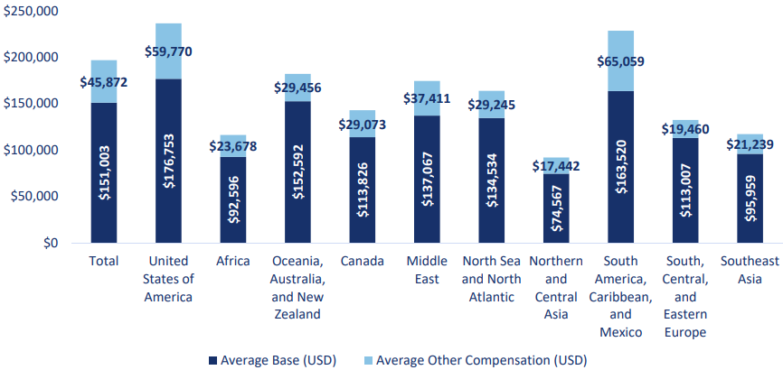
Working in the industry
Base Pay and Other Compensation by Work Region
Source: 2018 SPE Membership Salary Survey

Slide 19
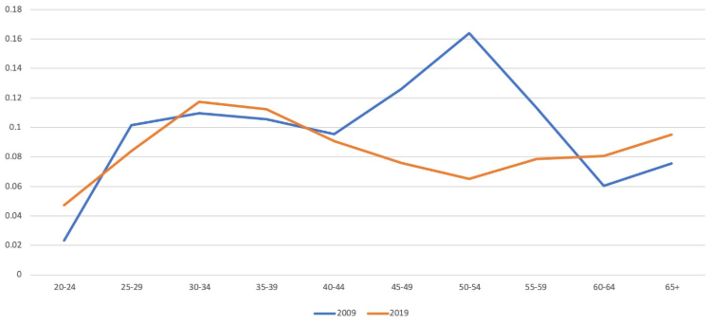
Demographics in the Industry
2019 SPE Professional Membership by Age
Notes:
Since the last downturn we have seen a lot of our older members have left the industry and we are seeing a larger number Young Professionals coming through to take over vacant roles. As the industry recovers we are seeing more positions open up for Young Professionals.

Slide 20
What about you?
Tips and summary of what your audience should do to best prepare for a career in the industry.

Slide 21
SPE’s role in the industry
The Society of Petroleum Engineers is a way for the E&P community to come together and share their knowledge, experience and skills beyond the boundaries of nationality, technical discipline or company.
We are the largest individual-member organization serving managers, engineers, scientists and other professionals worldwide in the upstream segment of the oil and gas industry.
International Events
OTC, ATCE and many more
Online resources
Papers, webinars
Regional Events and Communities SPE Sections and Chapters
Online Networks
eMentoring and SPE Connect
Recognition
Awards, Publication and Grants
Our combination of resources and expertise also allows us to develop unique publications and reports on the industry.
Notes:
You can also talk about your involvement and personal experiences in SPE Programs and activities.

Slide 22
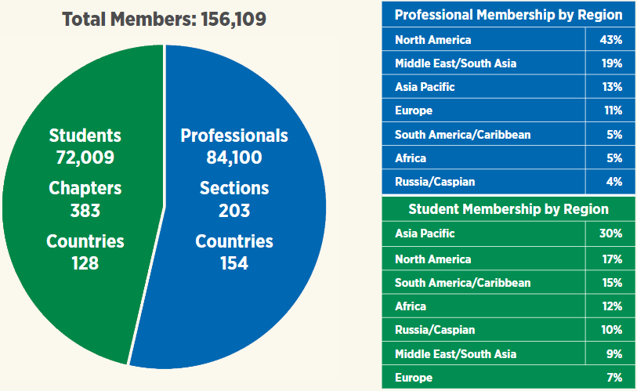
Our Professional Members
North America is where SPE started. We have a large number of Professional Members based there but our Professional Members are growing in the rest of the world each year.
Once regions have a certain number of Professional Members, local groups can be set up called “SPE Sections” who organize events and programs to support members in their area.
Our students and future professionals are more evenly spread out across the world.
Like our SPE Sections, if an Engineering university has enough SPE Members it can create its own SPE Student Chapters to organize events and activities to support the students in their University.
*SPE 2019 Annual Report
Working in Committees for Sections and Chapters are great way to learn new leadership skills and network with other students and professionals all over the world.

Slide 23
Young Member Programs
SPE has lots of programs, resources and activities to help your career both as a Student and as a young professional. Here are just a few;
Students
Student Chapters
Supportive groups, leadership opportunities
Scholarships, Fellowships and Awards
Funds to support your education
Ambassador Lecturer Program
Advice from experts at your place of study
SPE Connect – Student Community
Online network of members and resources
Student Paper Contests and PetroBowl
Global competitions to show your skills
eMentoring
Get continued supportive advice one to one
Young Professionals
SPE Sections
Regional communities and events by members
YP Awards and Spotlight on YPs
Global recognition for your work
Ambassador Lecturer Program
Develop presenting skills and support students
OnePetro, JPT SPE Magazines
Technical resources to continue your learning
eMentoring
Become a mentor and develop leadership skills
Webinars and Training Courses
Technical and soft skill training online
Notes:
Briefly go over some of the things SPE does specifically for student, you can also talk about any other programs you are involved in

Slide 24
How has SPE helped me?
Being a member of SPE has helped me grow…
A ‘constant’ in my professional life
Local and international participation
Visibility
Networking
Mentoring
Diverse Technical Learning
Corporate support
Be a part of and give back to the industry
…
Notes:
Personalise to you – all of these are suggestions

Slide 25
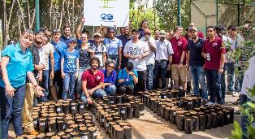
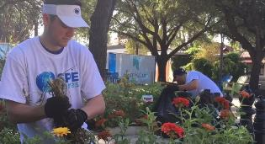
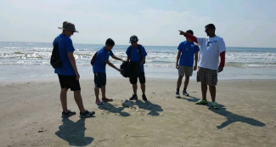
Global Responsibility
Producing the energy that drives the world’s economy has an impact on the environment, but SPE, energy companies and governments work together make that impact as small as possible.
SPE Supports community issues through SPE Cares and our continued studies into environment, sustainability, and raising awareness
Notes:
http://www.energy4me.org/energy-facts/environmental-protection/

Slide 26
Find out more about SPE and the industry
www.spe.org
www.energy4me.org/learn-about-energy/
http://petrowiki.org/
Or email SPE direct at service@spe.org

Slide 27
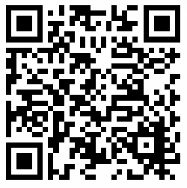
You can provide your feedback on this presentation by visiting our website;
www.spe.org/members/ambassador-lecturer-program.php
It can be found on our “request a visit” page
or by scanning the code below with your QR Code reader.

Slide 28
Thank you
Any questions?

