Slide 1
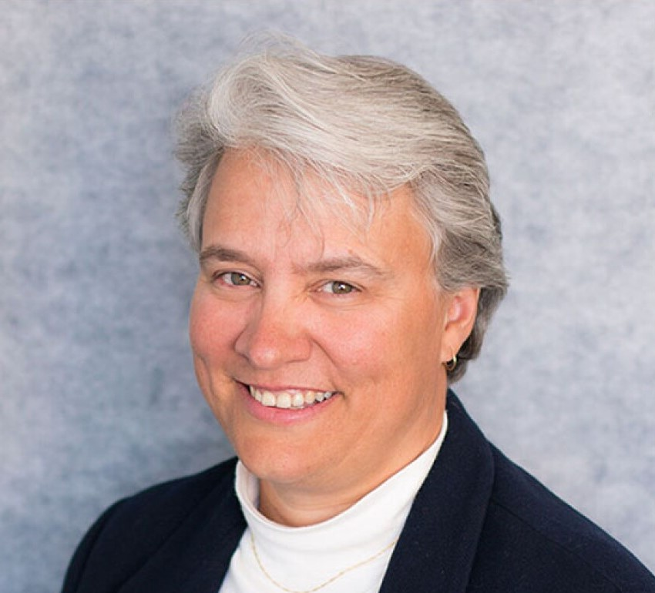
SPE Board of Directors Meeting, January 2026
Sharing highlights from the following board committees:
  Membership and Engagement
  Technical Content
  Finance
  Audit
Coordination meetings held for:
  Regional Directors
  Technical Directors
Please send feedback to president@spe.org
Dr. Jennifer Miskimins
2026 SPE President

Slide 2
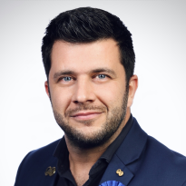
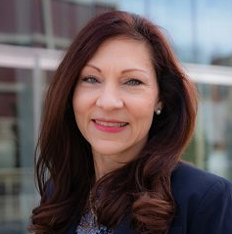
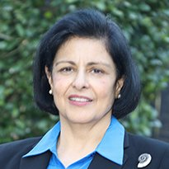
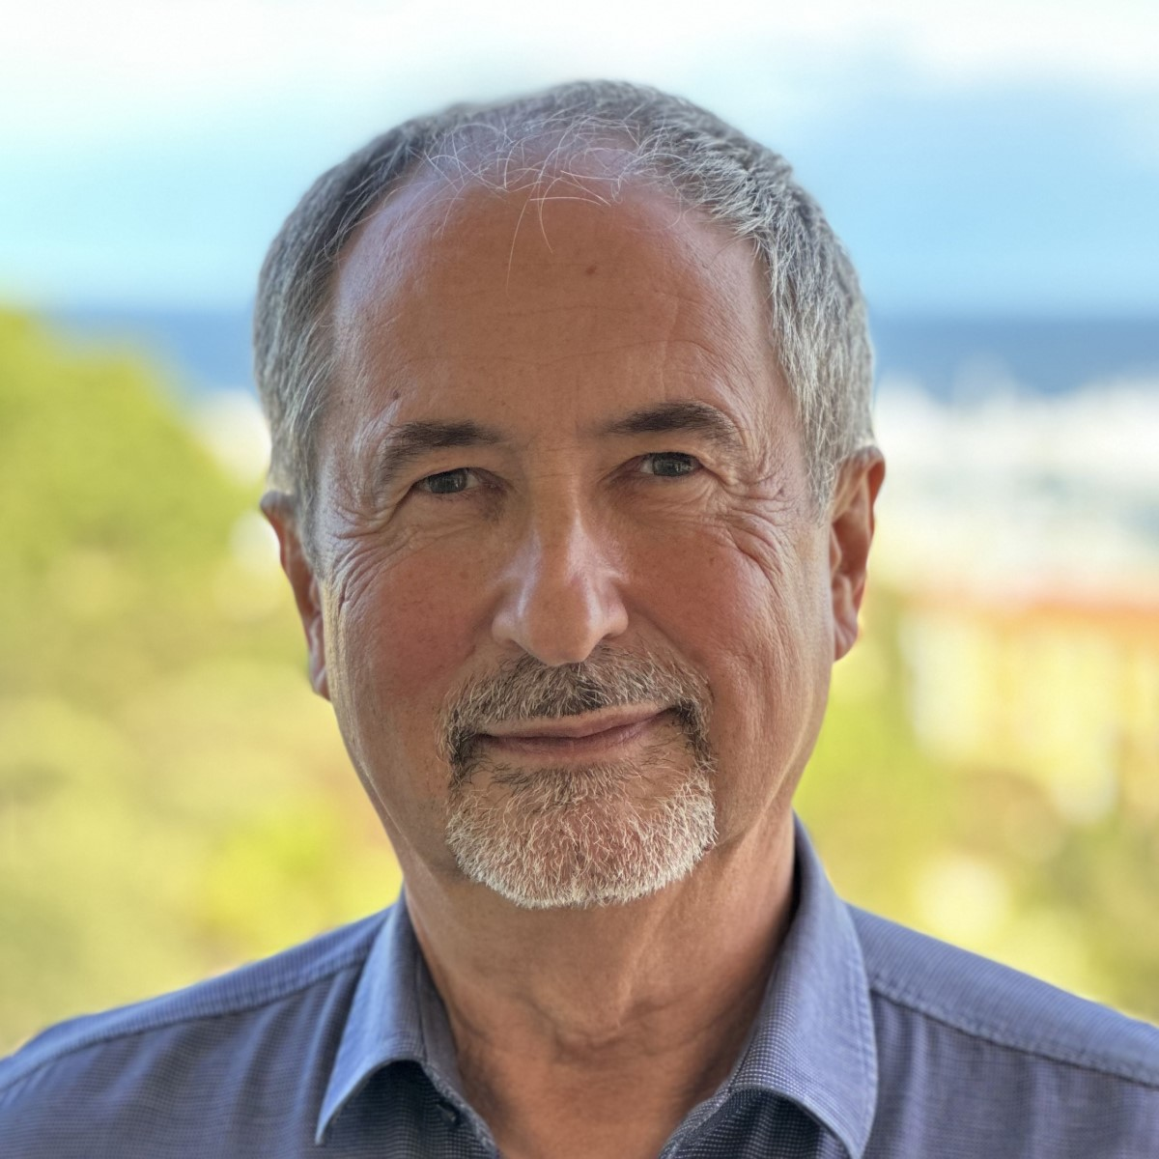
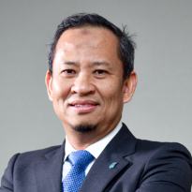
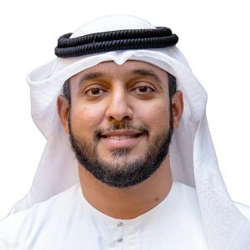
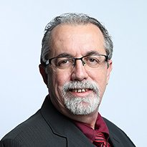
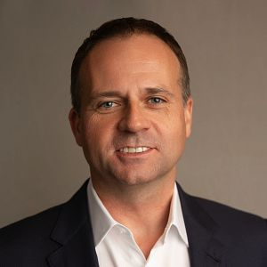
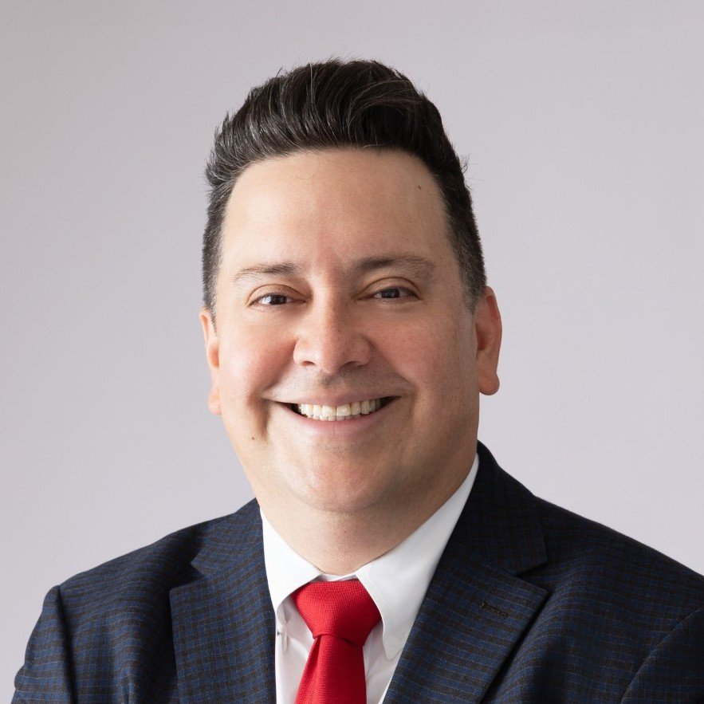
Membership & Engagement Committee – January 2026
Approved and recommended to the Board of Directors:
Sunsetting the Section Rebates Program, and the creation of a new grant program based on a flat rate per section, which excludes sections with more than 1,000 members.
The new Student Dues Structure to be implemented for FY2027. The high-income (category 1) tier fee will be USD 25, the upper middle (category 2) tier fee will be USD 15, the lower middle (category 3) tier fee will be USD 10, and the low (category 4) tier fee of USD 5. SPE will cover the category 4 fee for the next three years (2027-29) and reassess after this period.
Recommendation on Faculty Dues Waiver: That the Board Committee on Membership and Engagement approves that faculty advisors of student chapters will be assessed a professional member fee that is equivalent to the new (2027) student fee amounts.
Recommendation on the Distinguished Lecturer Program: That the Board Committee on Membership and Engagement approves reducing the number of distinguished lecturers to a maximum of 22 per season.
Declined:
The Board Committee declined a recommendation to change Student Member Criteria in the SPE Bylaws from “carry at least 30%...” to “carry at least 50% of a normal full-time academic load” for student membership eligibility.
Other topics reviewed/report/updates:
Discussed the classification of young professionals and create different value propositions for each career stage. Next step for staff to discuss this segmentation with the YP Committee and revert to M&E with a proposal at a virtual April meeting. Discussed new ways to organize mentorship for YPs including a “Bring a YP” program at SPE events.
Report on staff restructure for Member Experience and Communications.
Report on the results of SPE's pilot behavior-led member engagement campaign, which showed strong member engagement and will inform future marketing efforts.
For section name changes, requests can now be approved regionally by the respective RD; no need to go through the international board.
Pierre Emmanuel d’Huart
(Chair)
Linda Battalora
Sushma Bhan
Olivier Houze
Hazli Sham Kassim
Maged Mabrook
Carlos Pedroso
Gregory Stephenson
Carlos Torres

Slide 3
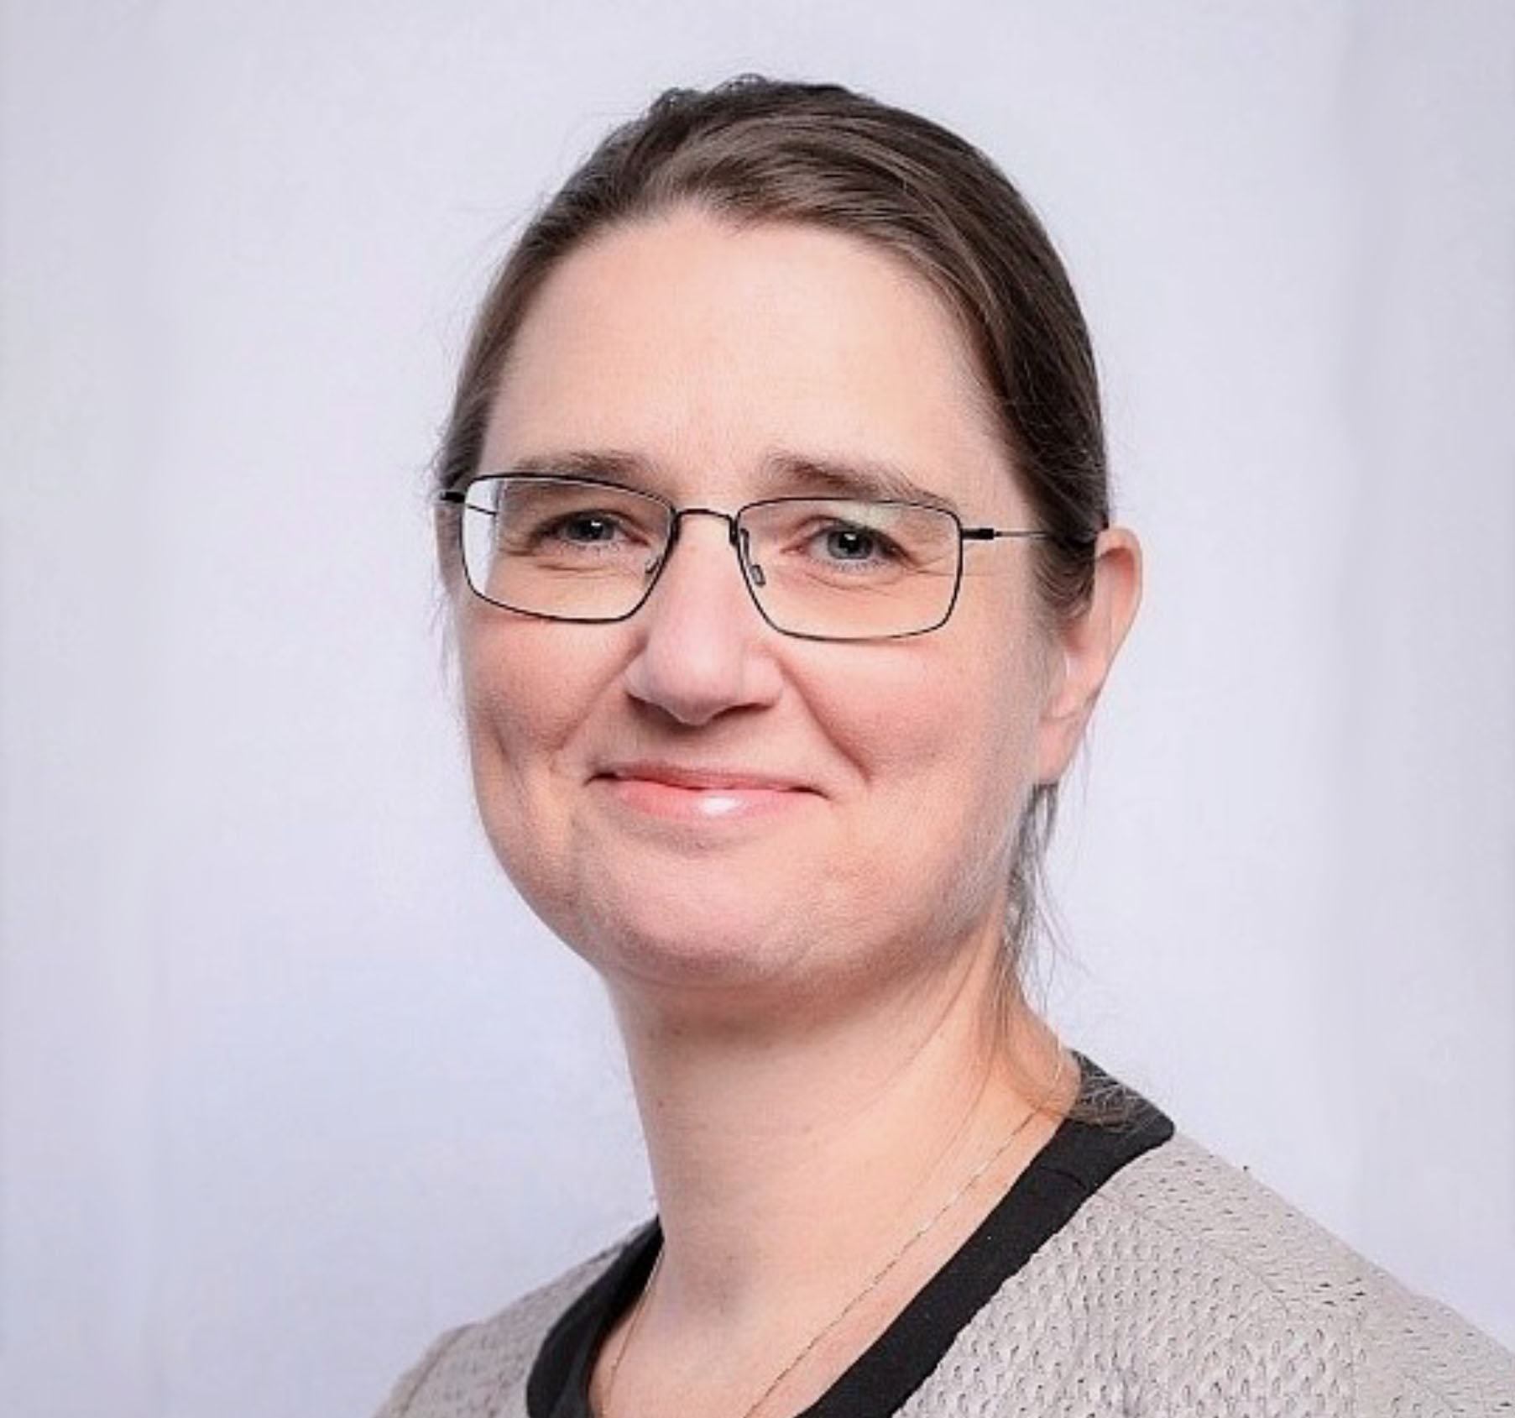
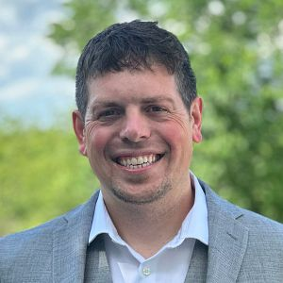
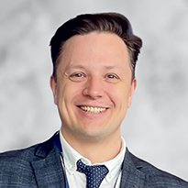
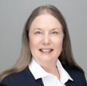
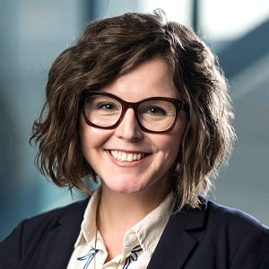
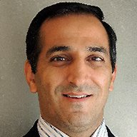
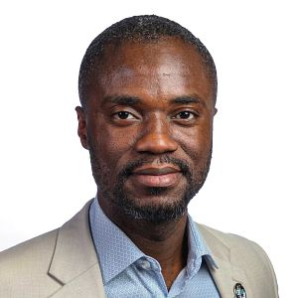
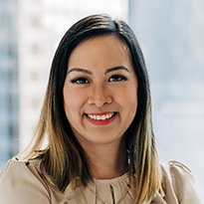
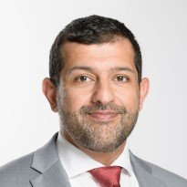
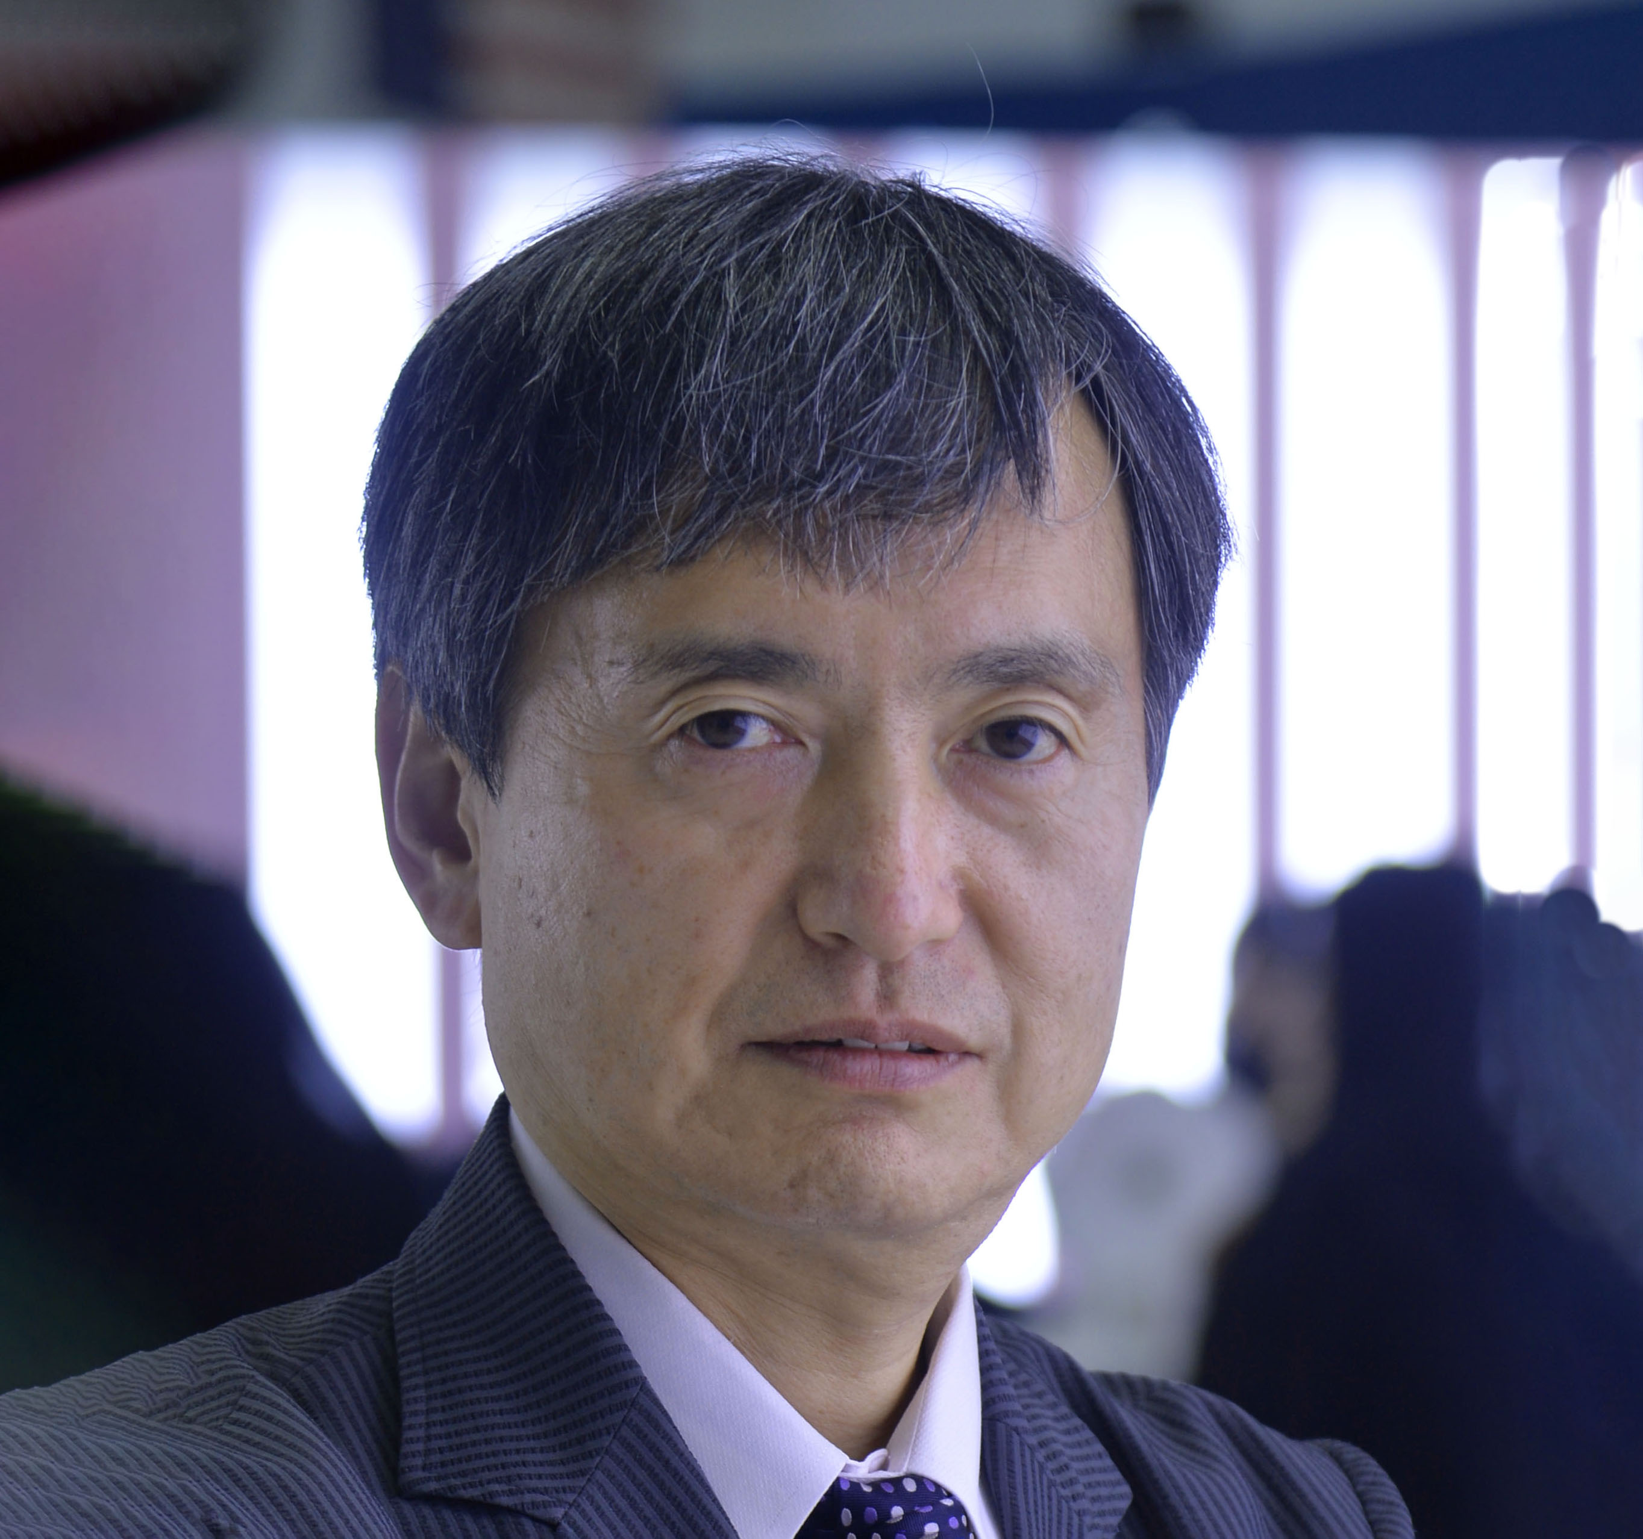
Technical Content Committee – January 2026
Approved and recommended to the Board of Directors to approve to require authors to use a third-party Pre-Check tool prior to manuscript submission that will check paper quality and completeness. ​
Approved:
  2 ERFs – The TC Committee approved the change in format for Well Integrity Symposium, UK/Amsterdam/Paris and SPE/ICoTA Asia Pacific Well Intervention and P&A Conference and Exhibition​, Kuala Lumpur
  Granting Technical Section-created webinars access​ to all users and offer 0.10 CEU/1.0 PDH credits and​ certificate of completion via Energy Stream as a member value.
  Renewing The Society for Professionals in Energy trademark in the U.S., subject to legal confirmation of SPE.org as proof of use and maintaining international registrations where proof is not required.
  The new Event Portfolio Management Policy. This policy clarifies who manages different event types, how the SPE brand is used, and how events are positioned within a single, coordinated portfolio, and draws a clear distinction between SPEI-managed events and section events.
  The development of a process to update the Board on the implementation of paper quality workgroup recommendations, and sunset the Paper Quality Workgroup
  Events under Review:
      SPE Caspian Technical Conference (CTC), Azerbaijan edition – staff will investigate holding CTC alongside Baku Energy Week and report back to the TC Committee.
      SPE Oilfield Chemistry Conference (OCC), US, and SPE Reservoir Simulation Conference (RSC), US –staff will proceed with OCC and RSC with continued cost control and revenue growth initiatives in 2028 (when ATCE outside US).
Received updates on:
  The Global Event Operations and Flagship Event Reports
  ATCE 2025 Debrief and Preview of ATCE 2026 and Beyond, which included the 2027-2030 ATCE locations
  OTC
  Core, Low Carbon and New Energy Classifications
  GEODE Project
  2025 TC Committee goals - defined and ranked
Peggy Rijken
Chair
Neil Boyer
Alexey Borisenko
Susan Howes
Sarah Kern
Rahim Masoudi
Riverson Oppong
Kim Oracheski
Abdullatif Al-Omair
Koji Yamamoto

Slide 4
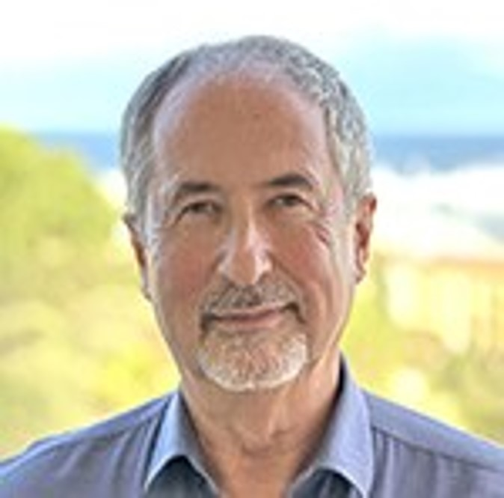

Finance Committee – January 2026
Received an update on SPE’s investment portfolio, reporting global investments of $37.1 million as of 30 December 2025.
Received an update on the FY2026B financial results, which reflected a net surplus of $650 thousand unfavorable to budget.
Received an update on the FY2026B forecast, which is projected to result in a $2.9 million deficit as of January 2026.
Received an update on the Richardson building and potential buyers.
Received an update on SPE’s IT strategy implementation.
Olivier Houzé
Chair
Jennifer Miskimins
Susan Howes
Hazli Kassim
Peggy Rijken
Pierre Emmanuel d’Huart

Slide 5
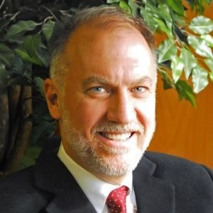
Audit Committee – January 2026
Approved the unmodified FY2025 results of the financial audit conducted by RSM.
Received an update on cybersecurity, noting SPE’s adoption of the CIS framework to strengthen cybersecurity, with 2026 initiatives focused on asset and account centralization, improved vulnerability and incident management, role-based training, and defined milestones and KPIs.
Reviewed the pre-approved conflict of interest policy, legal matters and conducted a closed session.
Hazli Kassim
Chair
Alexey Borisenko
Carlos Torres
Olivier Houzé
Ford Brett

Slide 6
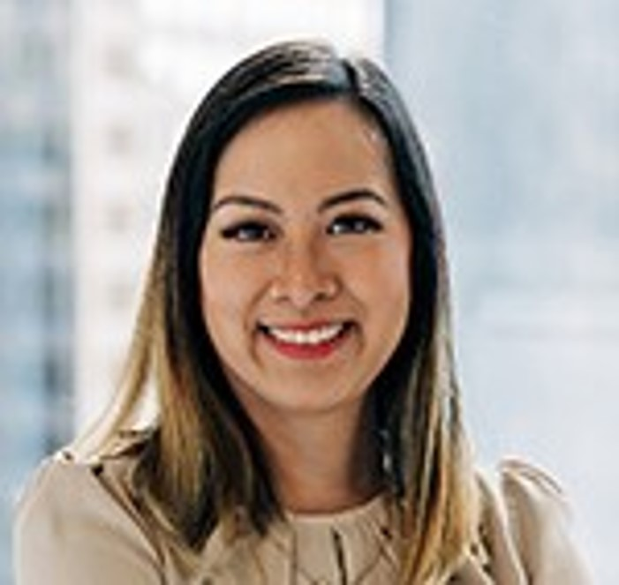
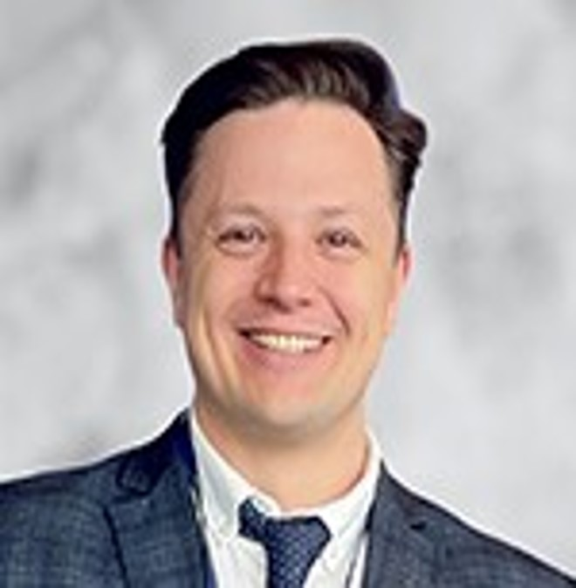

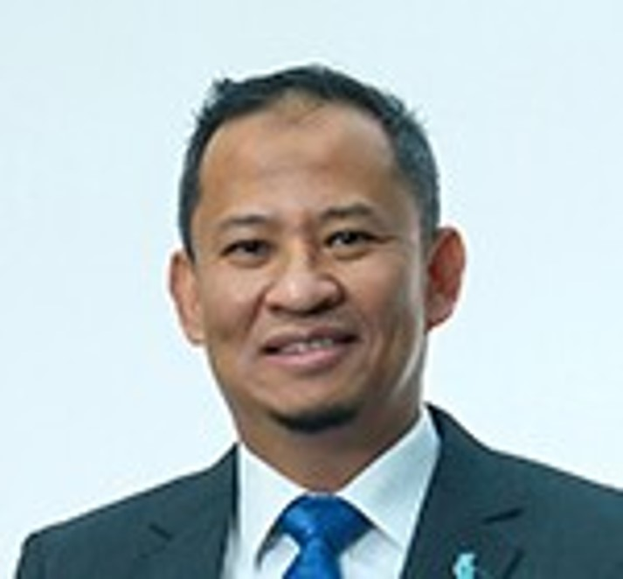
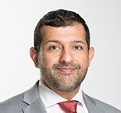


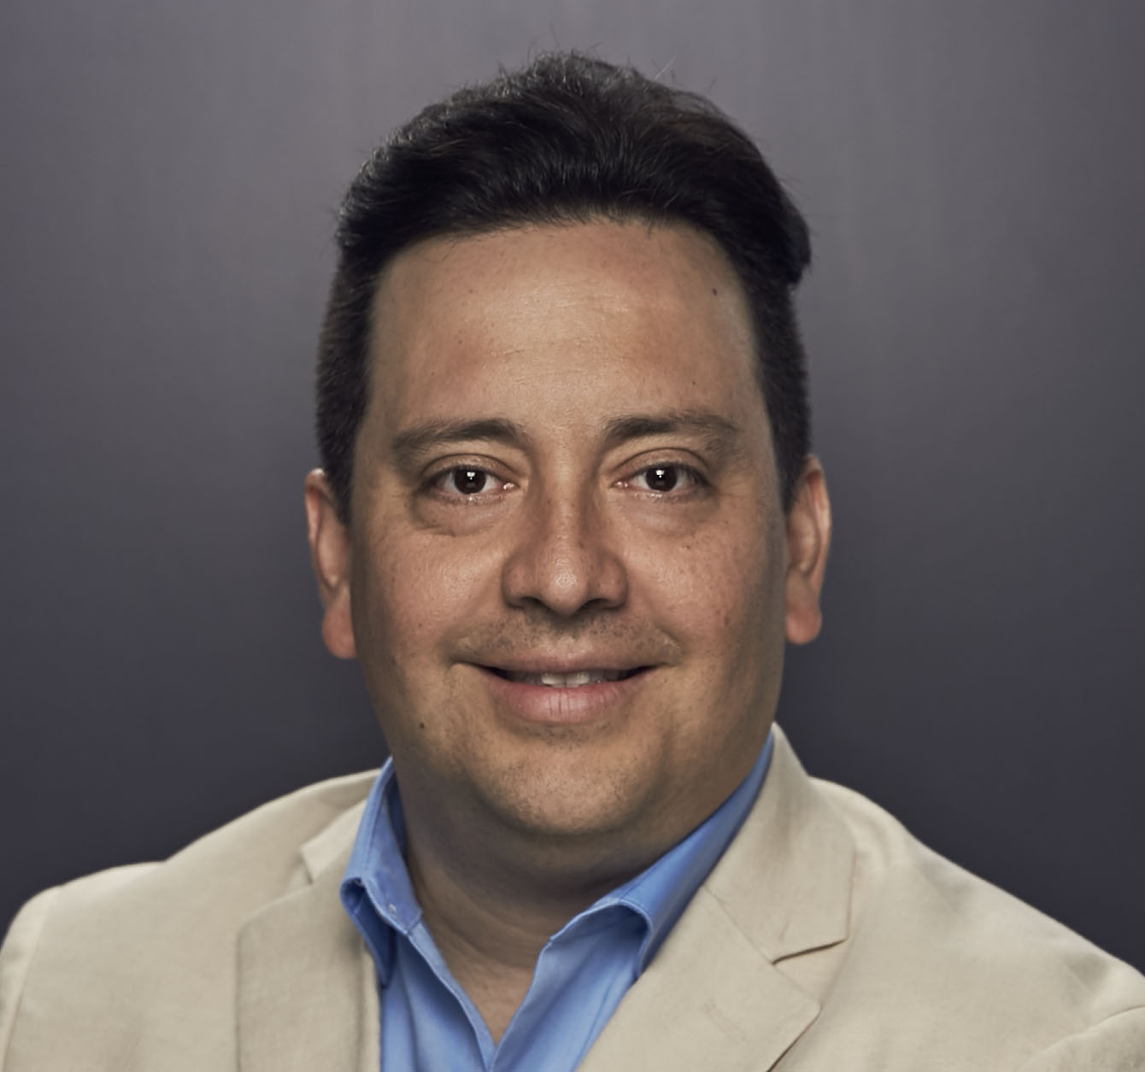
Regional Directors – January 2026
Reviewed updates on the restructured SPE Communications and Member Experience department.
Discussed streamlining the Section and Chapter awards program.
Discussed the implementation of student dues beginning FY2027.
Discussed on the Section rebates program.
Received Regional updates.
Kim Oracheski
Lead
Alexey Borisenko
Neil Boyer
Pierre D-Huart
Hazli Kassim
Maged Mabrook
Abdullatif Al Omair
Riverson Oppong
Carlos Pedroso
Carlos Torres
Koji Yamamoto

Slide 7
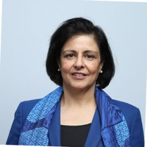
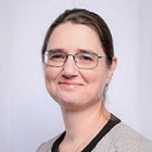
Technical Directors – January 2026
TS Sustainability and Member Expectations
Reviewed, discussed and tentatively approved both documents with a request for minor changes.
The initiative is designed to emphasize focusing organizational effort on quality technical
output rather than maintaining a high quantity of less engaged sections.
Reinforce quality and commitment, potentially reducing the number of supported TSs.
Technical Section Moves and Discipline Consolidation
  Methane (MTS): Formally moved to HSES discipline and renamed to align with industry trends.
  Robotics (RASTS): Initiated move to Data Science (DSEA) to consolidate synergies.
  Projects, Facilities, and Construction & Production and Operations: Consolidating web pages.
Technical Section Update: Growth & Pipeline Strategy
  ATCE Booth ROI: 14 participating sections achieved 31% membership growth (vs. 19% without). Strategy continues with enhanced signage based on this validated return.
  Student Engagement: Global outreach yielded a 26% response rate (110/428 chapters) requesting direct mentorship and connection with Technical Sections.
  GEODE Funding: 2 of 5 invited U.S. chapters responded (2 MOUs signed); $5,000 per chapter allocated to drive campus-wide promotion and speakers.
Sushma Bhan
Lead
Linda Battalora
Sarah Kern
Rahim Masoudi
Peggy Rijken
Gregory Stephenson

