Slide 1
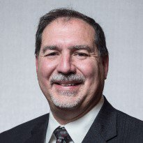
SPE Board of Directors Meeting, April 2024
Sharing highlights from the following board committees:
  Membership and Engagement
  Technical Content
  Finance
Coordination meetings held for:
  Regional Directors
  Technical Directors
Please send feedback to president@spe.org
Terry Palisch
2024 SPE President

Slide 2
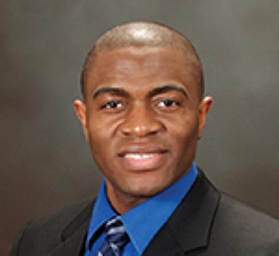
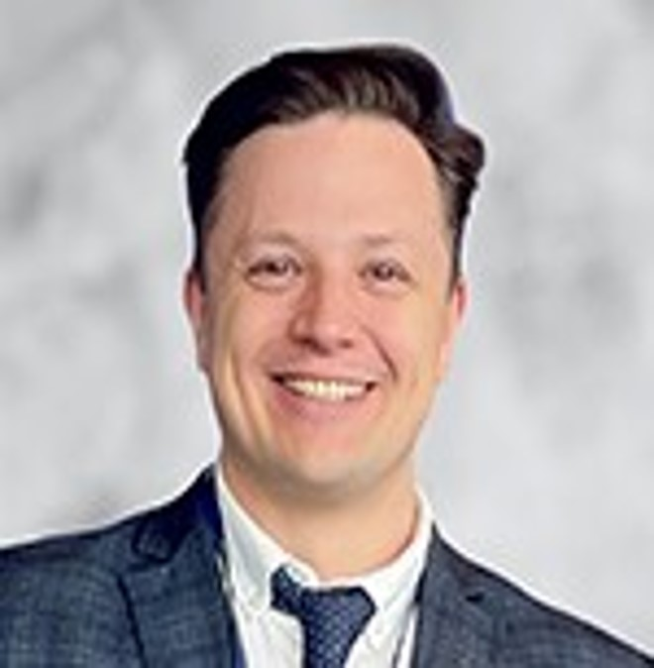
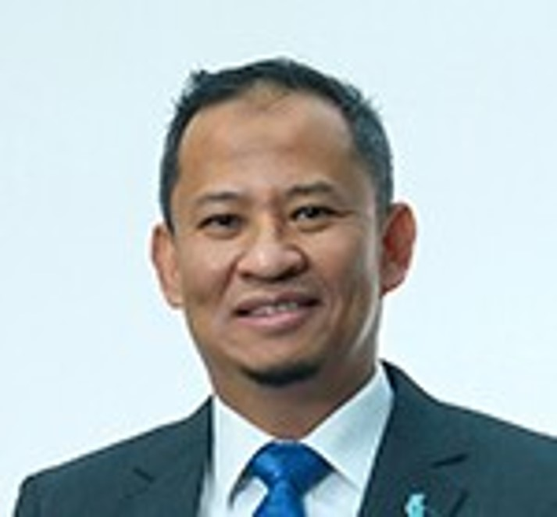
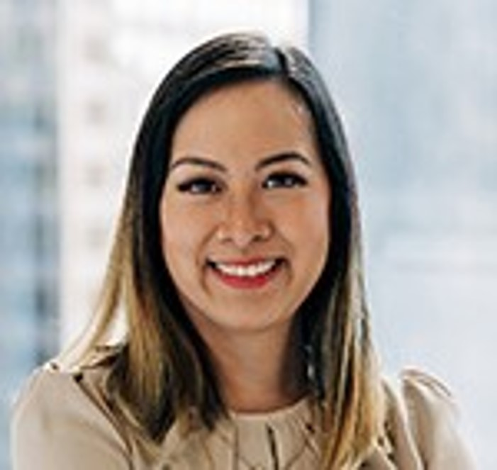
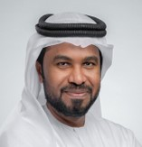
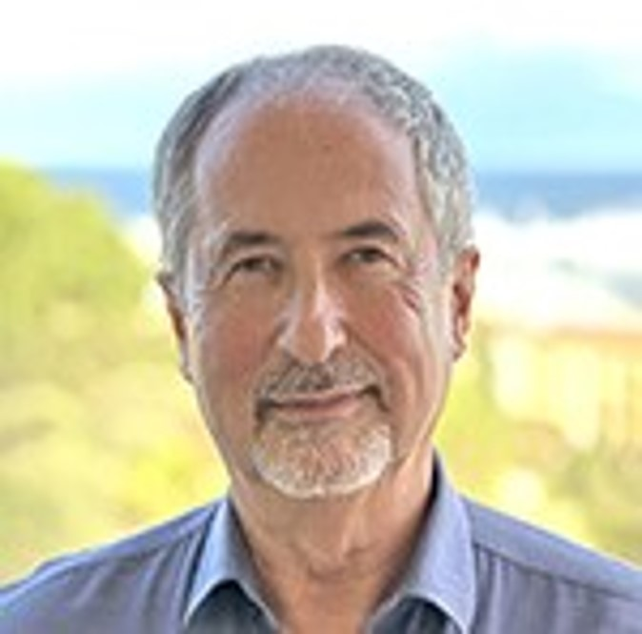
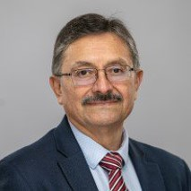
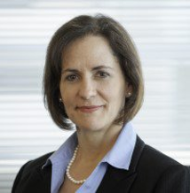

Membership & Engagement – April 2024
Approved the name change of the ‘Baghdad Section’ to the ‘Central Iraq Section’ which will reflect regional representation and inclusion strategy.
Approved a dues increase for Country Groups 2,3, and 4 for the 2025 dues cycle.
Approved an update to the Nominating Policy for the Regional Director position to read ‘…or being endorsed by, a regional advisory group…’ to solicit a greater slate of qualified candidates.
Approved the Student Paper Contest requirement to allow one faculty co-author per entry, with the student remaining the primary author.
Further discussed SPE Member Value Assessment Survey. An initial meeting was held earlier during the Board meetings.
Discussion around young member programs.
Simeon Eburi
Chair
Alexey Borisenko
Hazli Kassim
Kim Oracheski
Mohamed Al-Marzouqui
Olivier Houzé
Pierre Emmanuelle
D’Huart
Rodolfo Camacho
Sue Staley

Slide 3
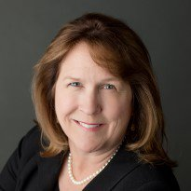
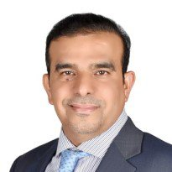
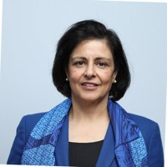
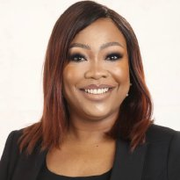
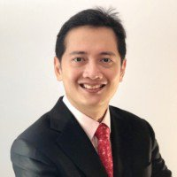
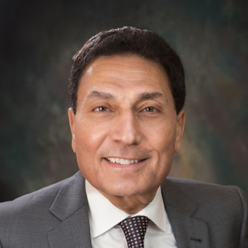
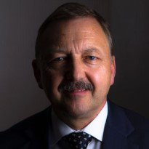
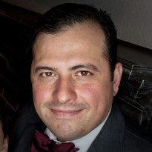

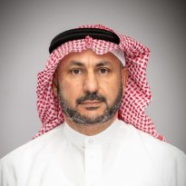
Technical Content – April 2024
Approved and recommended to the Board of Directors to
  reinstate the 2019 OnePetro SPE member pricing.
  create a formal selection criteria policy for the SPE Journal Editor-in-Chief (EIC) and Executive Editor (EE) position.
  change the fees for Individual Purchases and Licensing of SRMS .
  create the Offshore Completions Technical Section.
Reviewed and approved the Kuwait SPE International Symposium and Exhibition: Oil and Gas Sustainable Production Development in the Energy Transition Era Event Request (ERF).
Discussed the SPE Branding and established a workgroup to explore and recommend a proposal to the Committee to the Board of Directors before the July Board meeting.
Received updates on ATCE 2024; from the workgroups on “Best of the Best Papers” and PetroWiki; from the Geothermal Events and Activities (GEODE) Advisory Committee.
Further discussed SPE Member Value Assessment Survey. An initial meeting was held earlier during the Board meetings.
Discussed and approved Houston, Texas, as the 2026 ATCE location.
Karen Olson
Chair
Hamad Al-Marri
Sushma Bhan
Oghogho Effiom
Henricus Herwin
Med Kamal
Robin Macmillan
Robert Martinez
Carlos Pedroso
Hisham Zubari

Slide 4
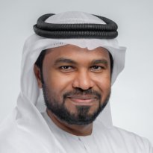
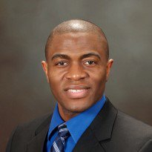

Regional Directors – April 2024
Staff presented tools and communication channels for RDs to effectively communicate. Staff will explore creating Officer Teams Channels by region.
Staff presented student chapter applications received, points of confusion, and next steps for the judging process.
Regional Directors discussed and shared ideas around member-to-member communications to drive awareness on the recent graduate free professional membership.
Staff presented an update on the submission rates and revised annual reports. A preliminary overview of chapter needs and challenges was presented with further evaluation to be presented in July.
Updates were provided on how to access the regional profile summary reports and on section and chapter establishments and disestablishments.
Regional Directors voiced their opinions on section concerns to be fed into a larger discussion at the Board Committee on Membership and Engagement meeting and Technical Content.
Mohamed Al Marzouqi
Simeon Eburi
Oghogho Effiom
Henricus Herwin
Hazli Kassim
Robert Martinez
Pierre Emmanuelle
D-Huart
Carlos Pedroso
Kim Oracheski
Alexey Borisenko
Hisham Zubari
Lead

Slide 5
Technical Directors – April 2024
  Received Updates on the DOE GEODE Project & SPE-ARMA Workshop on Subsurface Storage
  TDs were presented the proposed Offshore Completions TS final paperwork and recommended approval to TC
  Regional participation breakdown of Technical Sections (TS) indicates alignment with overall SPE membership demographics, with some TS needing outreach to specific regions for balanced membership.
  Reviewed upcoming tasks and meetings, underscoring the importance of global representation and continuous development in technical sections.
Robin Macmillan
Lead
Hamad Al Marri
Sushma Bhan
Sue Staley
Rodolfo Camacho
Karen Olson

Slide 6
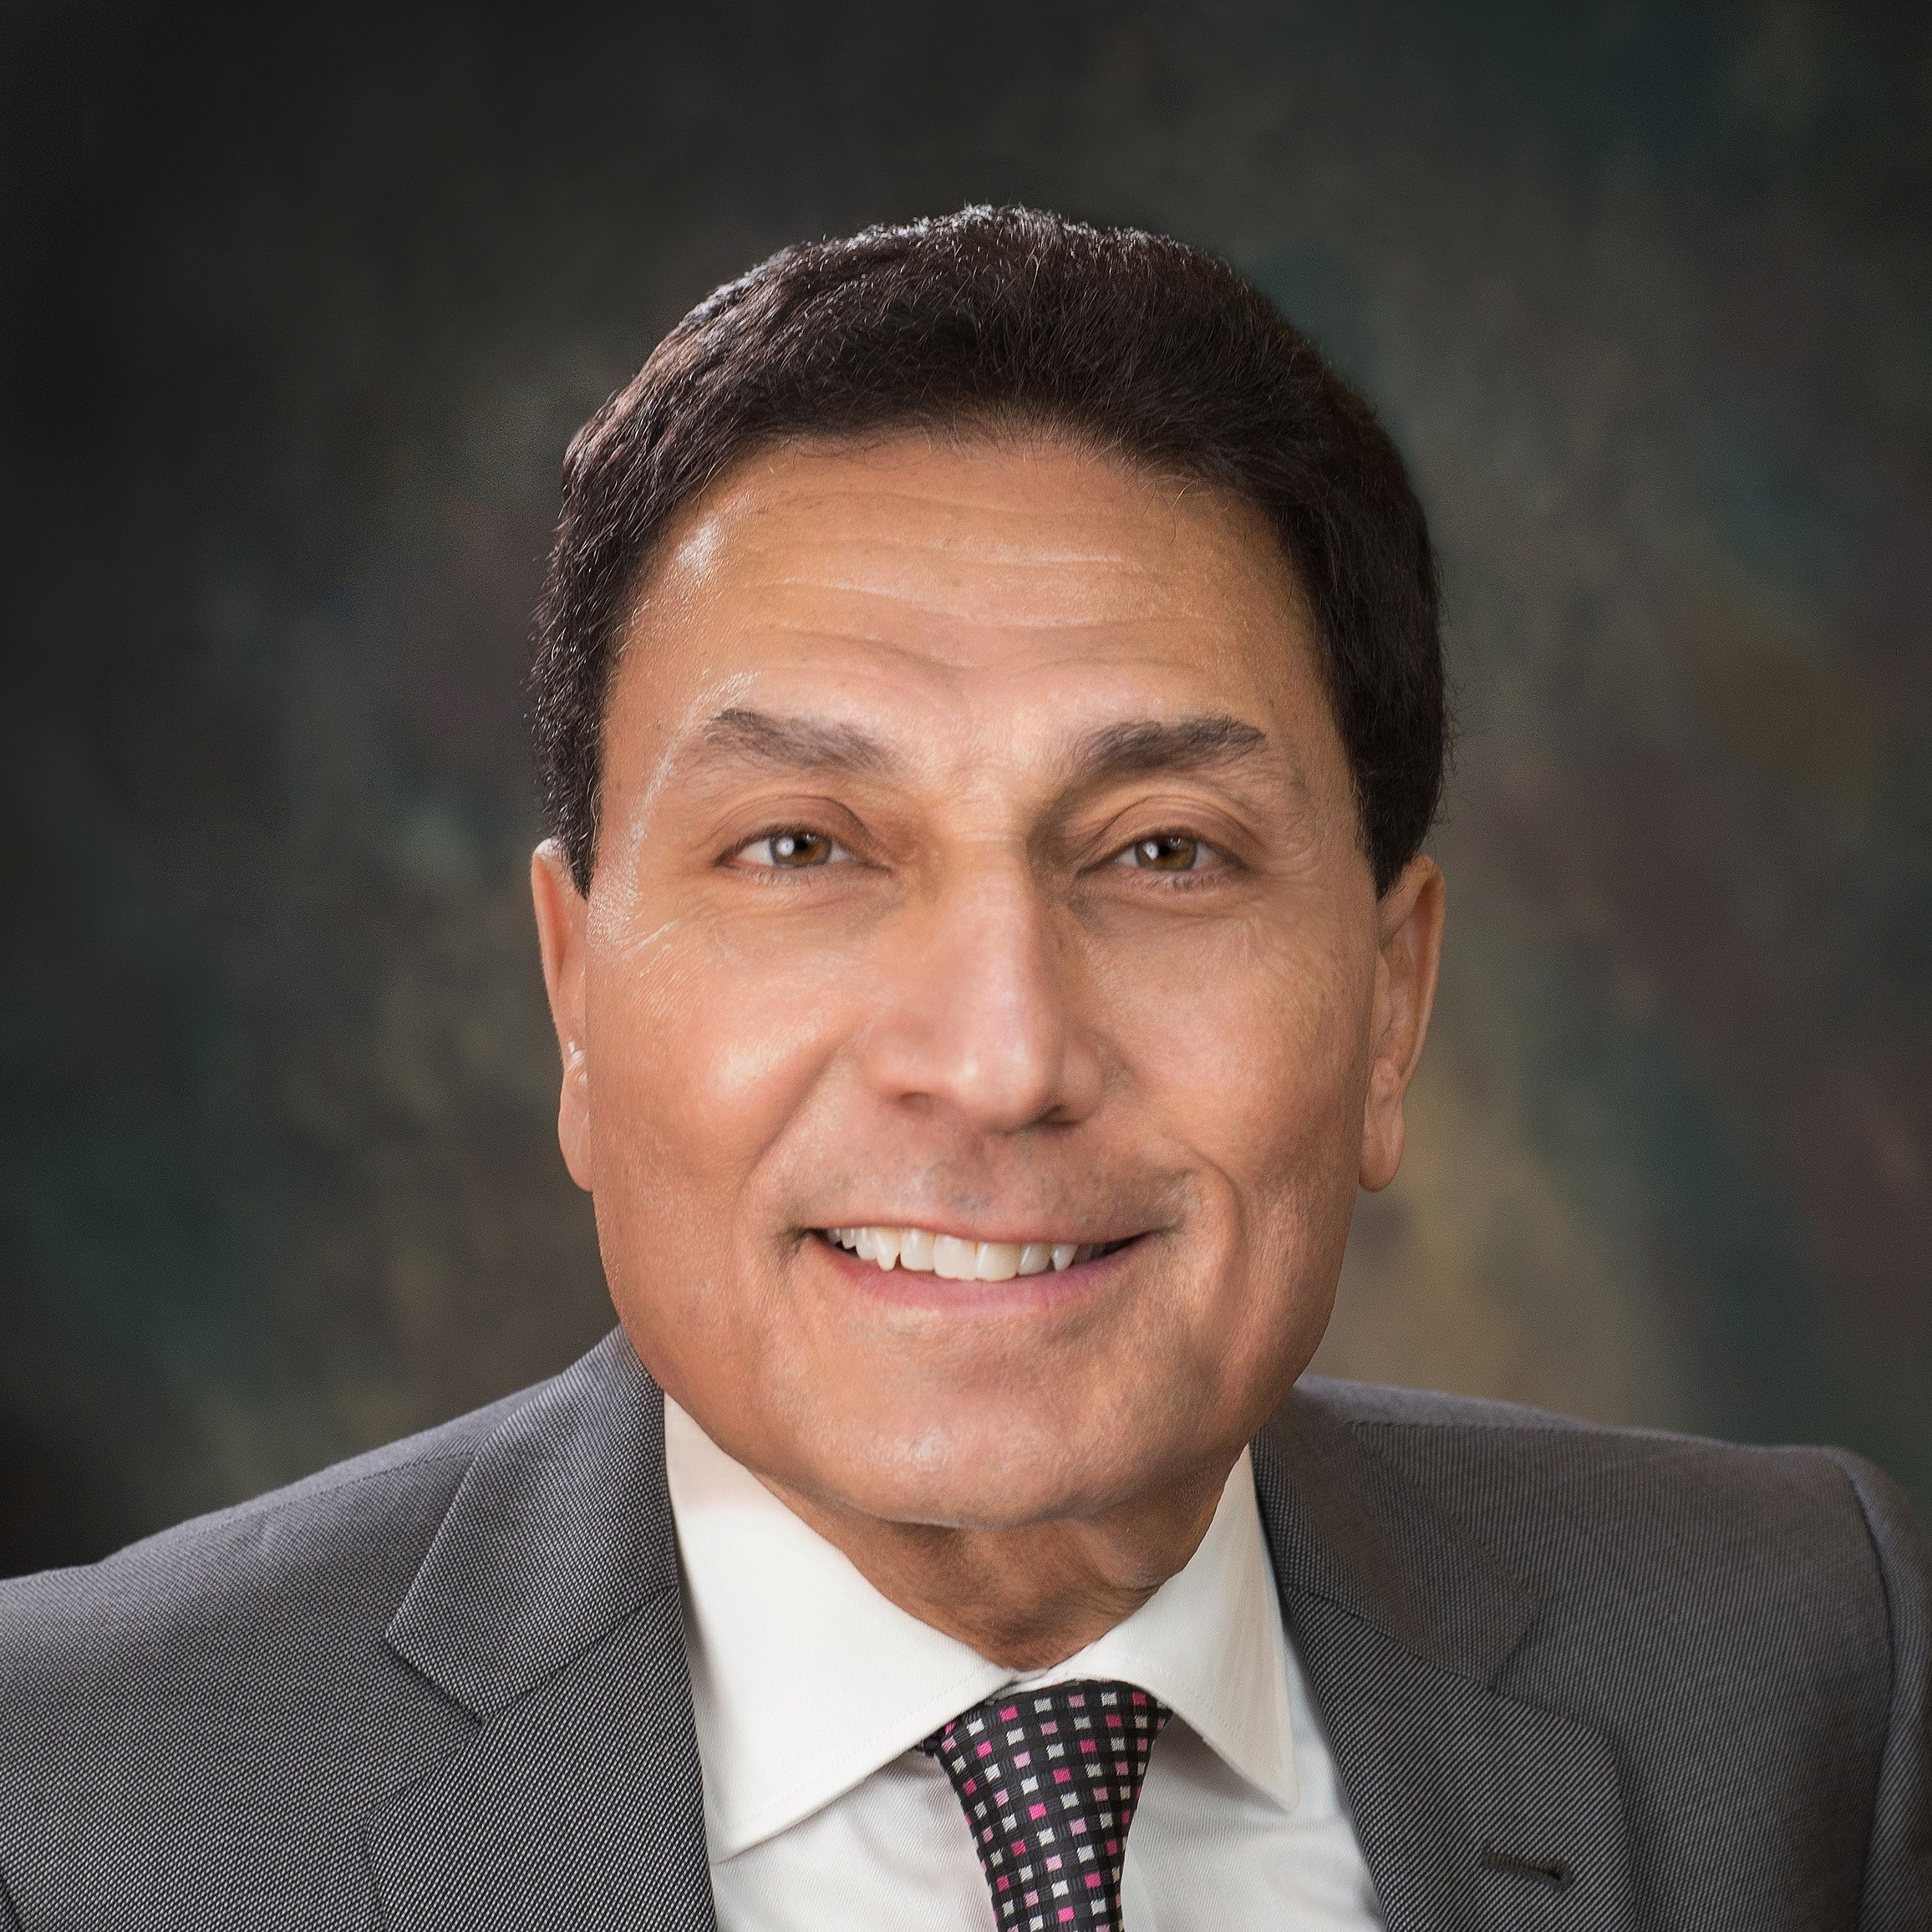
Finance – April 2024
Provided an update on SPE’s investment portfolio through March 2024 of $34.9 Million.
Received an update on the FY2024 unaudited operating loss of $4.1 Million as well as a $4.5 Million gain in global investments due to market performance.
Received an update on the SPE Richardson Building and interest received from the prospective client – Milestone.
Discussed plans to update the SPE Investment Policy to ensure alignment with the organization’s post-pandemic operational needs.
Discussed plans to rework the SPE budget process, specifically looking at the benefits of annual budgeting vs. two-year cycle budgeting.
Med Kamal
Chair
Terry Palisch
Olivier Houzé
Karen Olson
Simeon Eburi
Oghogho Effiom

