Slide 1
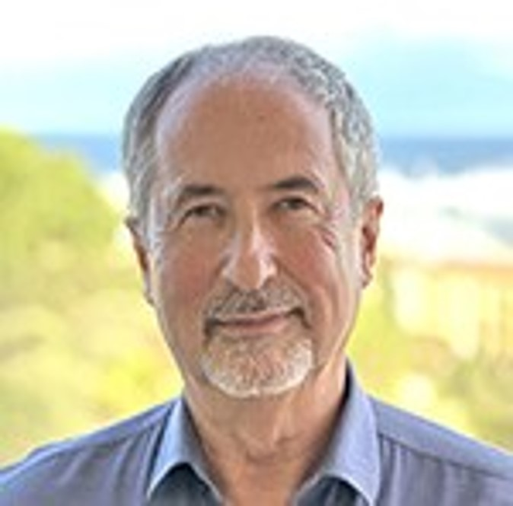
SPE Board of Directors Meeting, October 2025
Sharing highlights from the following board committees:
Membership and Engagement
Technical Content
Finance
Audit
Coordination meetings held for:
Regional Directors
Technical Directors
Please send feedback to president@spe.org
Olivier Houzé
2025 SPE President

Slide 2
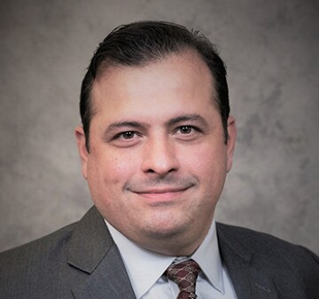
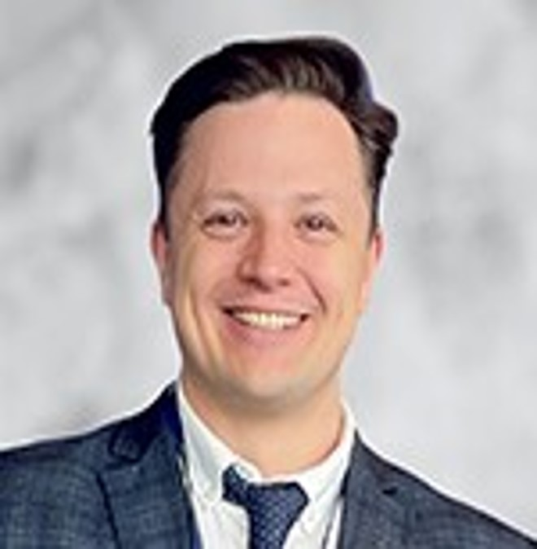
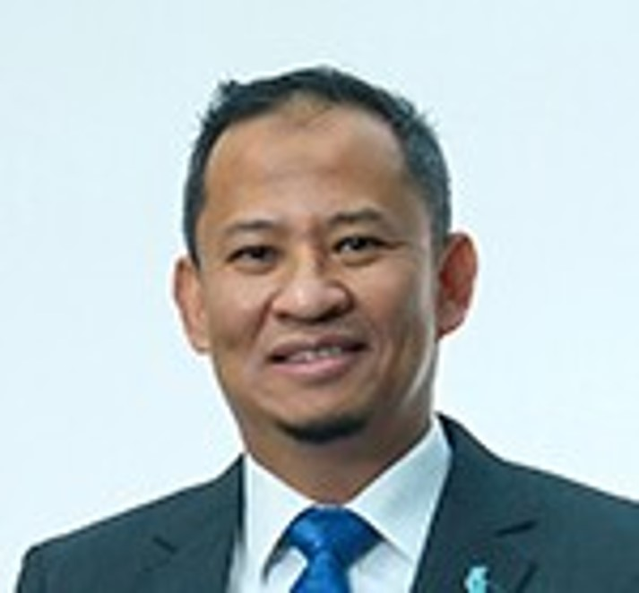
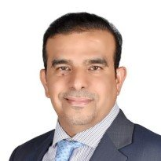
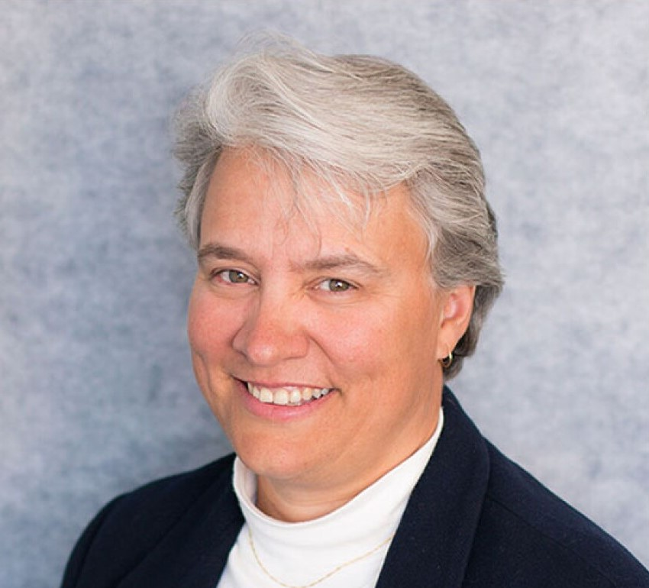
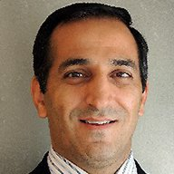
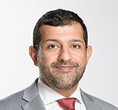
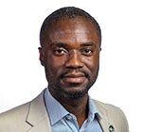
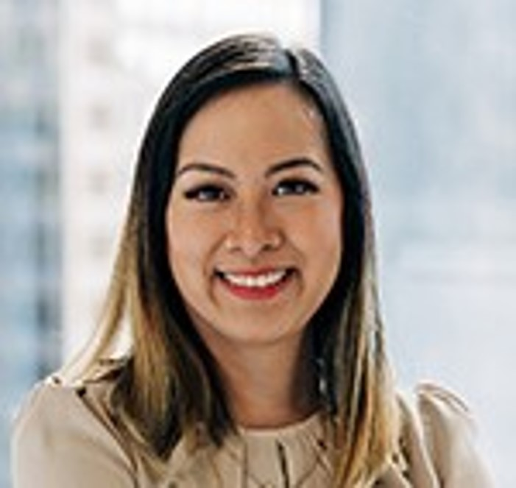
Membership & Engagement – October 2025
Approved and recommended to the Board of Directors to approve:
A petition from the Ukraine Section for a dues waiver for 2026.
The introduction of student dues beginning in 2027 with a plan on how this should be implemented to be presented at the January 2026 Board Meeting.
Setting up a work group focused on assessment and impact of optimization, of the Distinguished Lecturer Program including cost cutting for the 2027 season.
The renaming of the Business & Leadership Committee to the Leadership Development Committee.
Other items covered included the following:
Declined the immediate review of the Regional Director structure and merging any regions at this time as it would be more appropriate after the new strategic plan is developed.
Declined a recommendation from the Education and Accreditation Committee to launch a survey around Energy Transition at this time.
An update was provided on the ‘NextGen – Early Career Lectures’ pilot with events anticipated to start in 2026.
Potential modifications to the Section Rebate Program considering the use information in annual reports including funds on account, annual cash flow, scholarships, retention and recruiting.
Robert Martinez
Chair
Alexey Borisenko
Hazli Kassim
Hamad Al Marri
Rahim Masoudi
Jennifer Miskimins
Abdullatif Al Omair
Riverson Oppong
Kim Oracheski

Slide 3
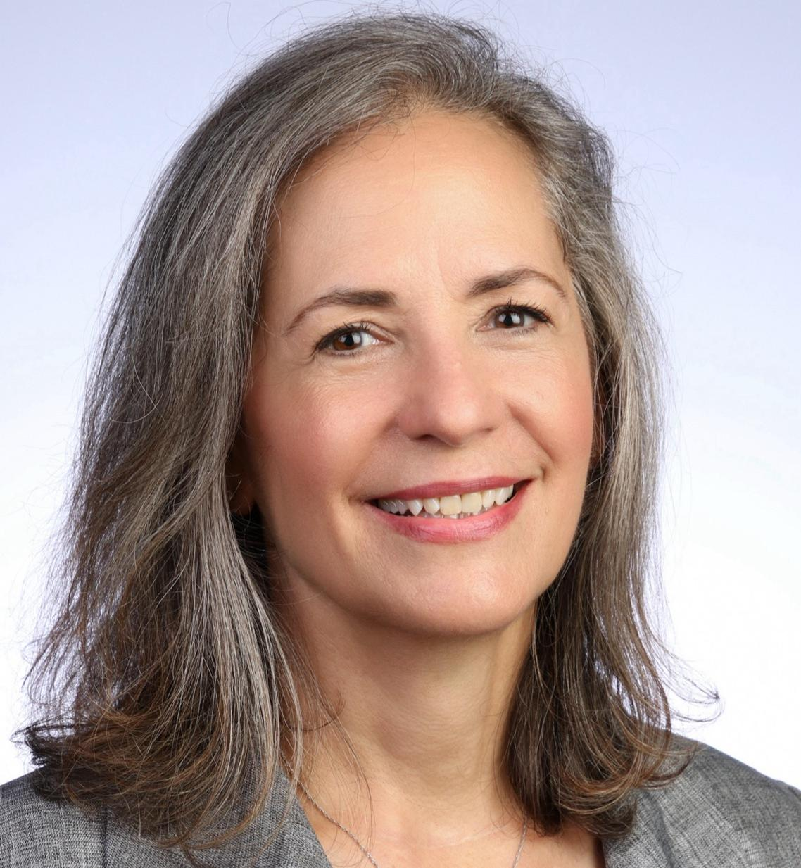
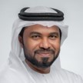
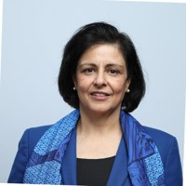
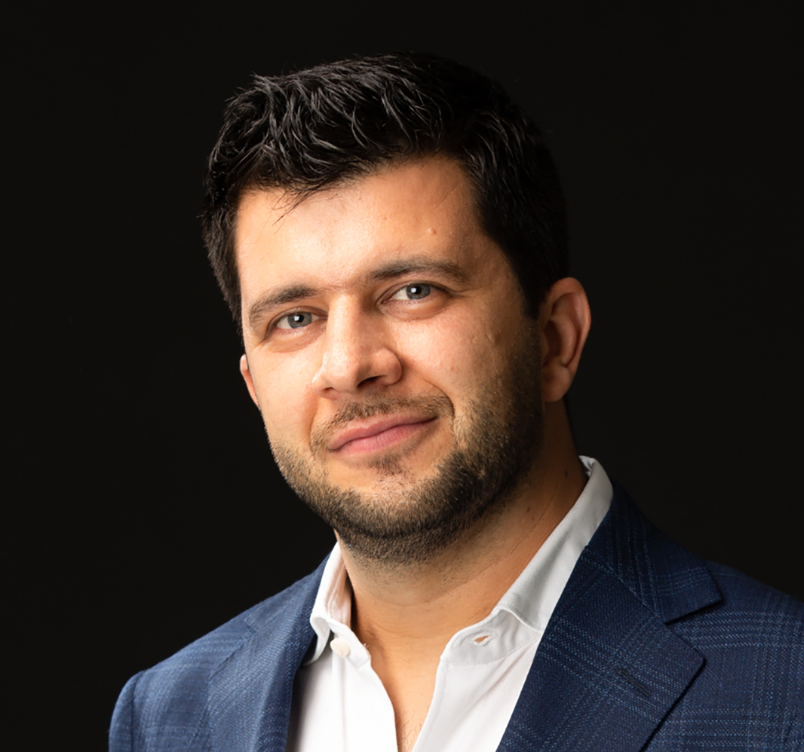
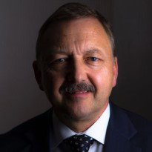
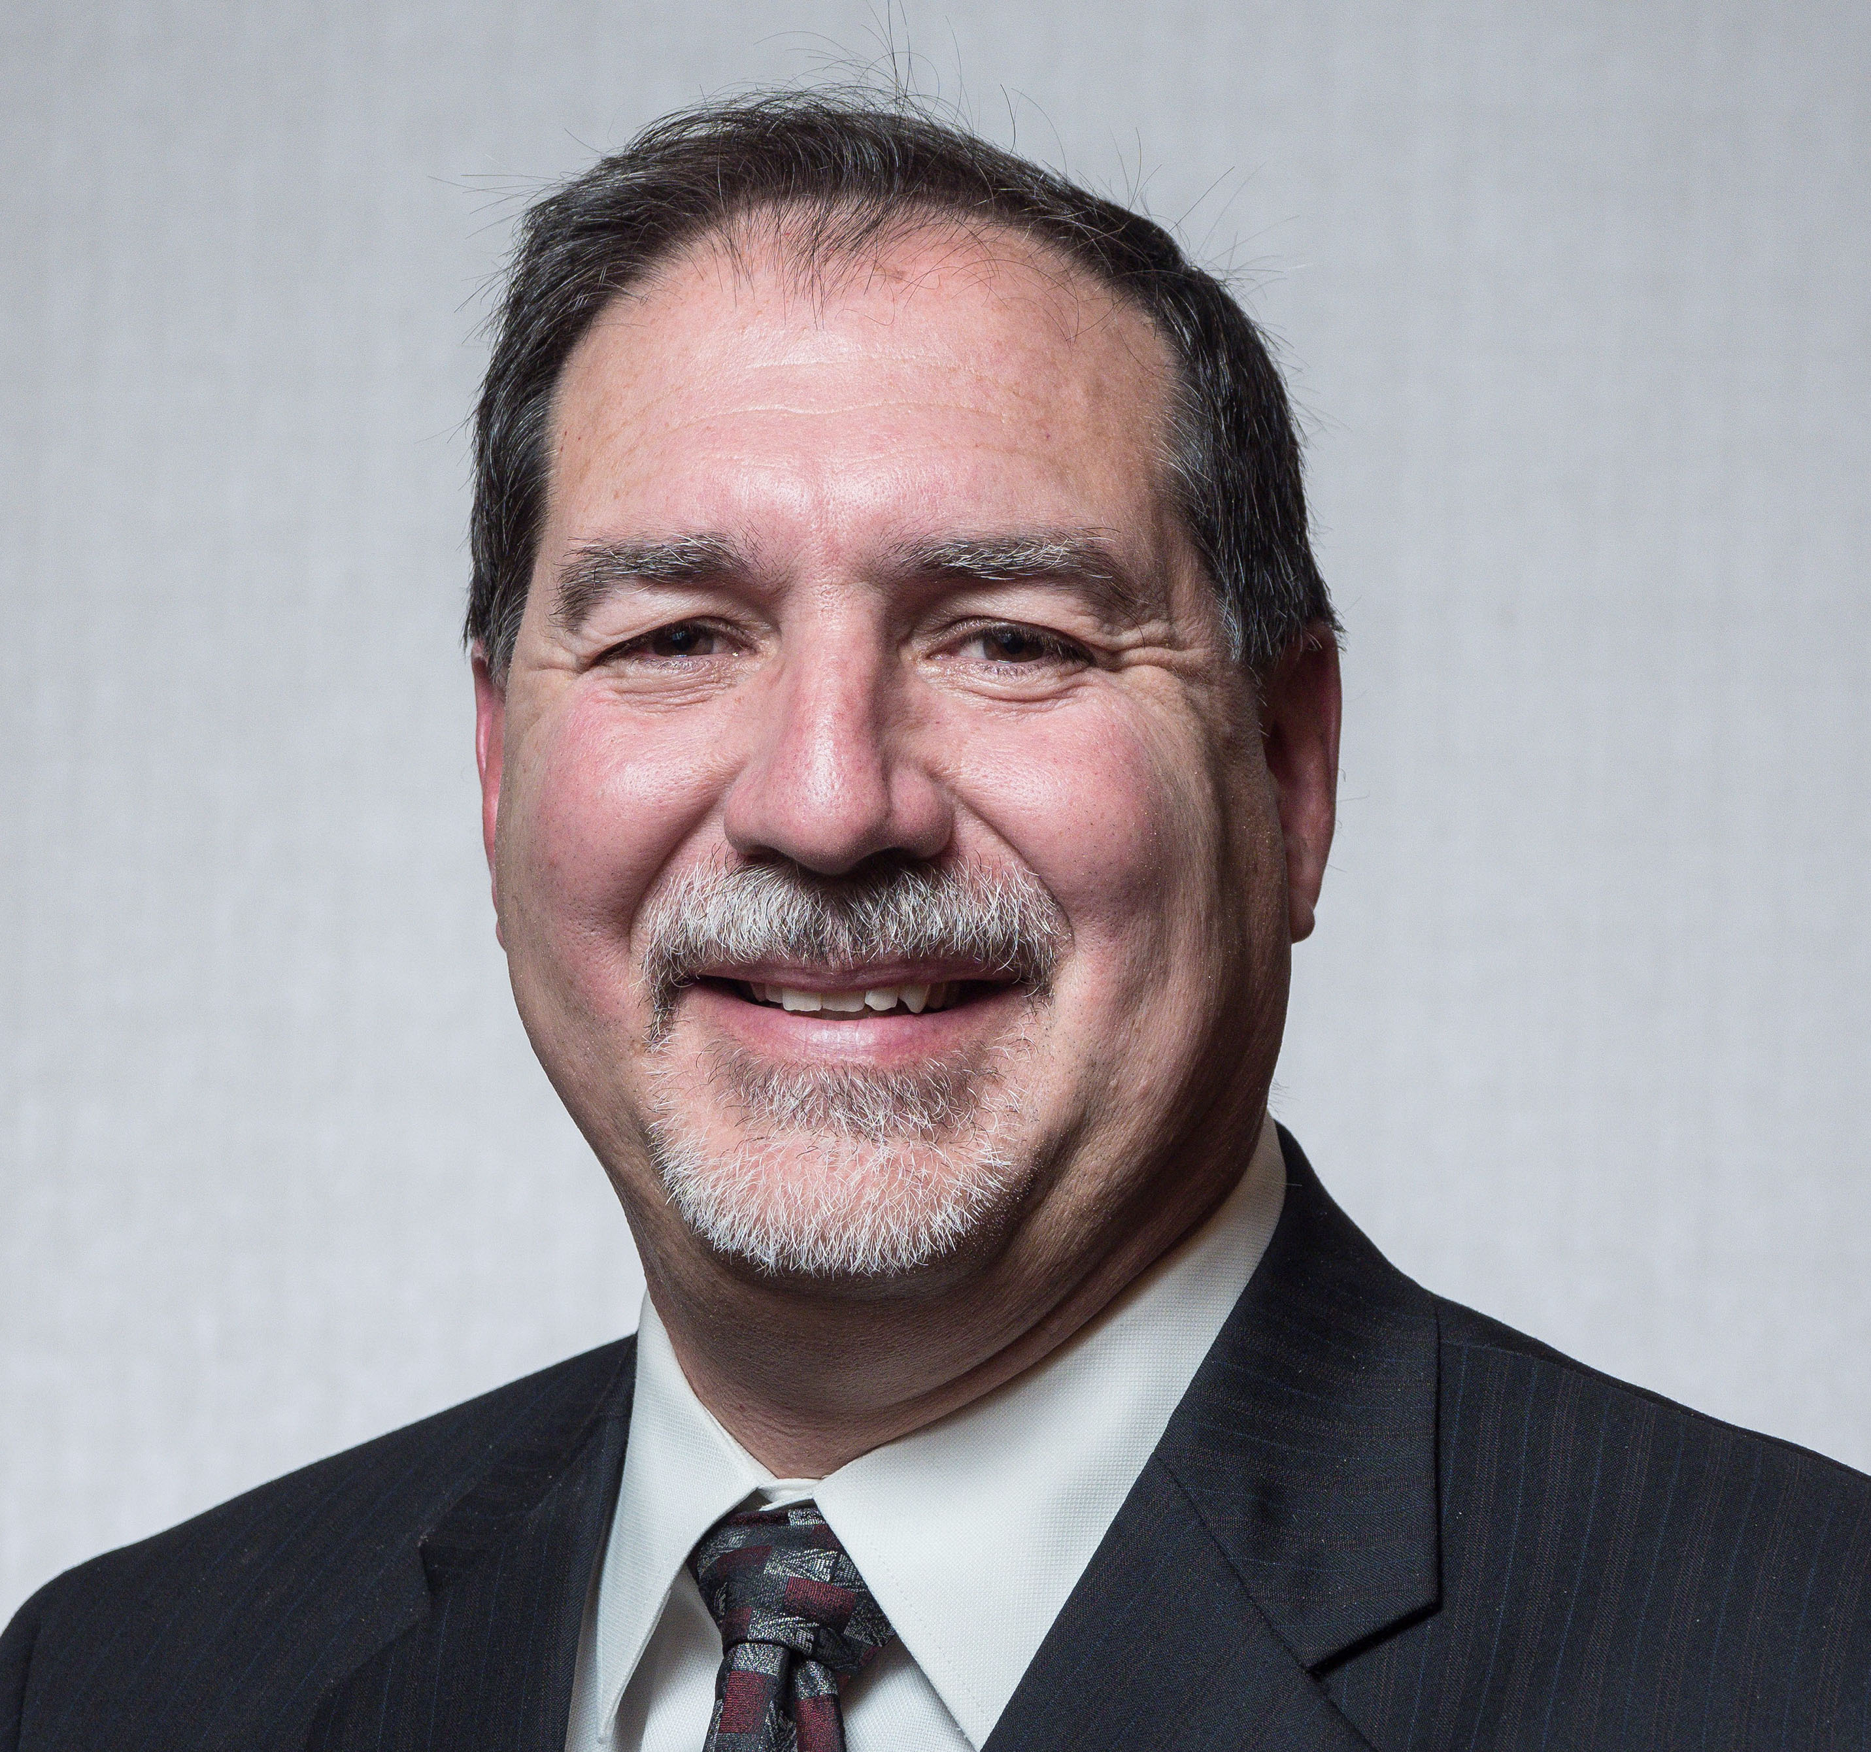

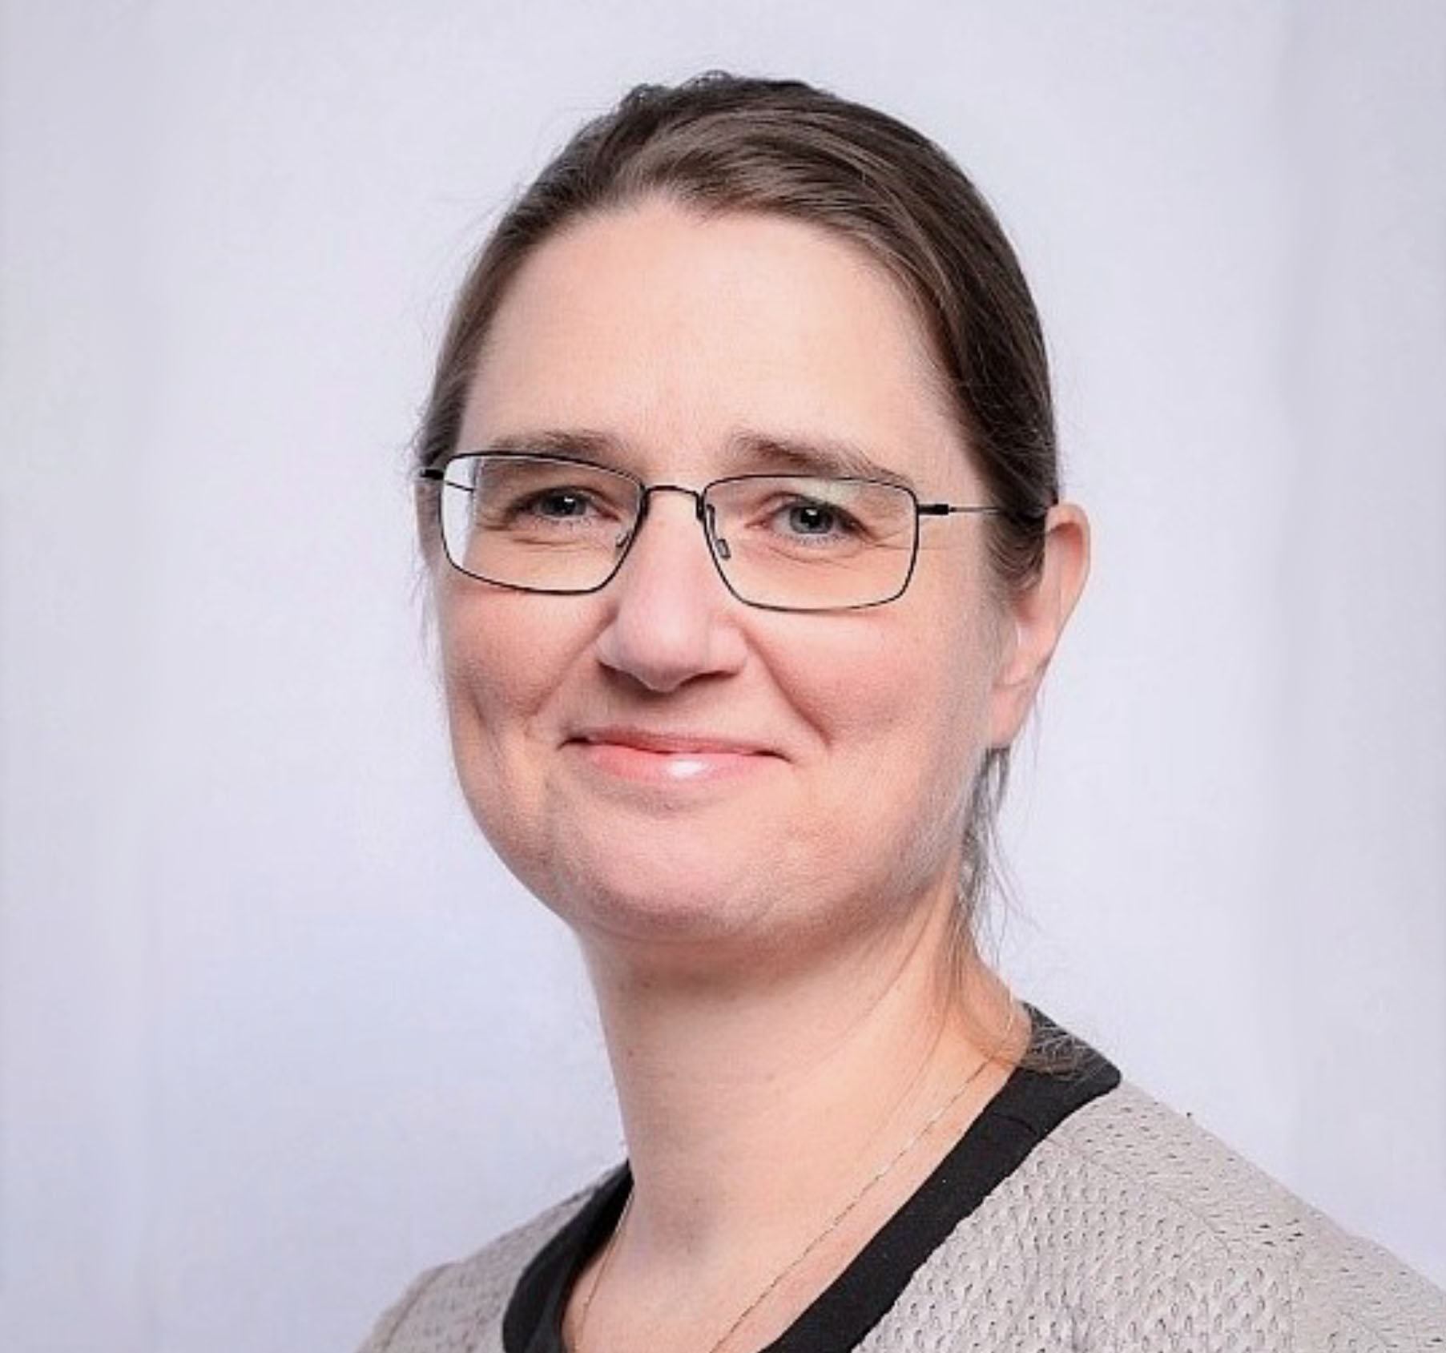
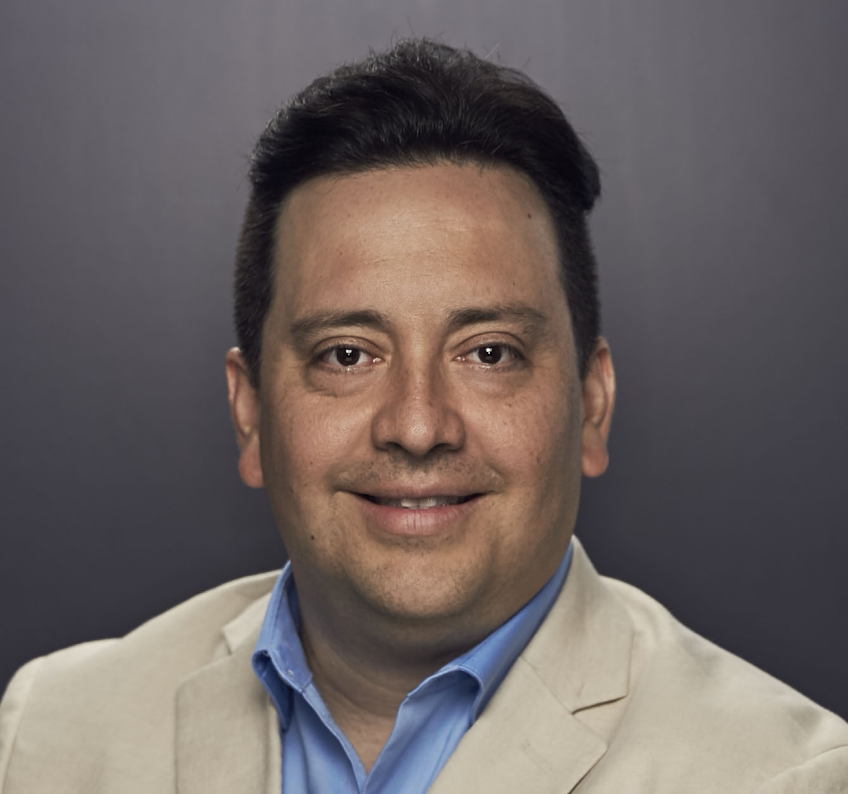
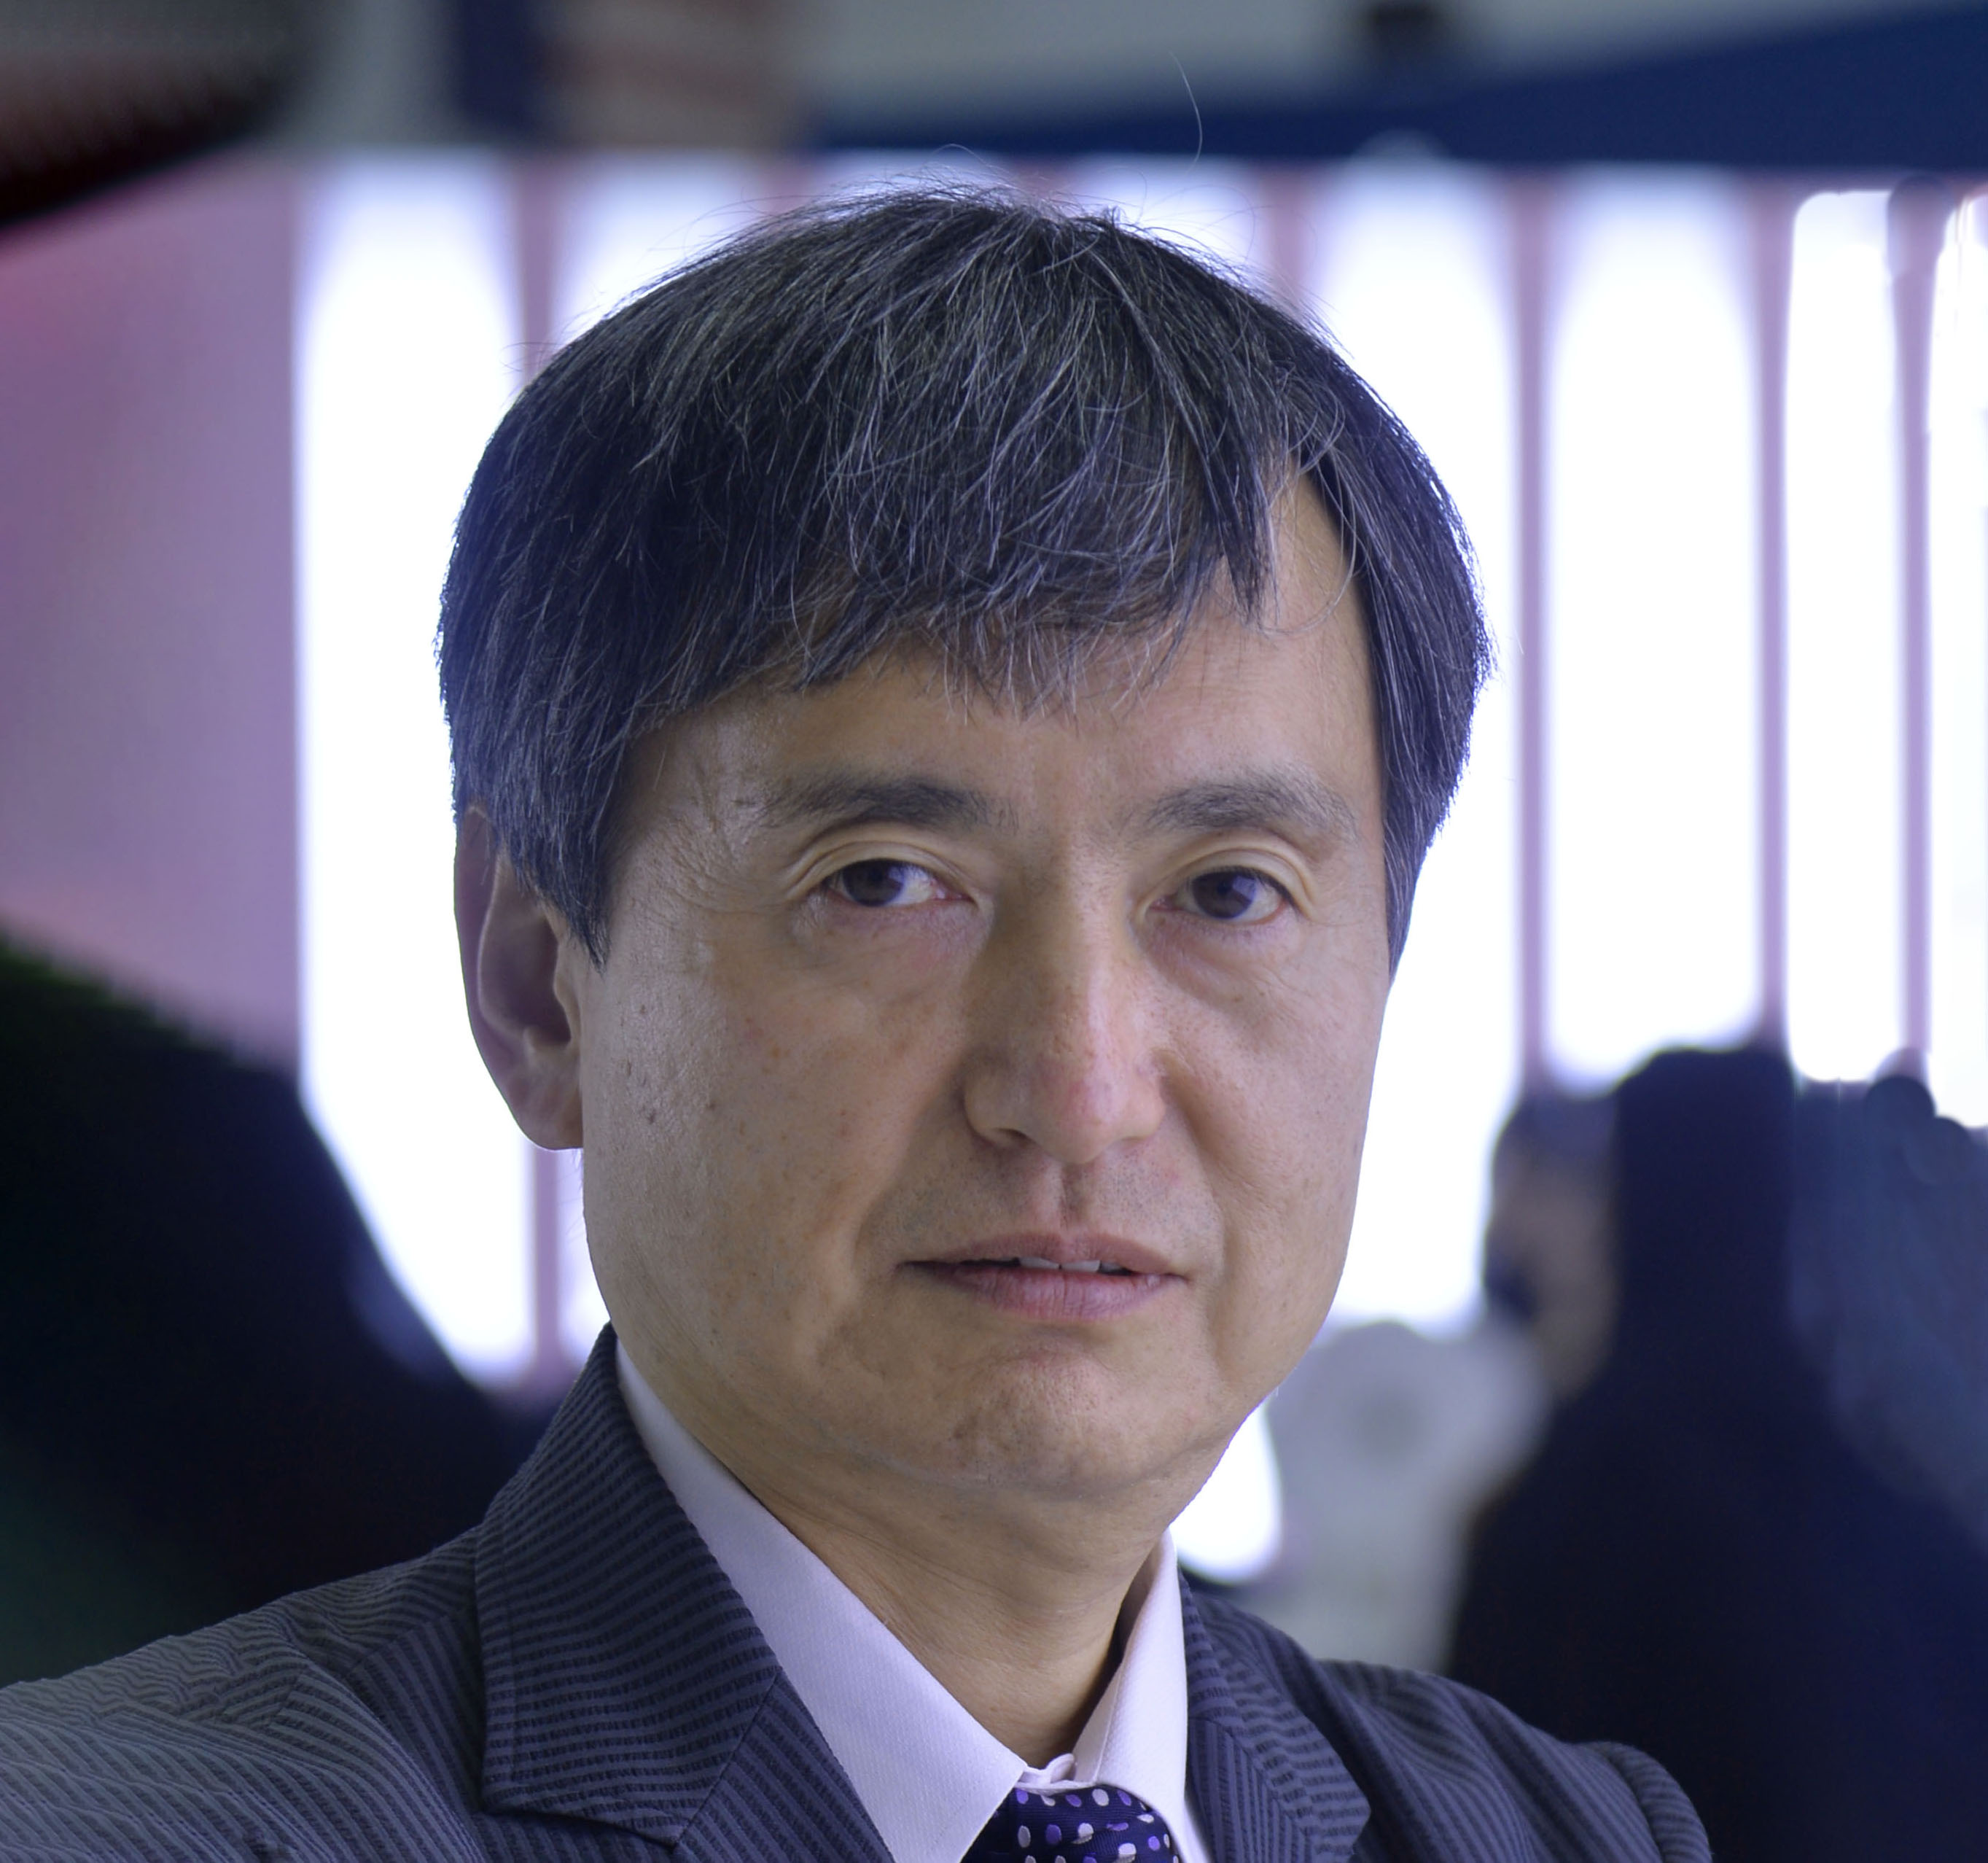
Technical Content – October 2025
Approved and recommended to the Board of Directors to approve the:
the Section Event Publishing in OnePetro. Moving forward, section-organized, regional conferences have three options for publishing papers in OnePetro.
new Publication Ethics Policy for posting and rollout across all SPE publications.
Approved Dubai as the 28ATCE location and set a deadline of 30 November 2025 to confirm 30ATCE among possible alternatives.
Approved an Event Portfolio Review process to review certain events needing to improve profitability.
Paper Quality Workgroup recommended, and the TC Committee approved the Workgroup to move forward with:
Adoption of reranking of papers within sessions, based on manuscript submissions
Creating training videos for program committees and authors
Minimum qualifications for committee members
Additionally discussed was the implementation of AI pre-check tool to screen papers, to assess paper completeness and investigate if AI was used to write all or part of the paper text – Tabled until January meeting
Received updates on:
ATCE 2025 Planning
ATCE 2026 and beyond
Discussed next steps for the use and definitions of Core, Low Carbon and New Energy Categories for use by SPE publications and events. The staff will present a proposal at the January 2026 meeting.
The annual Steering Committee and Flagship Events Reports
2025 TC Committee goals
Under Any Other Business, Robin Macmillan discussed Drillbotics Student Competition organization and funding.
Sue Staley, 2025 chairperson of the Technical Content Committee, handed over her role to Peggy Rijken, 2026 chairperson of the Committee.
Sue Staley
Mohamed Al Marzouqi
Sushma Bhan
Pierre Emmanuelle D-Huart
Robin Macmillan
Terry Palisch
Carlos Pedroso
Peggy Rijken
Carlos Torres
Koji Yamamoto

Slide 4
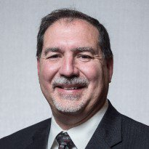


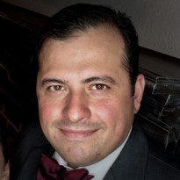
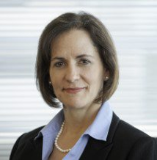
Finance Committee – October 2025
Approved amendments to the Board of Directors travel policy.
Received an update on SPE’s investment portfolio, reporting global investments of $39.3 million as of 30 September.
Received an update on the FY2025 audited results, which reflected a net operating loss of $5.1 million.
Received an up on the FY2026A financial results, which reflected an operating surplus of $107 thousand.
Received an update on the Richardson building and potential buyers.
Noted the incoming Finance Committee members would review and reassess the current Key Performance Indicators.
Terry Palisch
Chair
Olivier Houzé
Jennifer Miskimins
Hamad Al Marri
Robert Martinez
Sue Staley

Slide 5
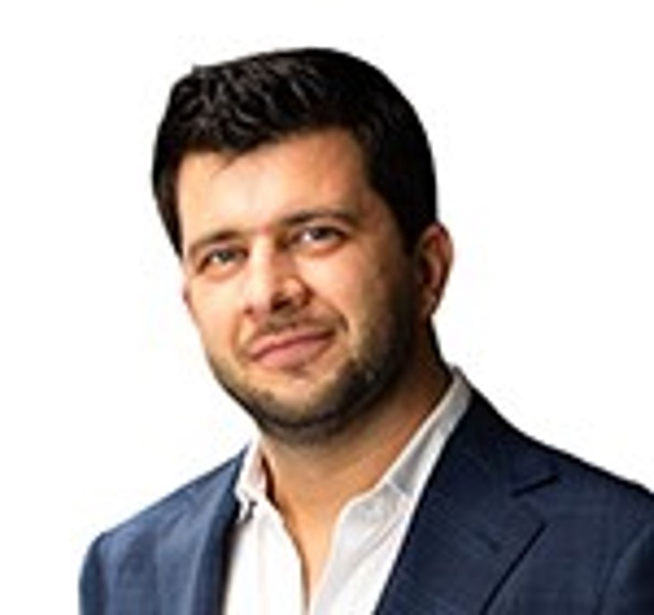
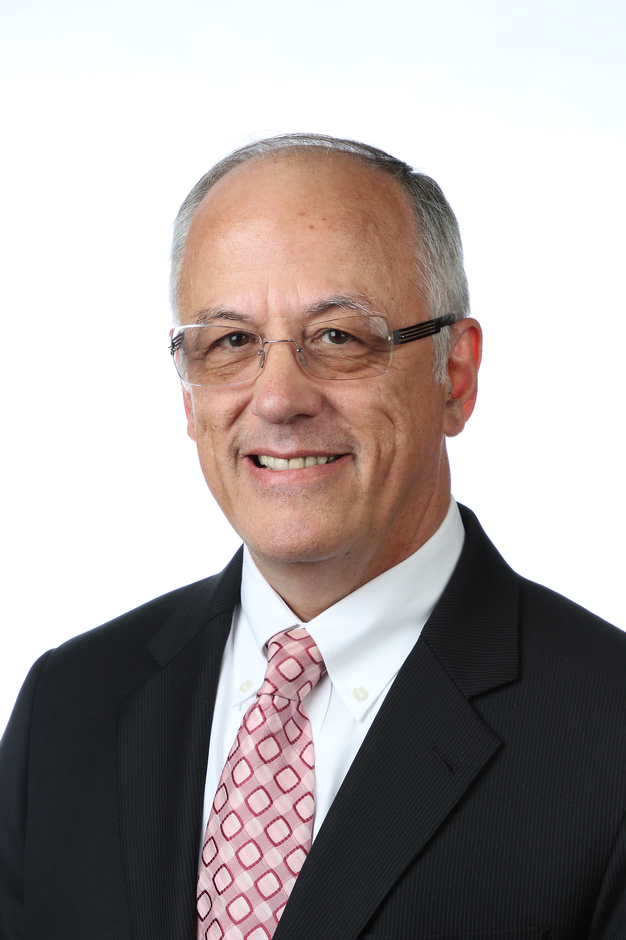
Audit Committee – October 2025
Received an update on the internal cybersecurity audit findings. SPE leadership will present a proposed response plan during the January 2026 Audit meeting.
Received an update on the FY2025 audit, which concluded with an overall clean opinion. RSM’s audit opinion:
In our opinion, the accompanying financial statements present fairly, in all material respects, the financial position of the Company as of March 31, 2025, and 2024, and the changes in their net assets and their cash flows for the years then ended in accordance with accounting principles generally accepted in the United States of America.
Approved amended verbiage in the SPE Legal Policy.
Hamad Al Marri
Chair
Sushma Bhan
Pierre d’Huart
Terry Palisch
Roland Moreau

Slide 6
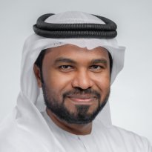

Regional Directors – October 2025
Review of Program Changes
The Regional Awards Program will be run at the discretion of each Regional Director and decoupled from the International Awards Program.
The International Petrobowl final will be sunset, with contests conducted at the regional level with SPEI staff support and volunteers.
The Section Rebate Program has been suspended until the January 2026 Board Meeting where a modified program will be recommended.
The operations of the Section & Chapter Awards Programs are to be streamlined with a recommendation presented to the Board in January 2026.
The eMentoring Program and the Virtual Career Pathways Fair will be sunset
Discussion on Current Regional Directors Structure
Look at metrics today and future growth potential
Review the role of Regional Directors
Discussion on Possible Regional Mergers
Mohamed Al Marzouqi
Lead
Alexey Borisenko
Pierre D-Huart
Hazli Kassim
Robert Martinez
Abdullatif Al Omair
Kim Oracheski
Riverson Oppong
Carlos Pedroso
Carlos Torres
Koji Yamamoto

Slide 7
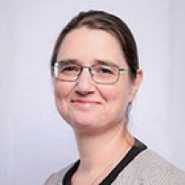
Technical Directors – October 2025
TS Sustainability and Sunset Criteria
The initiative is designed to emphasize focusing organizational effort on quality technical output rather than maintaining a high quantity of less engaged sections.
The goal is to reinforce quality and commitment, potentially reducing the number of supported TSs to those that are fully active and engaged.
Volunteer Burnout Challenge
Reported challenges with volunteer burnout among core leaders, noting that the same repeat volunteers are carrying the workload in many sections.
The recognized strain on volunteers, who manage day jobs and personal commitments, makes it difficult to recruit new participants.
Student Chapter Engagement & Geothermal Special Interest Groups (SIG)
A recent outreach campaign seeking Technical Section collaboration yielded 81 responses from student chapters globally, prompting staff to plan a follow-up email on November 1st to increase the response rate.
Supported by Geode funding, a pilot program is establishing Geothermal Special Interest Groups (SIGs) within five student chapters to promote cross-disciplinary engagement, including both undergraduates and graduates.
Robin Macmillan
Lead
Hamad Al Marri
Sushma Bhan
Sue Staley
Rahim Masoudi
Peggy Rijken

