Slide 1



AMBASSADOR LECTURER PROGRAM
<PRESENTER NAME>
<COMPANY>

Slide 2
GUIDENCE FOR SPEAKER - - - DELETE SLIDE WHEN IN USE
What is the Ambassador Lecturer Program?
The Ambassador Lecturer Program is where a Young Professional member of SPE visits an SPE Chapter, a University, or higher level School to deliver a 30-45 min inspiring and informative presentation to students aiming to join the industry. YPs share their own experiences, advice, and relevant updated in the industry to help Students prepare for a successful career.
Do I have to use these slides?
No, these slides are designed to be a resource to help SPE facts and industry figures. You are very welcome to start your own slides, add and remove slides or use new images as you see fit.
It’s you the students want to hear from so make the presentation fit your story. All presentations should include basic information about the industry, information about SPE programs, and your own journey in the industry. All of the following slides are completely optional. Look out for RED TEXT where information should be removed before presenting!
Is there any other advice available for public speaking?
Yes, on the ALP resources webpage we have presentation guides and guides to help you set up your presentation and connect with local Schools and Universities. If you cannot access this email alp@spe.org for more information.
*** Once completed submit your feedback online so we can record your visit. ***

Slide 3

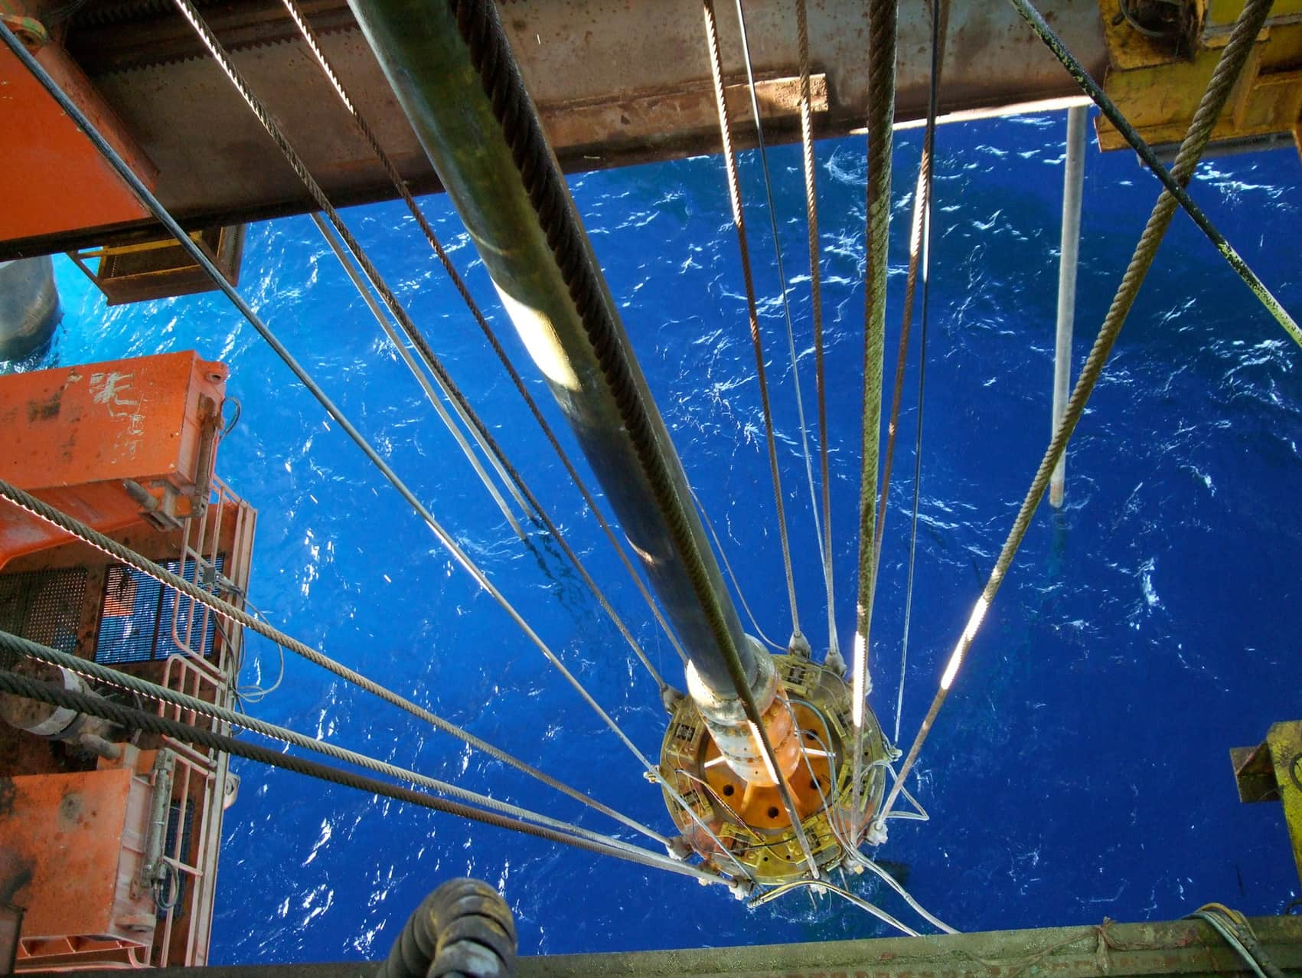





WELCOME
MY CAREER
JOURNEY
ABOUT THE
INDUSTRY
FUTURE
CHANGES
VITAL JOB
SKILS
ABOUT
SPE
ASK ME
ANYTHING!

Slide 4
ABOUT ME
  Your history
  Where you grew up
  your academic background
  Why you wanted to get into the enegy industry
Photo of you

Slide 5





PROJECTS I WORK ON
  About your job
  Where you work
  What skills you need
  What do you love about your work
Photo relevant to your role

Slide 6

WHERE I’M
GOING
  What you are working on
  Future Plans
Photo relevant to your role

Slide 7


ABOUT THE ENERGY INDUSTRY

Slide 8











THE ENERGY MIX
Nonrenewable
Energy Sources
Renewable
Energy Sources
Secondary
Energy Sources
Energy from the ground that has limited supplies
Energy that comes from a source that’s constantly renewed
Energy that is converted from non-renewable or renewable sources
Natural Gas
Petroleum
Coal
Uranium
Hydro
Solar
Wind
Geothermal
Biomass
Electricity
Hydrogen
Different types of Secondary Energy, like Green, Blue and Grey Hydrogen refer to what type of primary energy sources was used to generate it.

Slide 9


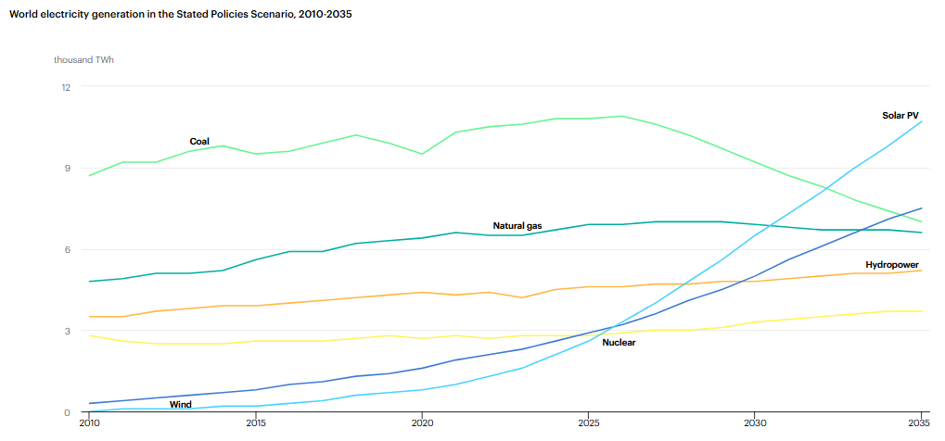
STATE OF THE ENERGY INDUSTRY
Global predictions of the Future Energy mix
Energy consumption continues to rise and is predicted to continue as quality of life and access to technology increases.
While Coal use is anticipated to drop over time, all other forms of energy are excepted to grow, with Solar and Nuclear taking up the increase in overall demand.
International Energy Agency | World Energy Outlook 2024

Slide 10
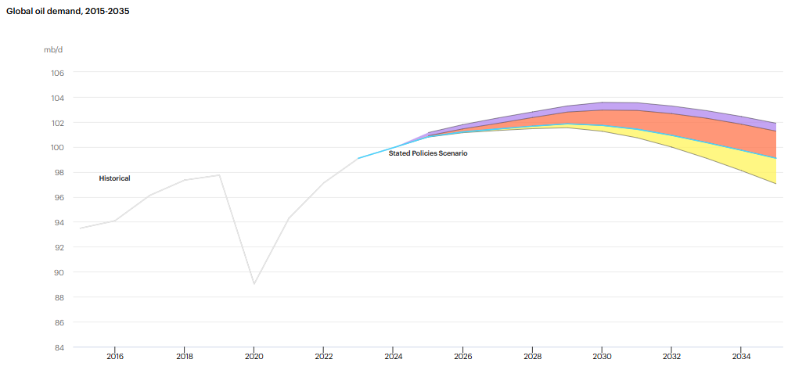
STATE OF THE ENERGY INDUSTRY
Policies and expectations on global oil demand
For oil specifically, it also continues to rise eventually starting to decline as solar and nuclear investments become more cheaper to run and improvements to battery technology improve.
International Energy Agency | World Energy Outlook 2024

Slide 11
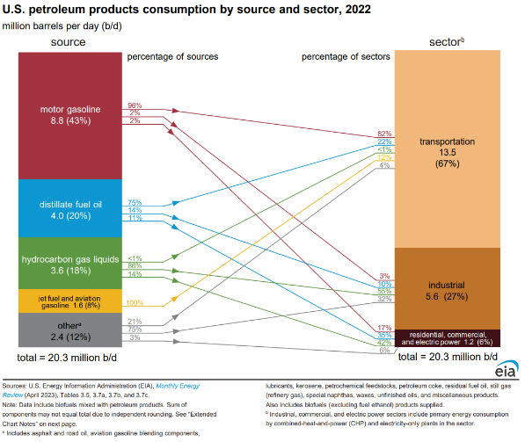
USES OF PETROLEUM
Other:
While most use of the oil and gas produced is used for fuel and electricity generation, there is a huge amount of other products which need petroleum we all use everyday. Many of which cannot easily be replaced by other sources.
  Beauty Products
  Medical Supplies
  Plastics
  Lubricants & Solvents
  Tarmac & asphalt
  Fertilizer & pesticides
  Paint & inks
  Clothing
  Insulation
  Synthetic Rubber
U.S. Energy Information Administration

Slide 12
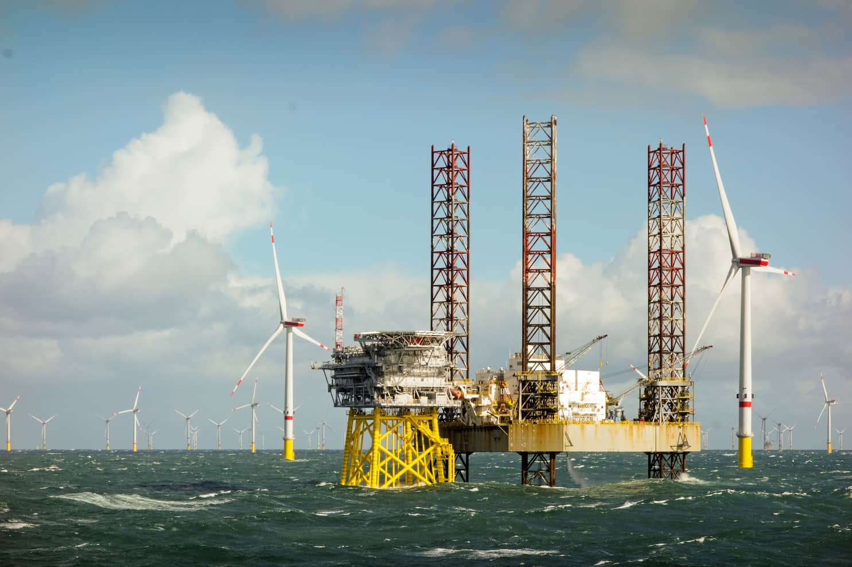





TRANSFERABLE SKILLS
Many energy companies are exploring multiple aspects of the energy mix, and many jobs have transferable skills.
Offshore Operations
Fluid Dynamics
Geology and Physics
Data processing and review
Global working
USED FOR:
Solar, Tidal, O&G, Wind and
Geothermal
USED FOR:
Geothermal, O&G, Hydroelectric, and Hydrogen
USED FOR:
All natural resources. Mining, Site development
USED FOR:
Wide use across industries for driving efficiency
USED FOR:
Wide use across industries.

Slide 13
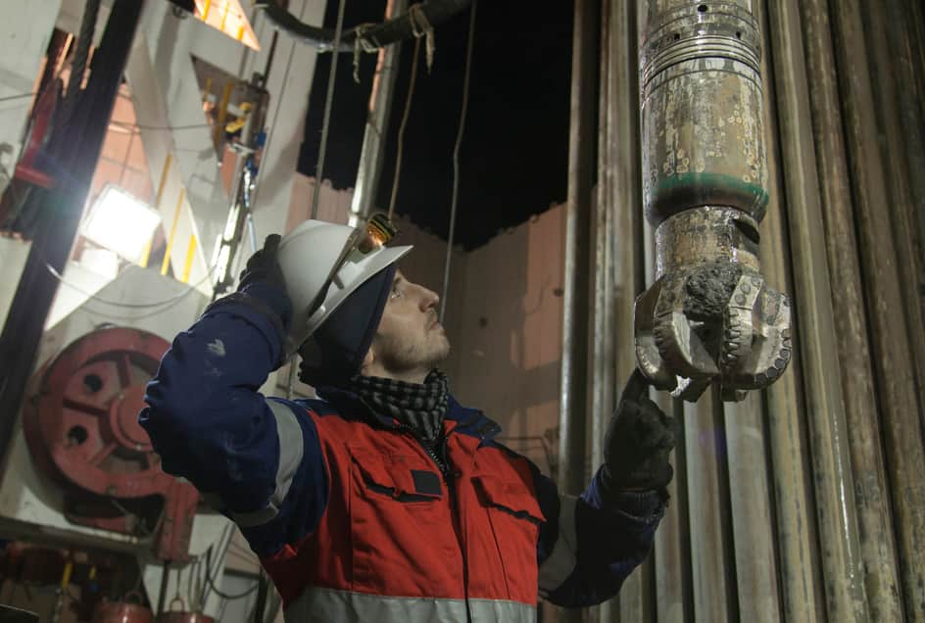



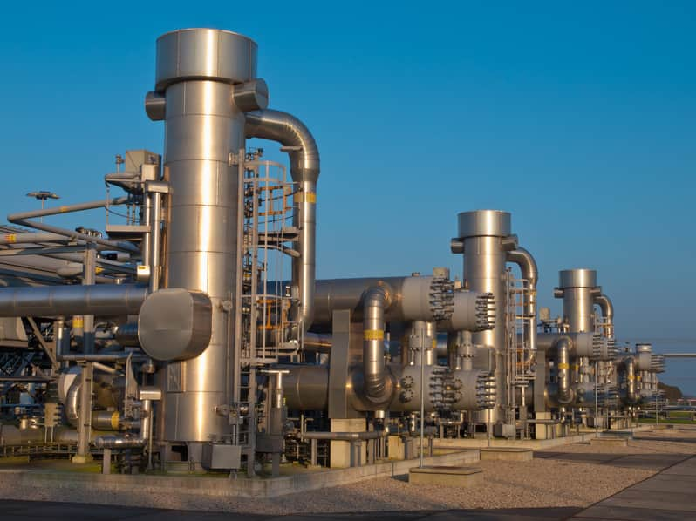

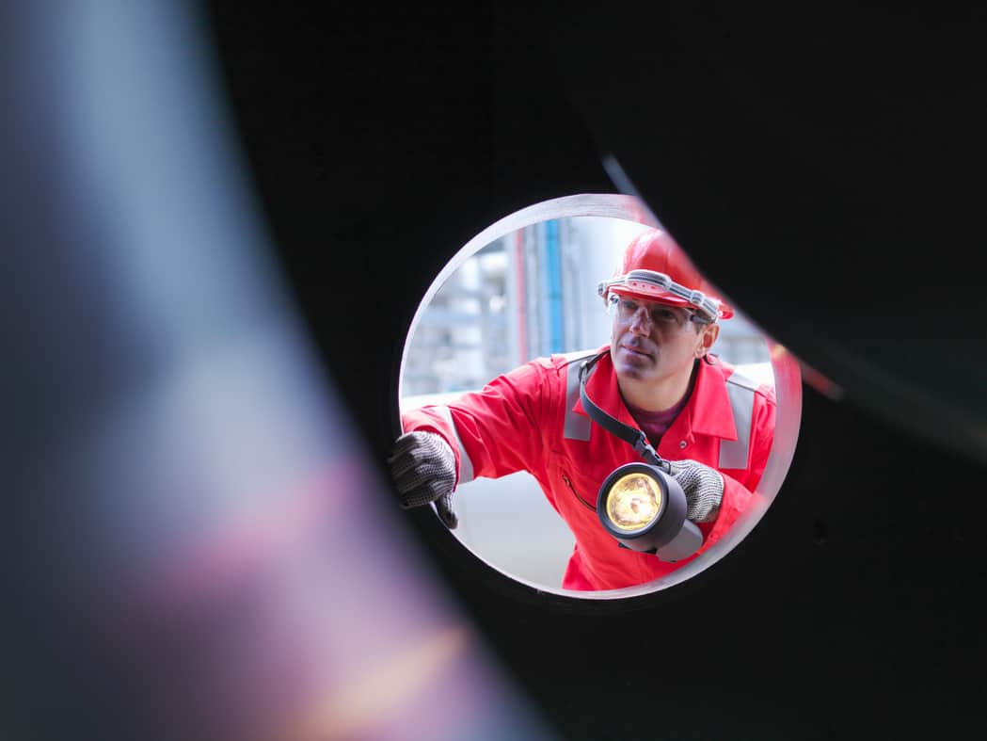
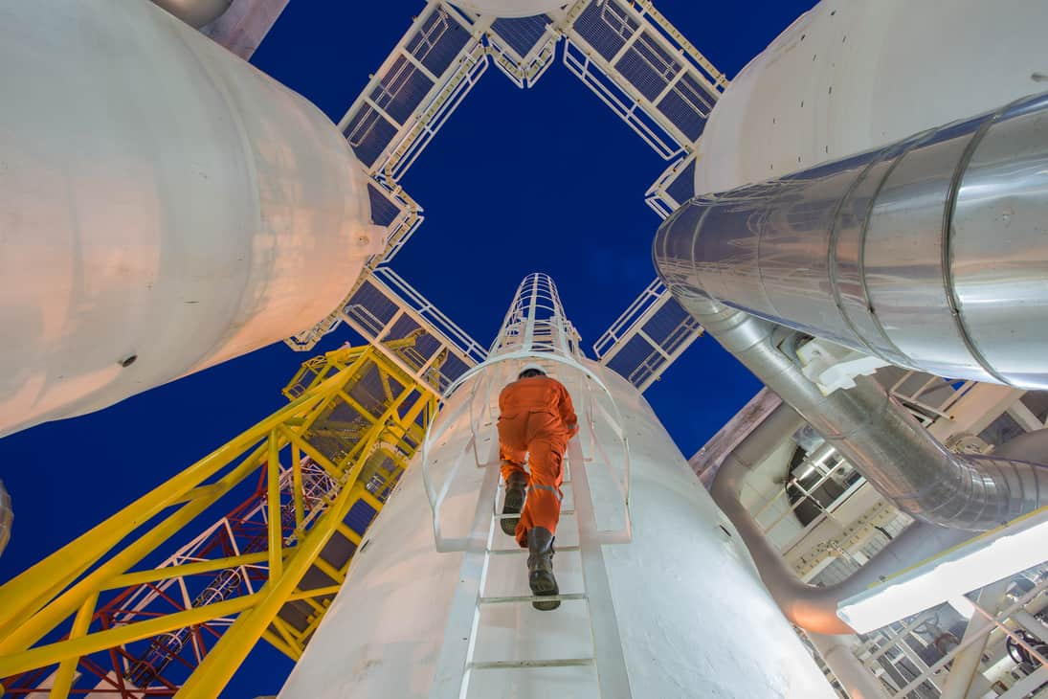
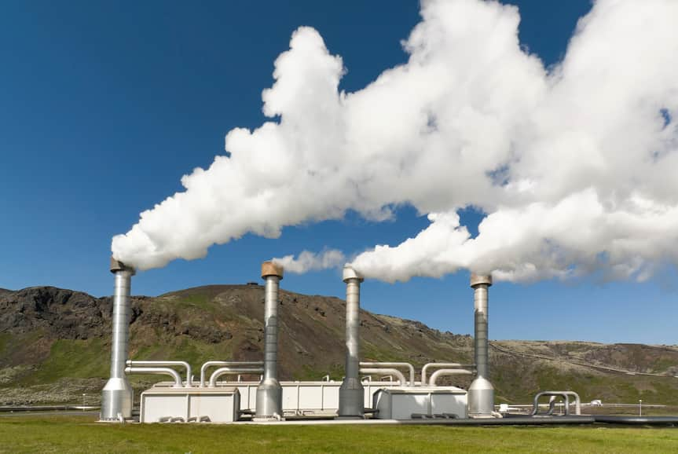


JOBS IN THE INDUTRY
Jobs in the industry now require a mix of traditional knowledge and understanding of the latest technologies and processes. The industry covers a wide range of roles!
Drilling
Completions
Reservoir
Production
Chemical
Finance
Facilities
Health & Safety
Geology
Environmental
Research
IT & Communications

Slide 14
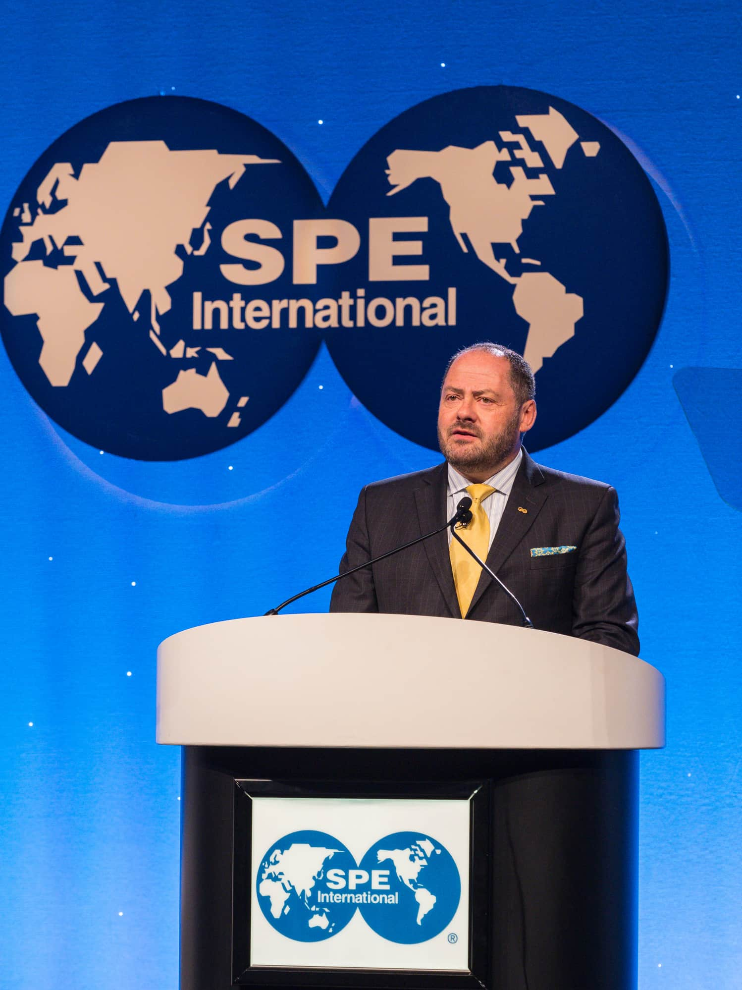




ABOUT SPE
COMMUNITY
PERSONAL DEVELOPMENT
A global community of professionals in E&P and related industries, to share knowledge, build networks, and support each other.
SPE has technical resources, training programs, funding, and recognition programs avalible to our members.

Slide 15


STATISTICS
119,120
MEMBERS
66,701 Professional Members and 52,419 Student Members across 138 countries.
203
REGIONAL SECTIONS
Regional groups of professionals, hosting events and programs, led by Members in the area.
427
STUDENT CHAPTERS
Universities with a group of members of can have their own committes to host SPE activities.

Slide 16



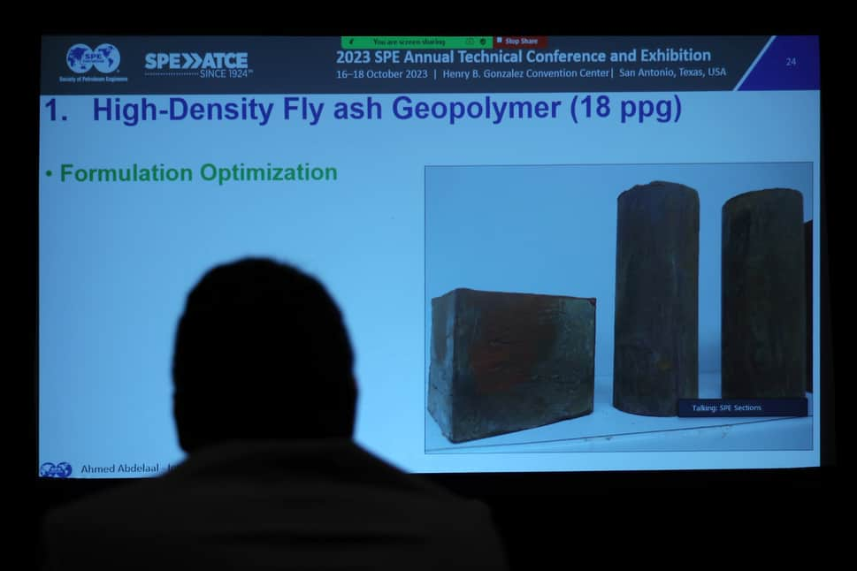
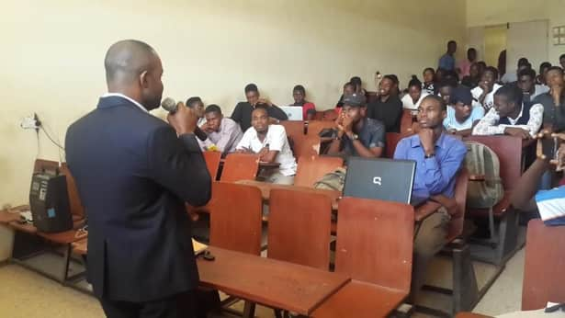
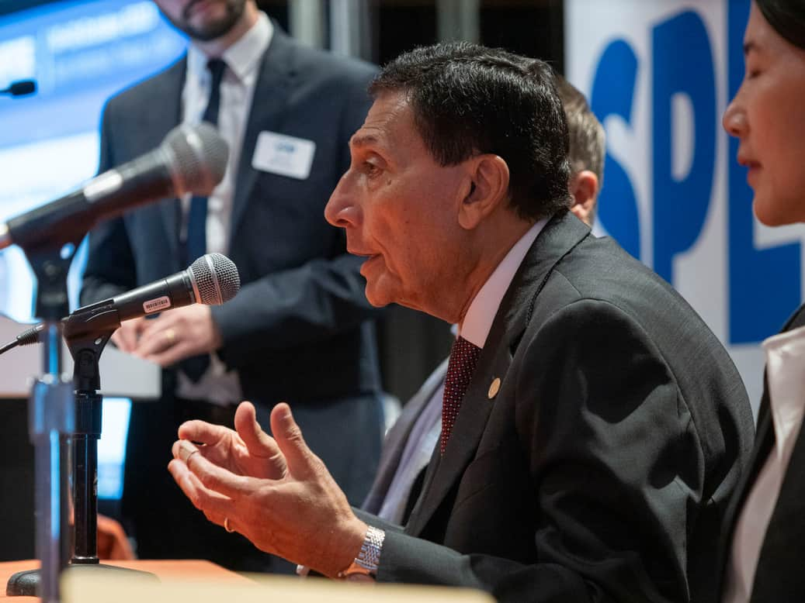

INTERNATIONAL MEMBER PROGRAMS
COMPETITIONS
PetroBowl
Student Paper Contest
Drillbotics
Scholarships
Fellowships
Section Travel Grants
FUNDING
SPE Connect
SPE Sections & Chapters
eMentorship
Ambassador Lecturer Program
COMMUNITY
EnergyStream videos
OnePetro & Publications
PetroWiki
Soft Skill Workshops
LEARNING
CAREERS
Jobs Fairs
Virtual Career Pathways Fair
CV & Interview Workshops
Conferences & Exhibitions
Technical Workshops
Seminars
EVENTS
RECOGNITION
Awards
Lifetime Honours
International Publications

Slide 17
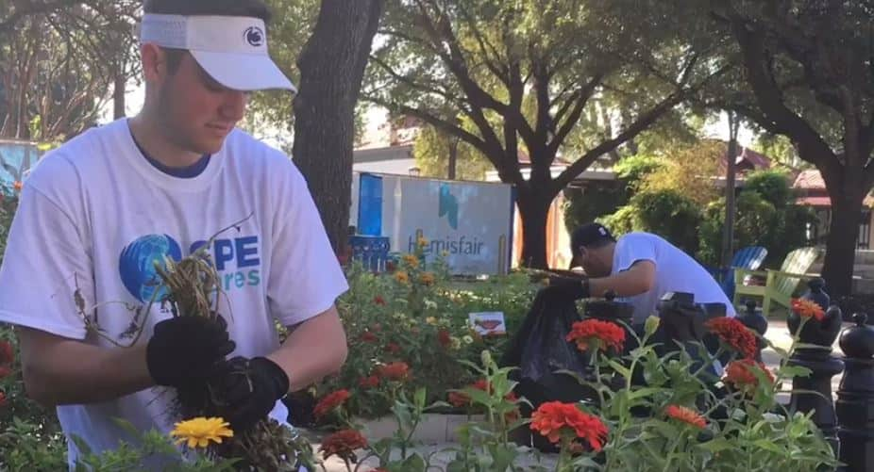


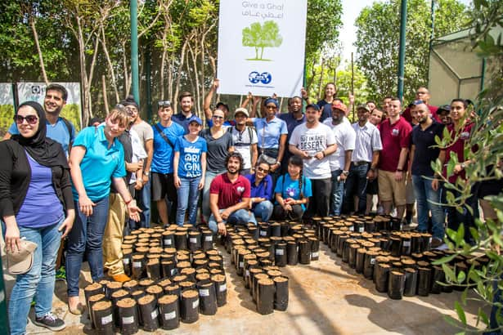
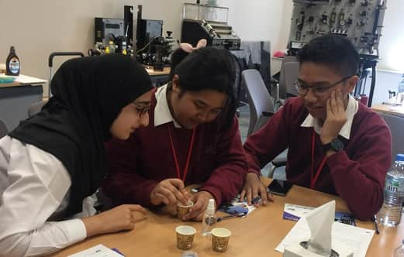


COMMUNITY PROJECTS AND PUBLIC OUTREACH
The climate crisis is an important issue and this must be addressed despite our growing energy demand and dependence on petrochemical products. SPE is doing its part to ensure the industry improves and has the talent it needs to speed up change.
Supporting Local Communities
SPE Cares is a program that encourages our members to support community projects, including tree planting, litter picking, charity drives, and donations.
Energy4me is a program that takes industry professionals into the classroom and teaches school children more about the energy industry.

Slide 18
Thank you for Watching!
Please ask me any questions!

